Slide 1

1 v 1 Moves
Perfecting the Skill

Slide 2
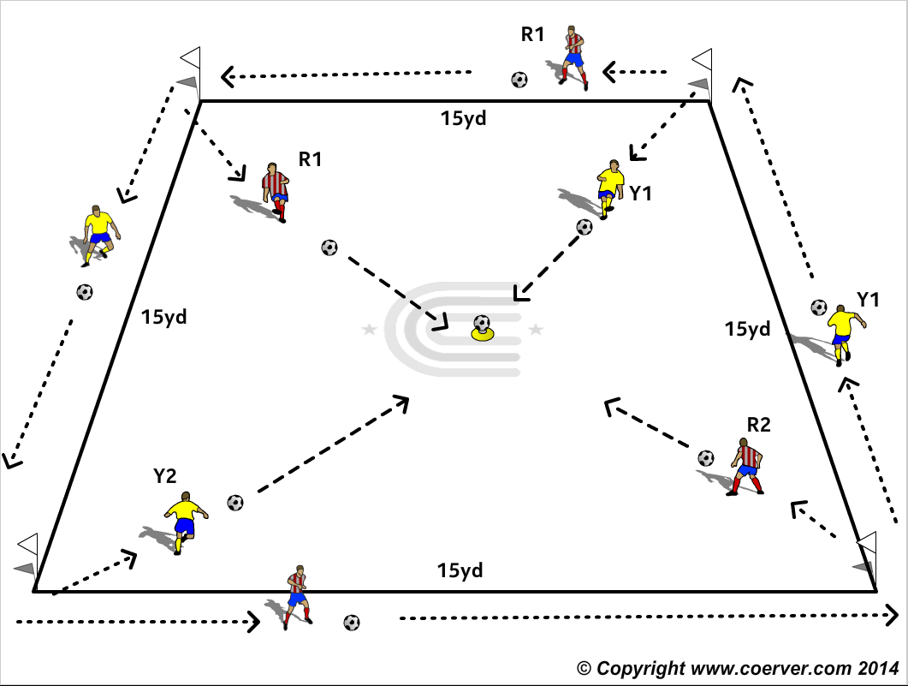
MOVES (M1)
PURPOSE: To improve stops and starts & Changes of Direction.
SET UP
A player with a ball on each corner of a 15 yard square.
A ball on a cone in the middle of the square.
ACTION
V1: On the Coach’s signal each player dribbles at speed around the square making a Stop and Start Move in the middle of each side of the square.
On completing the circuit and going around their starter cone they try to be first to hit the middle target.
Make Harder
V2: Now 2 Stops & Start in the middle
COACH’S TIP TO PLAYER
Encourage 2 touch turns at the corners if players able. Keep team scores. Eyes up to be aware of other shooters progress and accurate shooting.

Slide 3
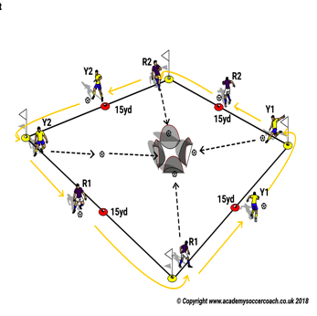

MOVES (M2)
Purpose: To Improve Changes of Direction & Stops/Start Moves.
SET UP
A player with a ball on each corner of a 15 yard square.
4 small Goals facing each corner.
ACTION
Game Moves to use at middle cones:
High Wave
Drag push
Pull Push
On the Coach’s signal each player dribbles at speed around the square and at each middle red cone makes a Stop & Start Move.
On completing the circuit they shoot at goal.
MAKE HARDER
Shoot with weaker foot.
COACH TIP TO PLAYER
Eyes up and try to be aware of other shooters progress.

Slide 4
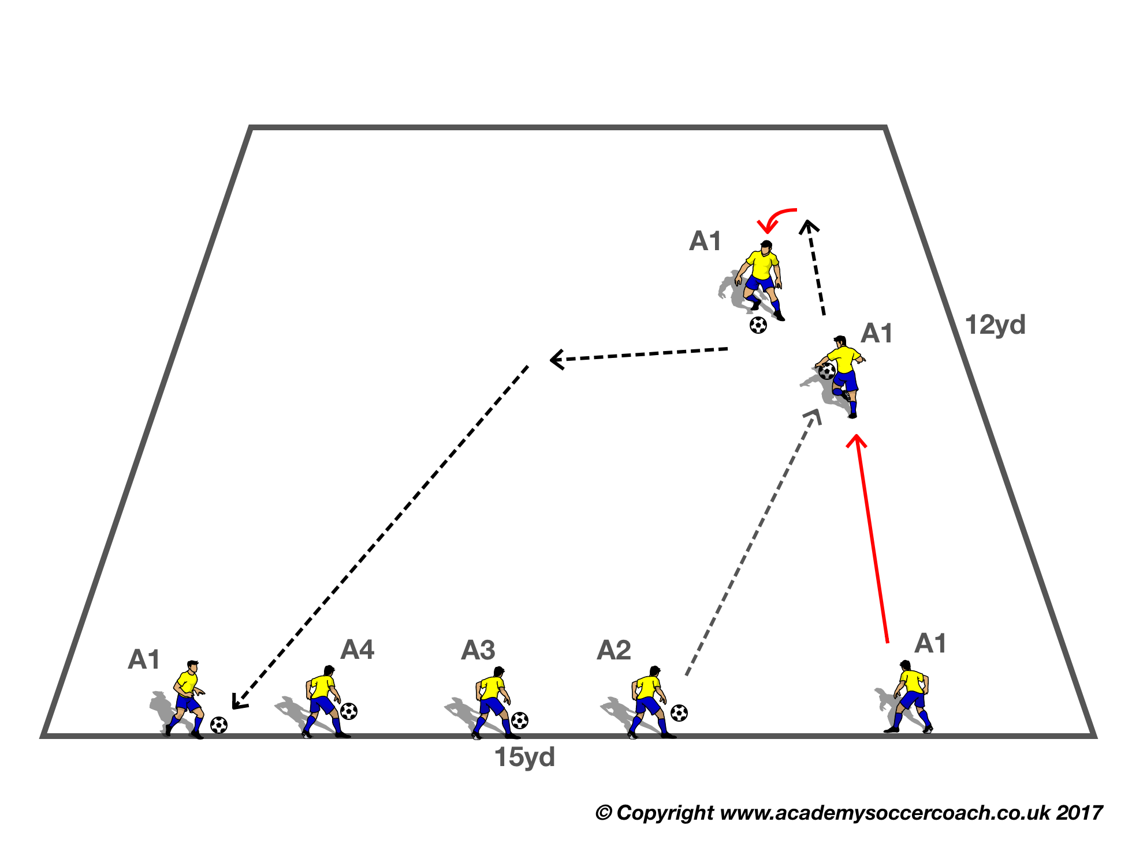
MOVES (M3)
Purpose: To Improve Feint & Change of Direction Moves.
SET UP
Players in 4’s, three with a ball, the first player no ball.
ACTION
Game Moves to use:
FEINTS
Side Step
Scissors
Drag Push
Game Moves to Turn (C.O.D)
Inside Cut
Outside cut
Step on
V1. First player with the ball passes to teammate without the ball, who takes one touch, makes a C.O D, then make a Move and accelerates to the end. The sequence continues.
MAKE HARDER
V2: The player who passes becomes a limited pressure defender.
COACH TIP TO PLAYER.
After the Move try and get back to the line in one or two touches.

Slide 5
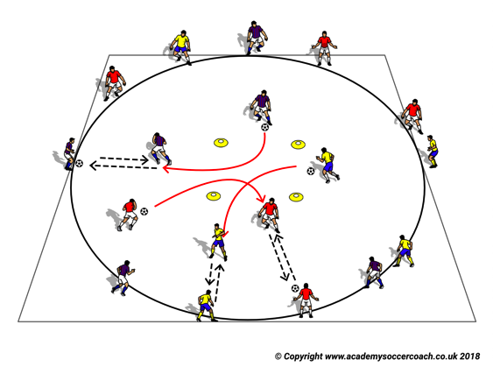
MOVES (M4)
Purpose: To Improve Feints /Stops/Starts/Changes of Direction.
SET UP
A 20yd circle with a 5yd square in the middle marked with cones.
3 teams of 4 or 5 players around the perimeter.
A ball to each team.
ACTION. On the Coach’s signal players with a ball dribble into the center square and make a Single Move and passes to a team mate on the perimeter and take the team mate’s place and the team mate repeats the sequence with a move in the square and pass to another perimeter team mate.
MAKE HARDER
Ask the players to make a double move in the square before passing to perimeter team mate.
COACH TIP PLAYER
Focus on excellent technique before speed. Speed will come with practice.

Slide 6
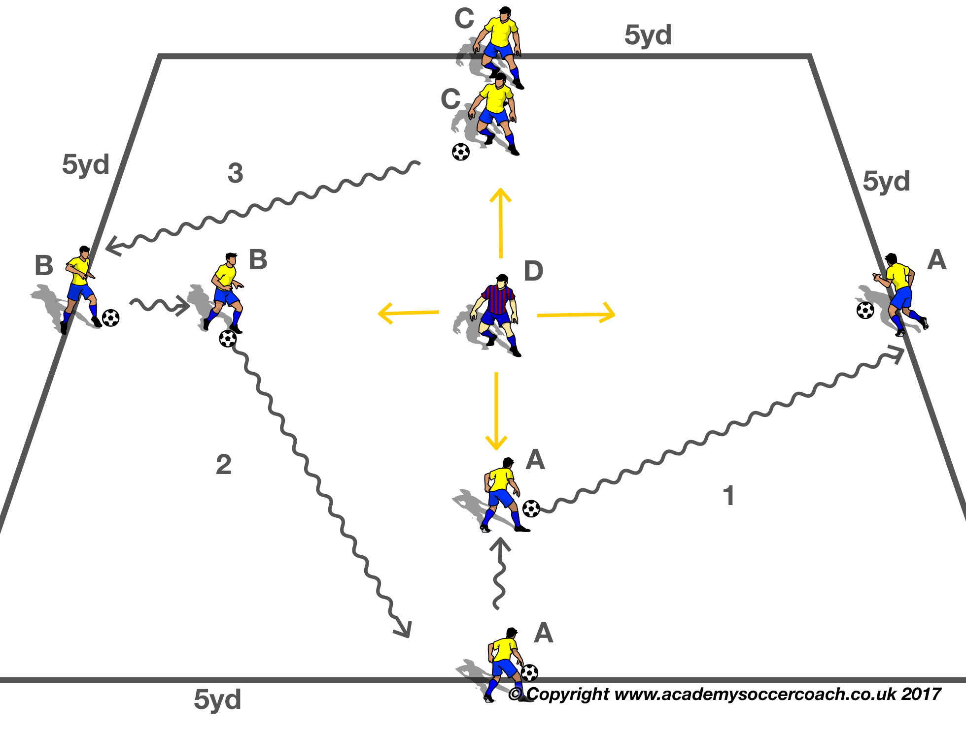
MOVES (M5)
Purpose: To Improve the Moves through unopposed repetition.
SET UP
A 5 yd square. A player with a ball in the middle of each sideline.
ACTION
One player in the middle as Limited pressure defender.
Players on the outside go in sequence, as the defender challenges.
Make Harder
Speed up
COACH TIP TO PLAYER
Look up as you come out of the Move.

Slide 7
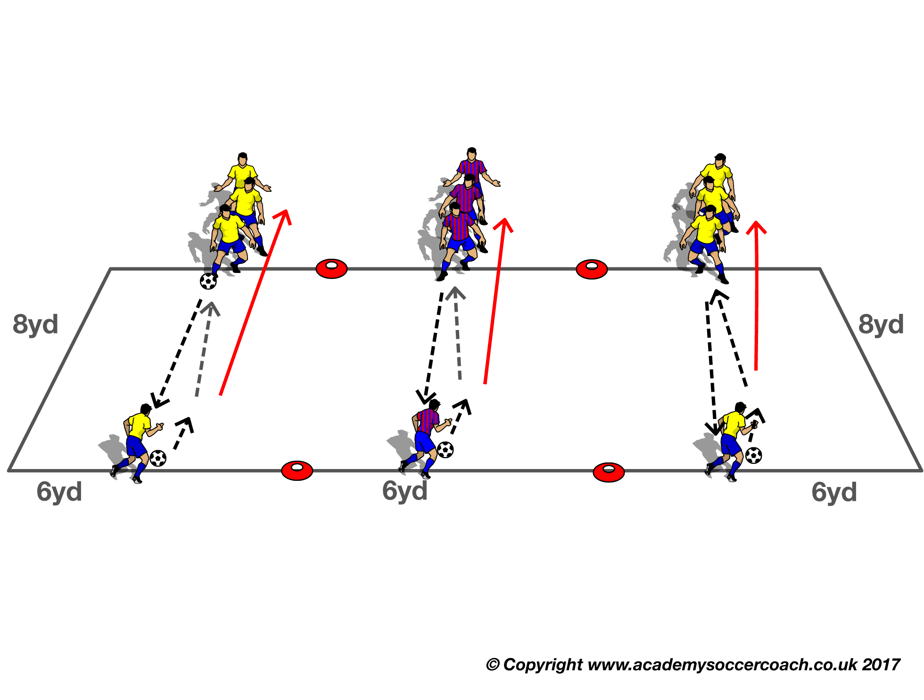
MOVES (M6)
Purpose: To Improve Changes of Direction.
SET UP
Three teams of three or four players at the end of each 8 x 6 yard grid.
ACTION
A Race. Each player makes Changes of direction then passes to waiting teammate, first team to finish wins.
Make Harder
Players have to make 3 different Changes of Direction Moves before they pass to the next teammate.
COACH TIP TO PLAYER
Make sure the player crosses the line before making a C.O.D

Slide 8
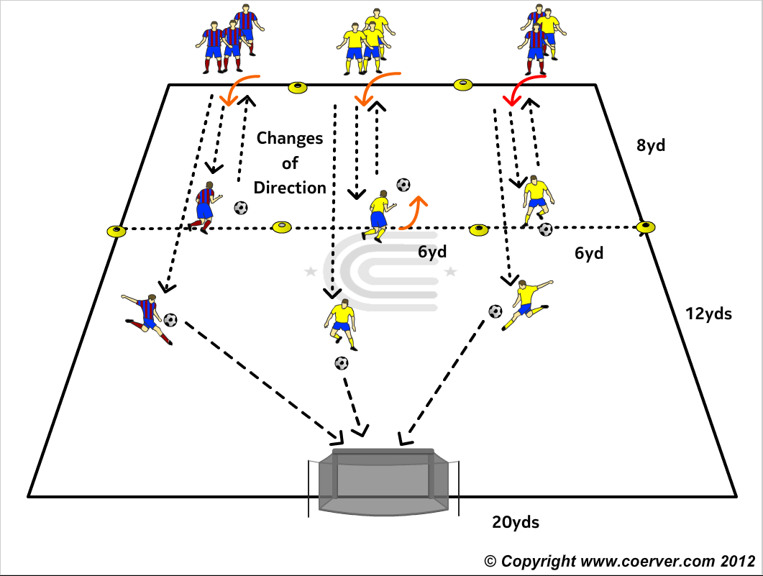
MOVES (M7)
Purpose: To Improve the quality & Speed of Changes of Direction to create Goal Chances.
SET UP
Three teams of three or four players at the end of each 8 x 6 yard grid with a goal in the middle of the end line at the opposite end from the teams.
ACTION
On the Coach’s signal, a player from each team dribbles to the end of the grid and make a Change Of Direction Move at end line, then back and makes another C.O.D, then pushes the ball forward and shoots (First to hit the net wins)..Chose two of these 3 Game Moves
The Step On
The Inside Cut
The Outside Cut
Make Harder
Player can only score if the ball hits the net without touching the ground.
COACH TIP TO PLAYER
Eyes up before you shoot.

Slide 9
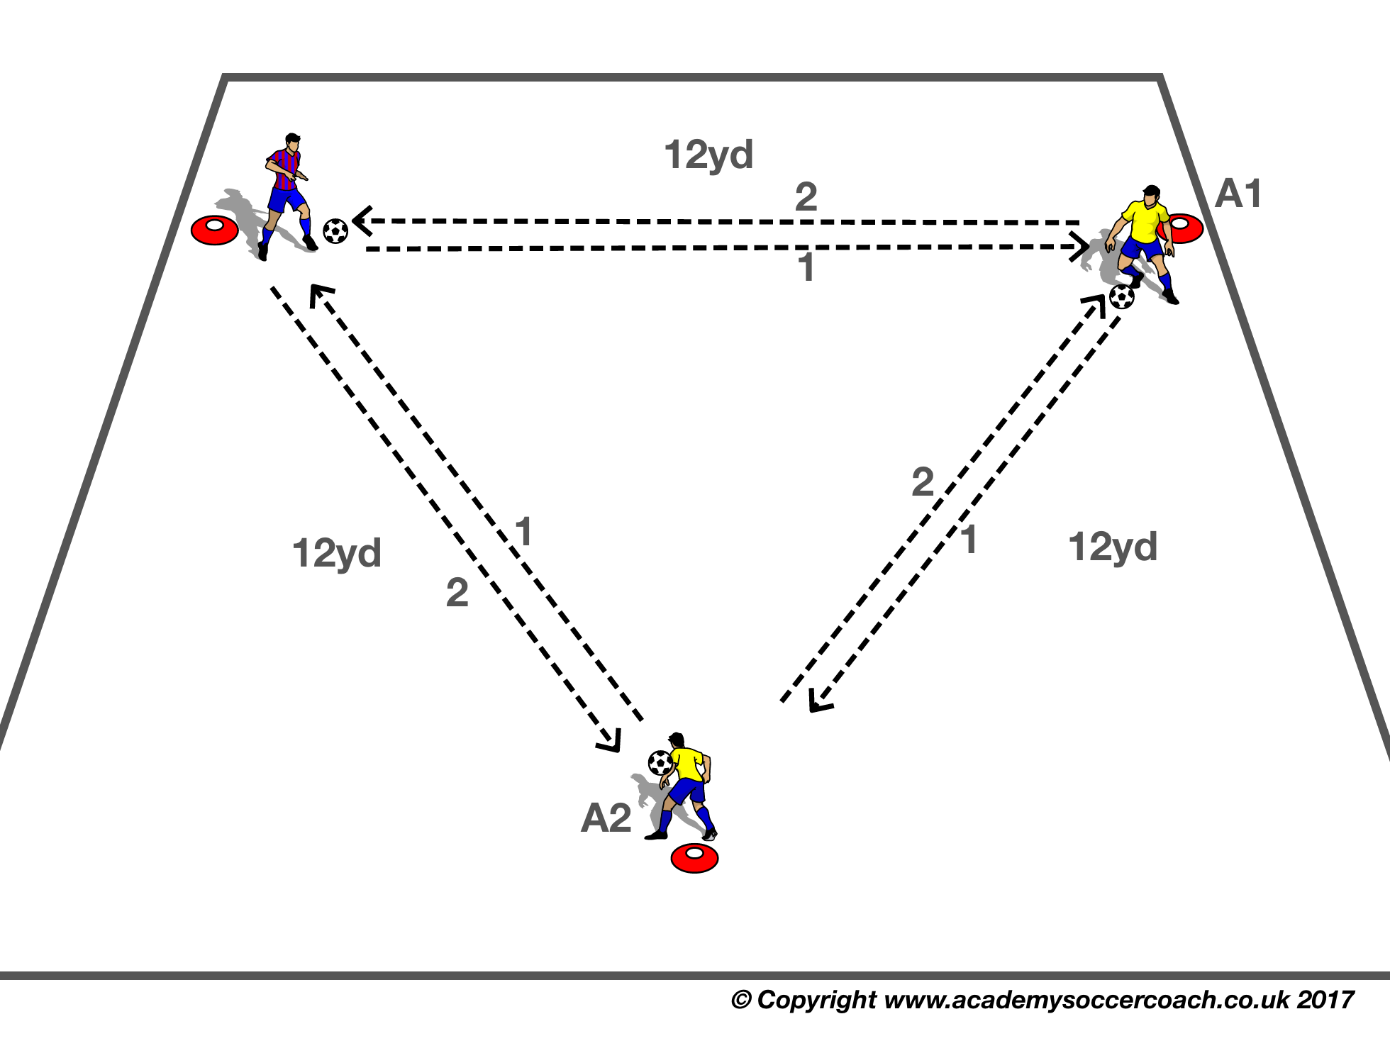
MOVES (M8)
Purpose: To improve Changes of direction.
SET UP
a 10 x 10 / 12 x 12 yard grid using 2 x blue/orange discs as per diagram.
3 x players per grid
2 x teams (Blue & Red)
ACTION
Every Player with a ball, makes a selected COD along the sides of the triangle
Make Harder
Player makes a different C.O.D each time.
COACH TIP TO PLAYER
Only take one or two touches before you make a COD turn.

Slide 10
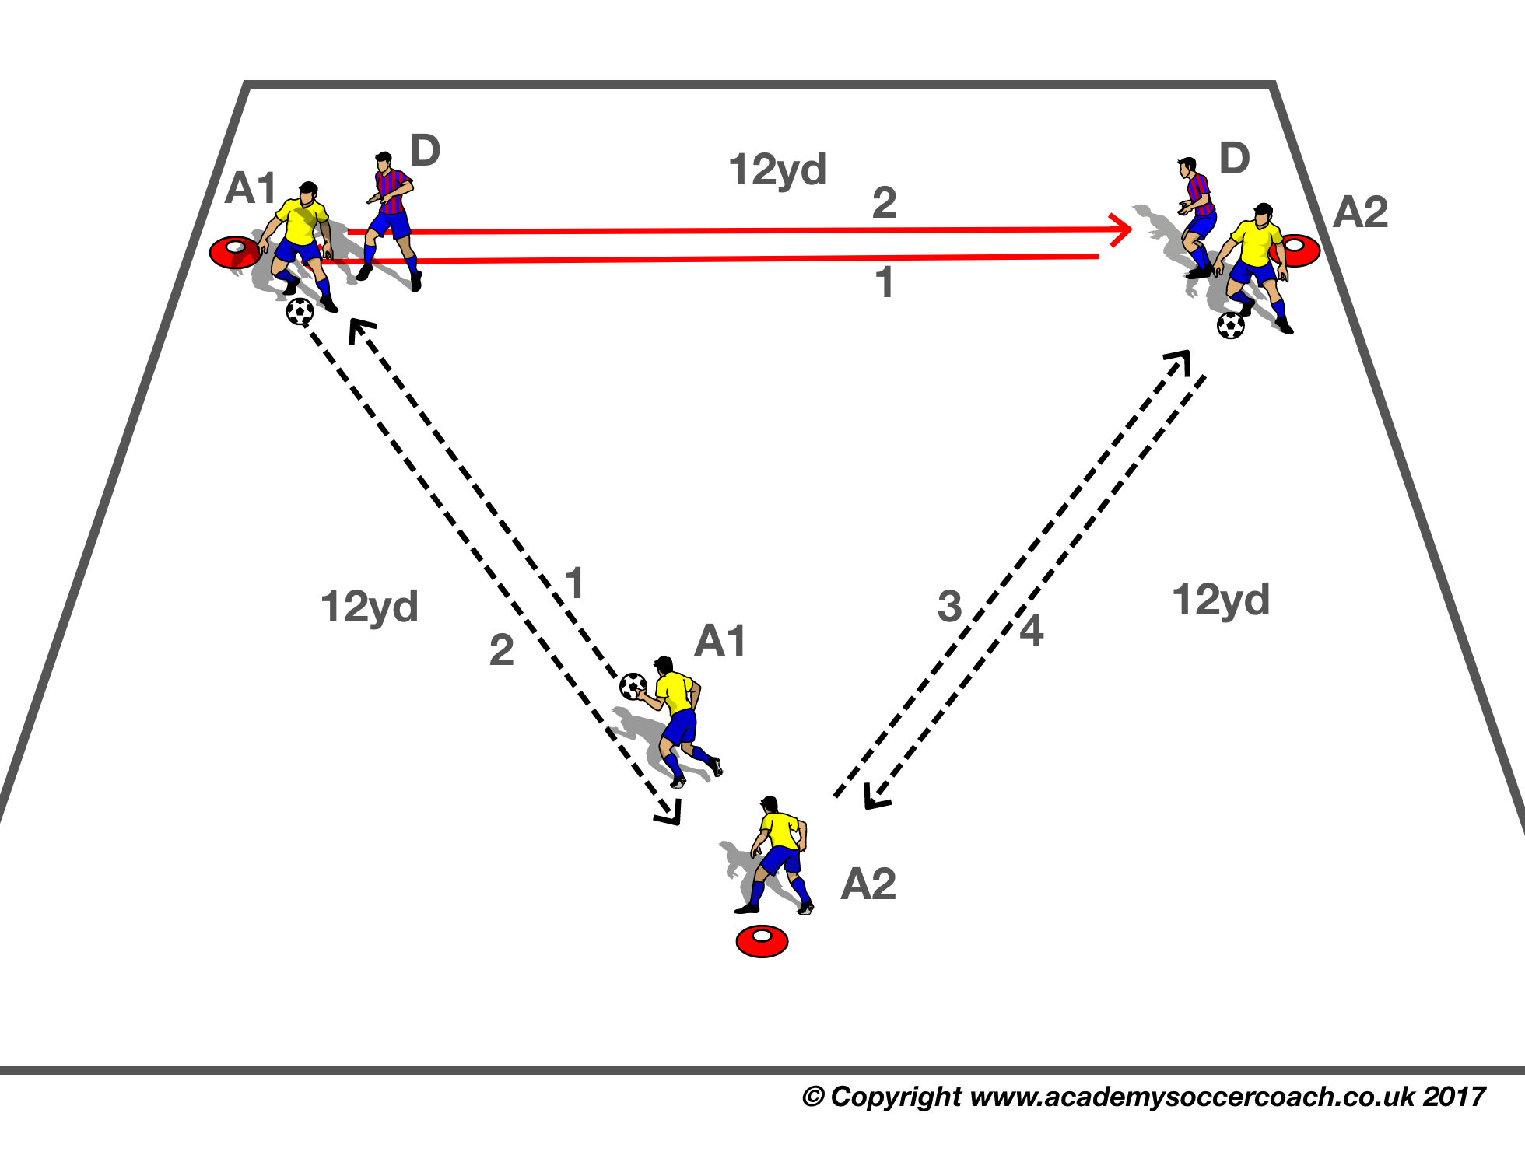
MOVES (M9)
Purpose: To Improve Changes of Direction & Shielding the Ball.
SET UP
A 10 x 10 / 12 x 12 yard grid using 2 x blue/orange discs as per diagram.
3 x players per grid, 2 with a ball each at the base of the triangle.
ACTION
Two players start on the big cone. One player at the base of the triangle is limited pressure defender. First player starts with the ball, when challenged by the defender, shields the ball, then passes to his waiting teammate, who takes the ball into the opposite corner, and the sequence continues.
Game Moves to use:
Inside Cut
Outside Cut
Make Harder
Speed Up
COACH TIP TO PLAYER
Only take one or two touches before you make a COD turn

Slide 11
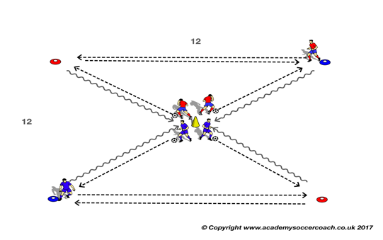
MOVES (M10)
Purpose: To Improve Changes of Direction & Shielding the Ball.
SET UP
A 10 x 10 / 12 x 12 yard grid using 2 x blue/orange discs as per diagram.
2 Teams of 3 players per grid, 2 with a ball each at the base of the triangle.
ACTION
Two players start on the big cone. One player at the base of the triangle is limited pressure defender. First player starts with the ball, when challenged by the defender, shields the ball, then passes to his waiting teammate, who takes the ball into the opposite corner, Competition; Team with most C.O.Ds in 45 seconds wins
Make Harder
Increase time.
COACH TIP TO PLAYER
Only take one or two touches before you make a COD turn

Slide 12
MOVES (M11)
Purpose: to improve Changes of direction and passing.
SET UP
a 10 x 10 / 12 x 12 yard grid using 2 x blue/orange discs as per diagram.
3 x players per grid, 2 x teams (Blue & Red).
ACTION
Two players start on the big cone. One player at the base of the triangle is limited pressure defender. First player starts with the ball, when challenged by the defender, shields the ball, then passes to his waiting teammate, who takes the ball into the opposite corner, and the sequence continues.
Make Harder
Speed Up
COACH TIP TO PLAYER
After your C.O.D look up and pass accurately ,so your teammate can take forward with first touch.

Slide 13
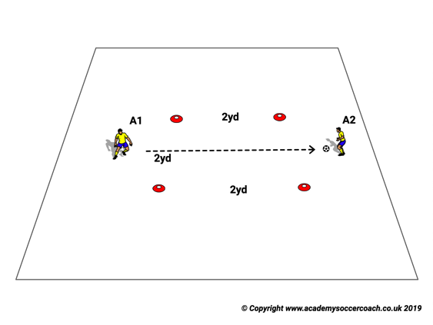
MOVES (M12)
Purpose
To improve Feint Moves by repetition.
SET UP
2yd x 2 yd. Square, two players face each other,A1 starts with the ball
ACTION
A1 passes to A2 and calls a Move Name,A2 stops the ball then makes that Move and passes back.
Make Harder
As player improve try the Move without stopping the ball under your body.
COACH TIP TO PLAYER
This is a good drill to do at home with your parent or sibling/friends.

Slide 14
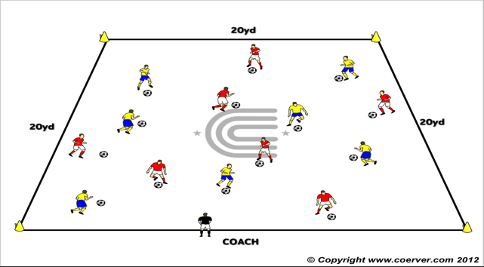
MOVES (M13)
Purpose: To improve Moves by repetition.
SET UP
A 20 x 20 grid marked with 4 cones at the corners.
Two teams of seven players with a ball each dribbling in the grid.
The Coach by the sideline.
ACTION: The players dribble around the grid and the Coach calls out a Game Move Label. (Use Game Moves List) The player makes that Move , and accelerates away
Make Harder
V2 The players dribble around the grid and the Coach calls out a Move Label. The player makes that Move, When the coach calls an odd number, players leave their ball and group together according to number called.
COACH’S TIP
Find space to make the Move.

Slide 15
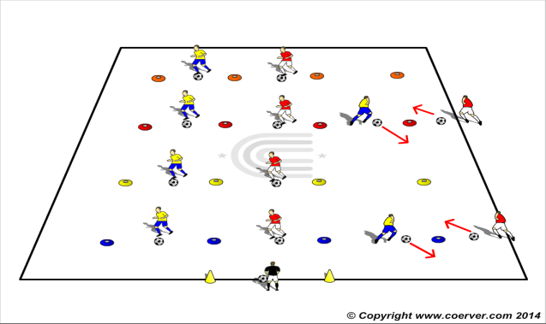
MOVES (M14)
PURPOSE: To imprint skills by repetition.
SET UP Players in pairs with a ball each standing 1 yard away from a cone (which is in the middle of the players).
ACTION Players do the Move on the coaches instructions, take the ball 45 degrees then end up facing each other waiting for next instruction to go
Make Harder
Player with the ball passes and follow as limited pressure defender. Receiver makes a Move and goes past him, the sequence continues.
COACH TIP TO PLAYER
Start slowly and then add speed and the movement is perfected.

Slide 16
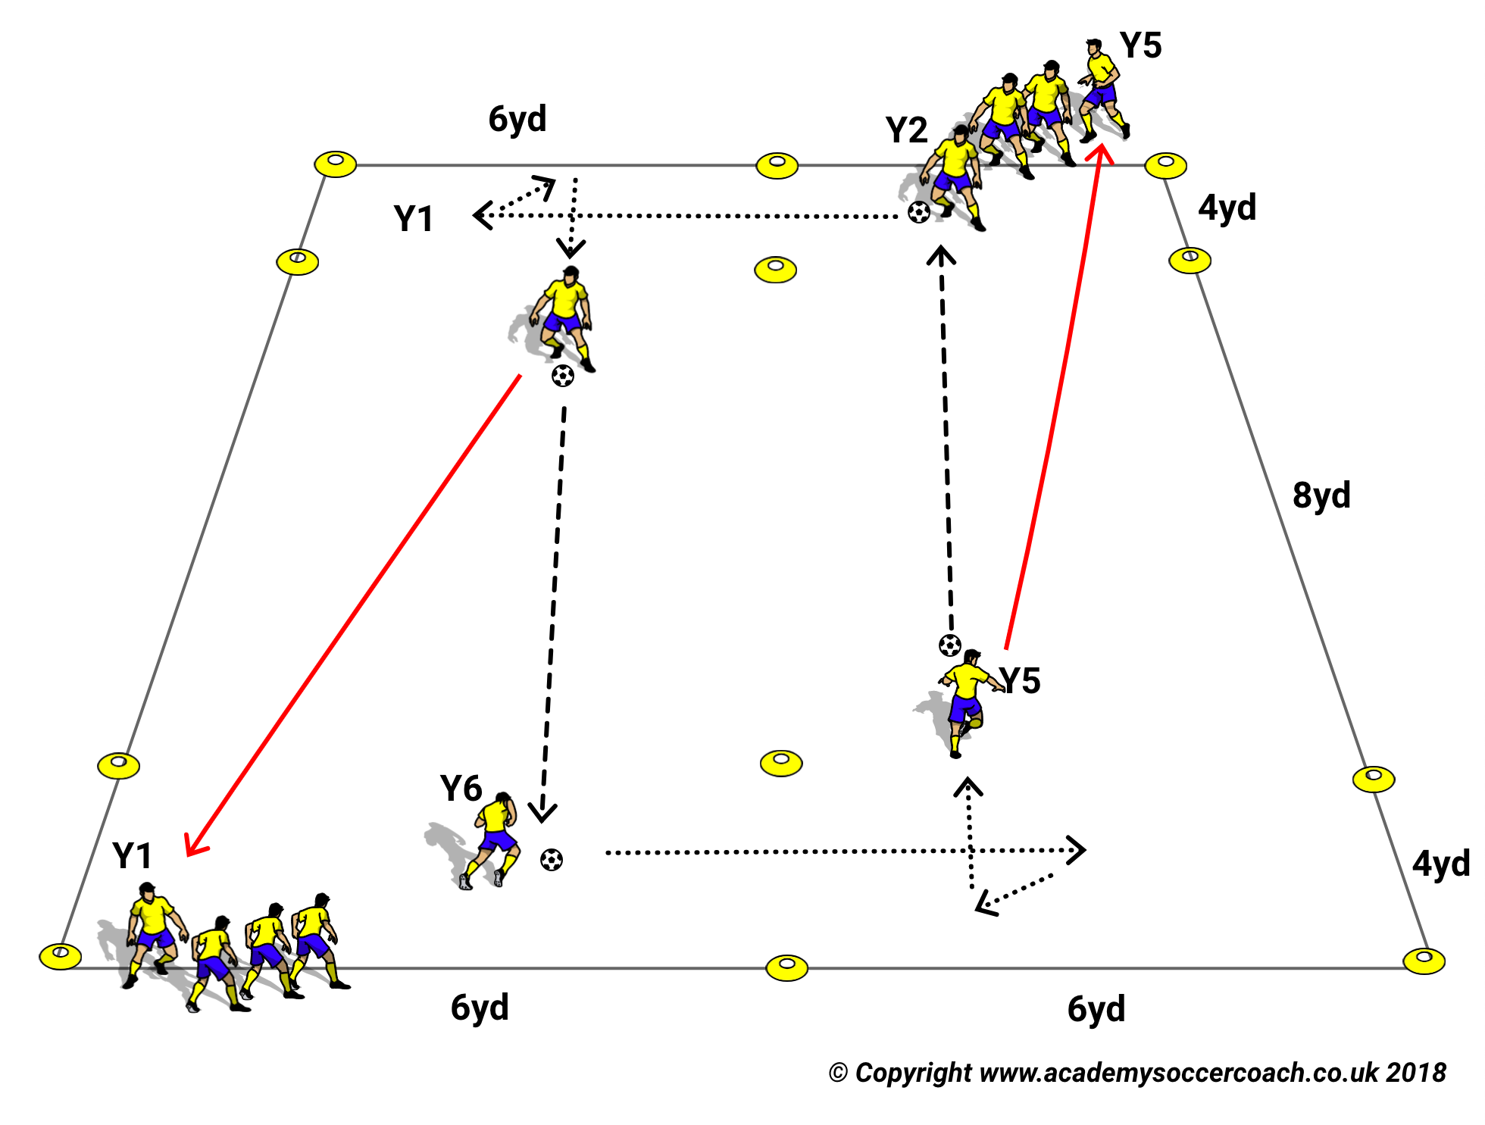
MOVES (M15)
Purpose: To Improve C.O.Ds and Passing.
SET UP
A 16x12yd Area with 4x6yd boxes marked at each end.
Half of each team lines up in Diagonally opposite boxes with a ball to each half team.
ACTION
On the Coach’s signal the first player on each half team pushes the ball across the grid into the next 4x6 box then passes to a teammate in the opposite box and follows their pass.
The teammate receives with the outside of the foot, pushes the ball into the adjoining box and continues the sequence. 2 balls are always in play and count in the scoring..
Teams win by completing the most passes in the time allotted by the coach.
MAKE HARDER
The Receiver pushes the ball with the outside of foot into the adjacent box and executes TWIST OFF COD moves then passes and follows.
The same moves can be practiced using the opposite foot when moving R to L in the boxes.
COACH TIP TO PLAYER
Do extra Practice with your weaker foot.

Slide 17
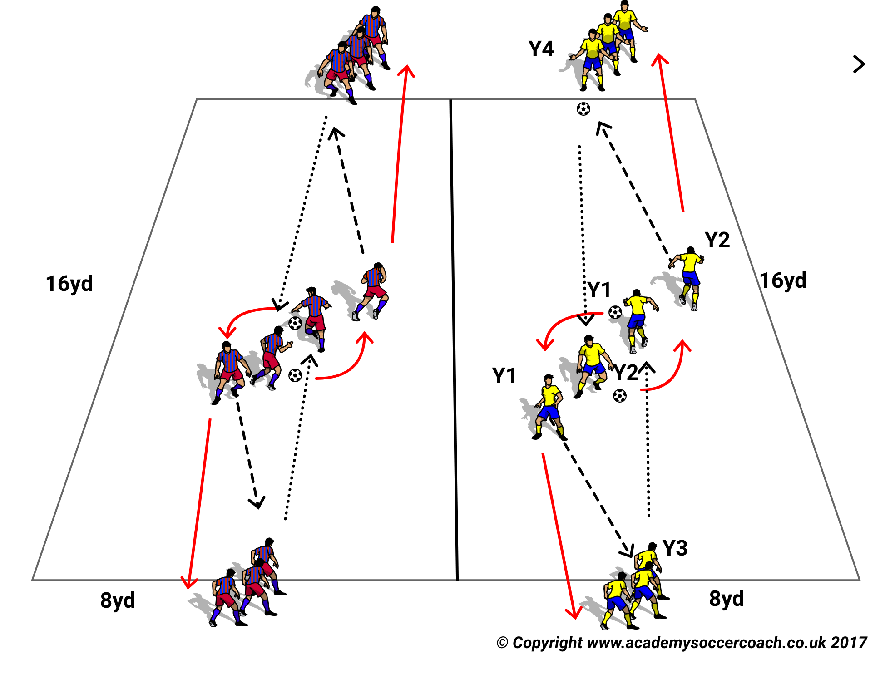
MOVES (M16)
PURPOSE. Technical Warm Up.
SET UP
2 8 x 16yd adjacent grids.
2 teams split evenly at either end of their grid with a ball to the first player in the four teams.
ACTION
V1 On the Coach’s signal the first players dribble to the middle of their grid, Inside Cut or Outside Cut around their teammate opposite and when around pass to their next team mate and rejoin the back of their team.
The winning team is the one that has most actions completed in the time the coach allows.
Make Harder
Now use Moves to pass to opposite Player
High wave 2. Pull Push 3. Pull Spin U Turn Step Over.
COACH TIP TO PLAYER
Go into a Move slowly accelerate away quickly.

Slide 18
1 v 1 Competition
Attack & Defence

Slide 19
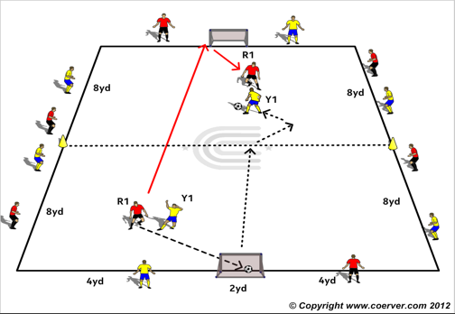
MOVES (M17)
Purpose: To improve 1 v1 Attacking & Defending.
SET UP
A 16 x 8yd area. Two teams facing each other across the grid.
Two small Goals on each end line.
One or two servers at each end with 5 balls each.
ACTION
V1 1 v 1 for 30 seconds. Outside players job is to keep the ball in play.
If goal scored, the scorer has to run back and around his goal then can defend.
If goal scored the server on that side passes to the player who has’t scored to try and score in opposite goal.
If a shot misses the goal, the server passes the ball to the defender who becomes an attacker.
Make Harder
Scorer now has to run back and touch the crossbar of his goal instead of going around it, then he can defend.
COACH TIP TO PLAYER
Defenders: Try to be touch close when pressing and keep opponent from crossing the mid line. The longer you press the more likely the opponent will tire and make mistakes, forced and unforced.
Attacker adjust your body shape so your first touch takes you away from the defender

Slide 20
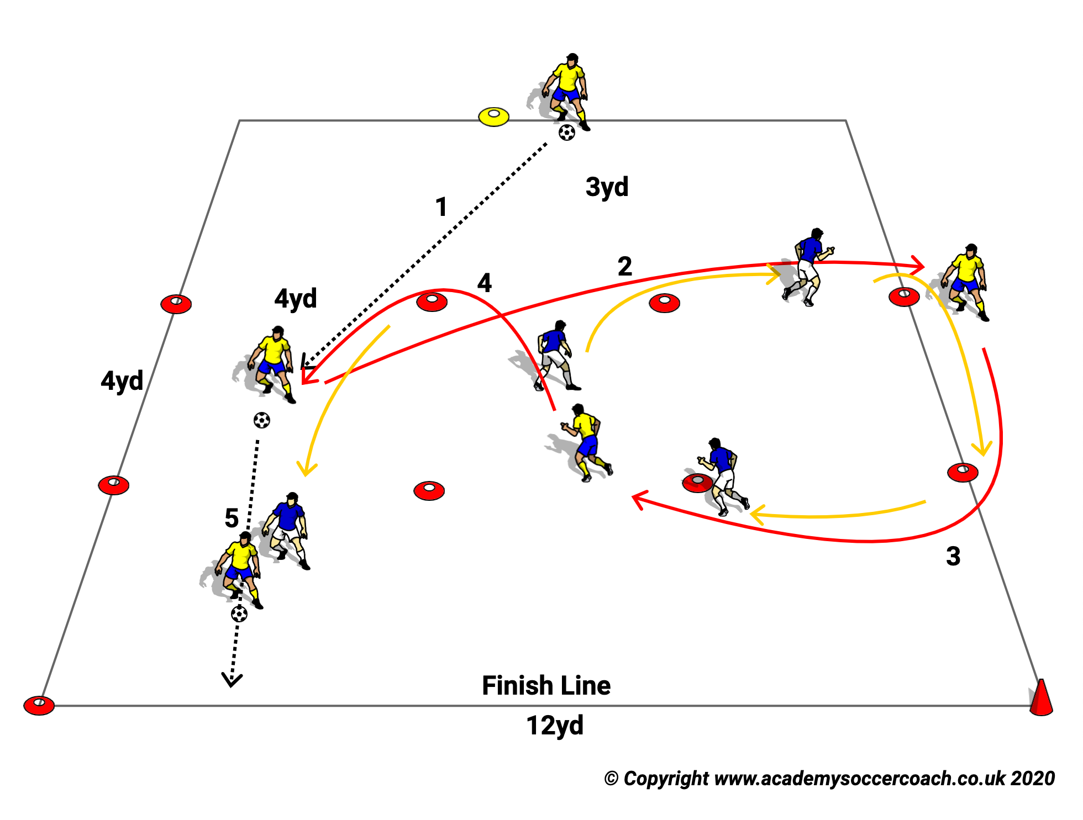
MOVES (M18)
Purpose: To Improve speed with & without the ball.
SET UP
3 Lanes of 4 x 12 yards Yellows start as attackers, reds defenders.
ACTION
Yellow takes ball into middle lane, red shadows his/her movements. Yellow tries to make space by leaving the ball ,going to either side, then quickly coming back and trying to run past yellow. Defender can not tackle.
Make Harder
Defender can now tag attacker before attacker crosses end line.
Coach Tip To Player
Attacker use your feints to fake to take the ball.
Defender, shadow , don’t rush in.

Slide 21
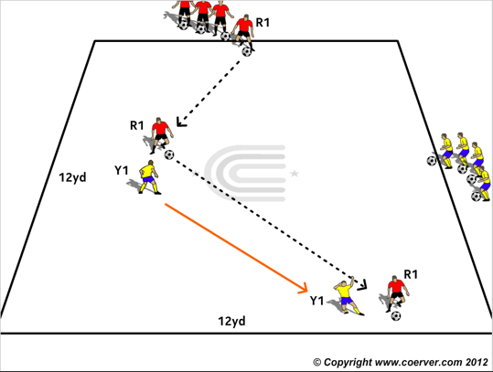
MOVES (M19)
PURPOSE. To improve 1v1 Attack & Defence.
SET UP
A 12x12yd grid with two teams with a ball to each player lined up on adjacent sidelines.
ACTION
V1 No Ball
A Yellow player is nominated as first defender.
A Red player tries to cross the grid and over his opposite line
If Red is successful a second Red tries
If successful a third Red tries.
The Yellow Defender must defend by tagging attacker, if he/she does ,then Red player becomes the new Defender and now it is Yellow team’s turn to attack.
When a team gets all their players to the opposite line the game continues in the opposite direction without a stoppage.
The sequence continues until the winning score as set by the coach.
MAKE HARDER
Add Ball.

Slide 22
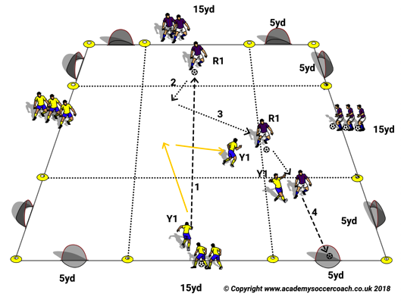
MOVES (M20)
PURPOSE. To improve 1v1 Attack & Defence.
SET UP
A 12x12yd grid with two teams with a ball to each player lined up on adjacent sidelines.2 goals on each side.
ACTION
A Yellow player is nominated as first defender.
A Red player tries to dribbles across the grid and over his opposite line with the ball under control.
If Red is successful a second Red tries to dribble across the area.
If successful a third Red tries.
The Yellow Defender must defend until he has stopped a Red crossing their line in control of the ball. Then Red player becomes the new Defender and now it is Yellow team’s turn to attack.
When a team gets all their players to the opposite line the game continues in the opposite direction without a stoppage.
The sequence continues until the winning score as set by the coach.
MAKE HARDER
Add two mini goals to each side of the area.
COACH TIP TO PLAYER
Attack: If you have apace use Speed ,if you are blocked try a Game Move.
Defence: Be patient don’t rush in to a tackle.

Slide 23
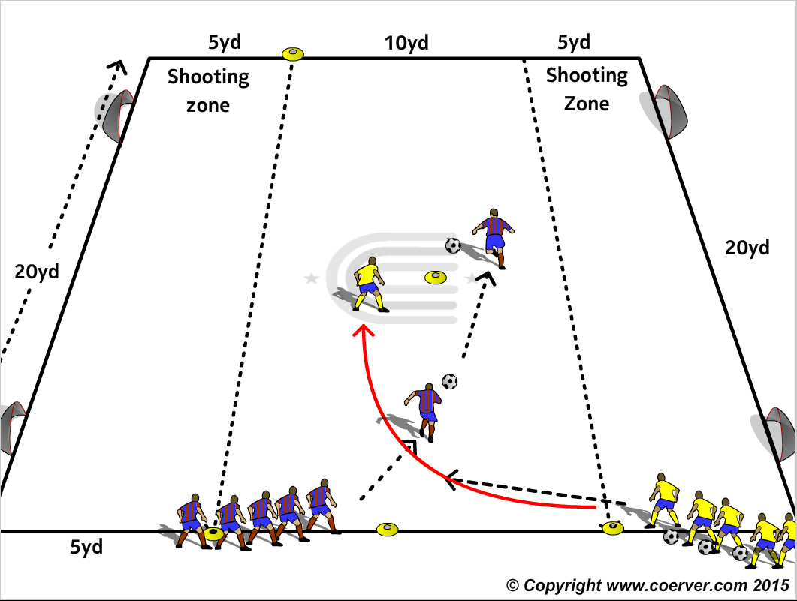
MOVES (M21)
PURPOSE. To improve 1v1 Attack & Defence.
SET UP
A 20x20yd field with two mini goals at opposite ends of field with 5 yd. shooting zones marked by cones and a center point about 12 yds. from goal marked by a cone.
Two teams positioned on the same side of the field. The Defenders, Yellows, with a ball each approx. 18 yds. from the goals Red will attack. Reds are approx. 10 Yds. from the goal line.
ACTION
Yellow passes to Red and overlaps Red to defend the two goals on the line farthest from Yellow. Red must speed dribble to at least the mid point cone then when past the cone can attack either goal and must get inside the 5yd shooting Line to score. Defender can not cross the line.
Game Moves: Scissors Side Step Drag Push Drag Side Step
MAKE HARDER
Defender can cross the line
COACH TIP TO PLAYER
Attacking:
Use Stop & Start moves to gain an advantage. If confronted use your feint Moves to create space on either side of Defender.

Slide 24
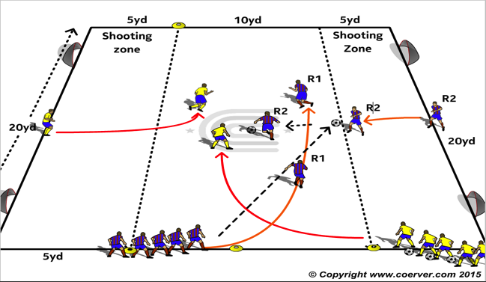
MOVES (M22)
PURPOSE. To improve decision making combine or go it alone.
SET UP. A 20x20yd field with two mini goals at opposite ends of field with 5 yd shooting zones marked by cones. A center point about 12 yds from goal marked by a cone.
Two teams positioned on the same side of the field. Yellows, the Defenders with a ball each are positioned approx. 18 yds from the goals and have second Defenders on the goal line between the Goals. Reds, the Attackers, are approx. 10 Yds from the goal line with a second Attacker on the midline between the opposite mini Goals.
ACTION. Yellow passes to R1 and overlaps R1 to defend the two goals on the line beyond Red.
R1 passes 1 touch to R2 who advances with the ball and R1 overlaps behind him/her and R2 & R1 combine to try to score against the 2 Yellow Defenders.
MAKE EASIER
No Goals Just try and get over end line
If the Defenders win the ball they can score on the opposite mini goals but must get inside the 5yd shooting zone to shoot.
COACH TIP TO PLAYER
Use overlaps 1-2s and screen runs to create openings for the player on the ball.

Slide 25
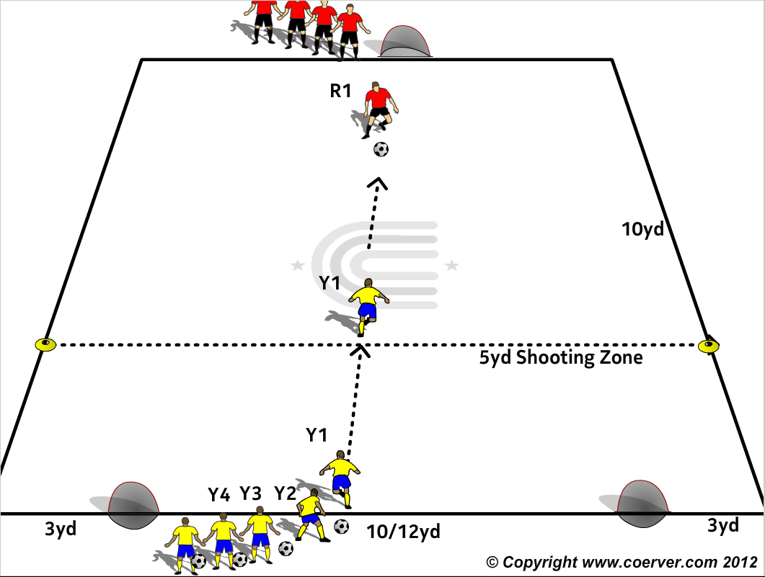
MOVES (M23)
PURPOSE. To improve 1v1 Attack & Defence.
SET UP
A 15x18yd grid with two mini goals 10/12 yds. apart and a 5 yd shooting line in front of them on one end line and another mini goal is on the middle of the opposite end line. A team each with a ball is stationed on the end line between the two goals. The other team is stationed by the goal on the opposite end line.
ACTION
Y1 passes to R1 and advances to defend against R1. R 1 tries to penetrate the Yellow shooting zone and score. If Y1 wins the ball he can score on the lone Red goal but must be within 5yd to shoot. Teams switch roles at Coach’s discretion.
Make Harder
Decrease Shooting Zone Area/oy Y2 becomes GK defending both.
COACHS TIP TO PLAYER
Attacker: Go forward and meet the ball on the run, your first touch distance relative to distance & position of the defender
Defender: Close the distance quickly, then hold.

Slide 26
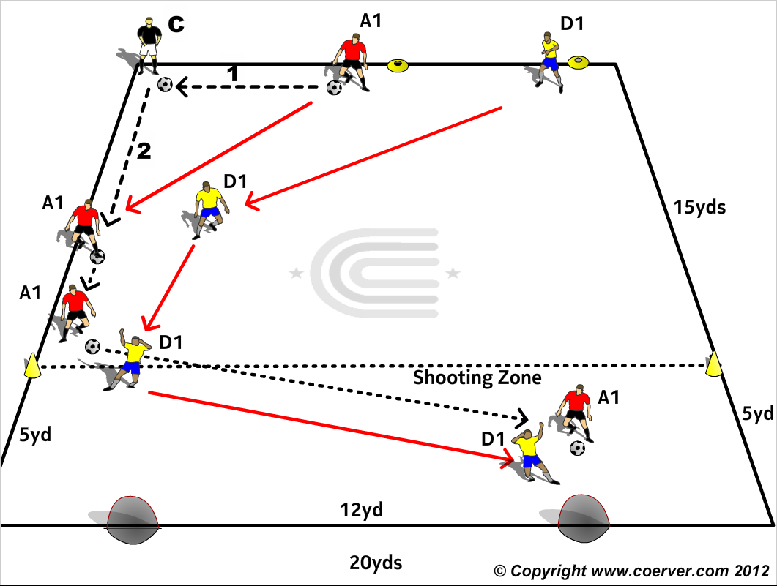
MOVES (M24)
PURPOSE. To improve 1v1 Attack & Defence.
SET UP
A 20x20yd grid with two mini goals 10/12 yd. apart at one end.
The Coach positioned at a corner on the opposite end of the field to the goals with Two Players, an Attacker A1 with a ball and a Defender D1 5yds beyond A1 on the end line.
ACTION
Coach plays a one two with A 1 and sprints to the sideline to receive the return pass.
Defender D1 challenges as soon as the coach plays the ball down the line,
and tries to stop A1 scoring on either goal.
COACHES TIP TO PLAYER
Attacker try to use at least one of your S&S moves. The High Wave hesitation often works to gain an advantage.

Slide 27
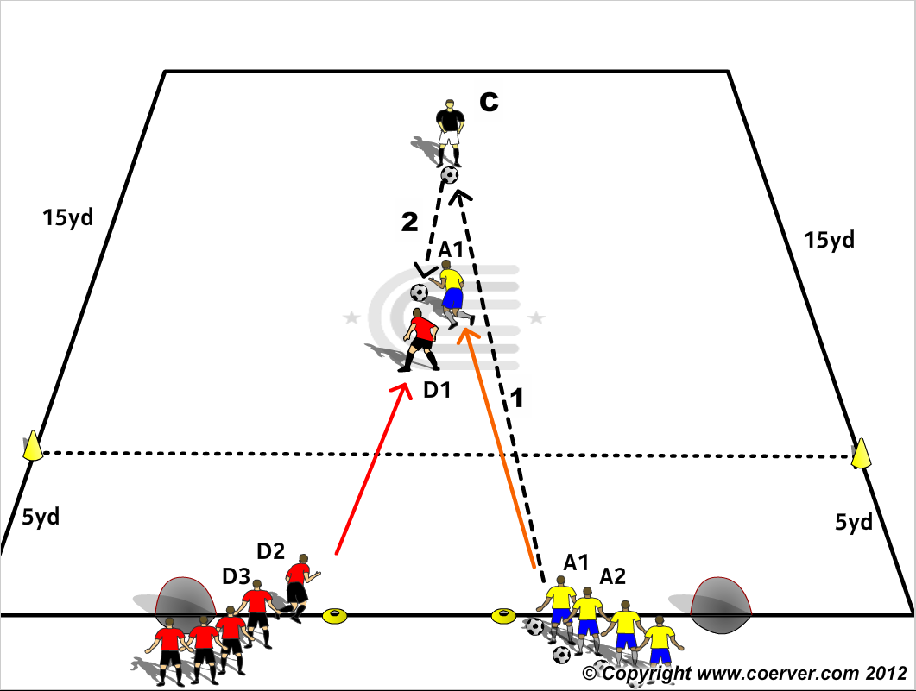
MOVES (M25)
PURPOSE. To improve 1 v 1 Attack & Defence.
SET UP.
A 20x20 area with two small goals 12 yds. apart on one end line.
Two teams stationed between the goals. One team with a ball to each player, start as attackers
The Coach stationed 15 yards from the teams facing the teams.
ACTION
A1 passes to the Coach and sprints to take the return pass with his back to goal as D1 sprints to pressure him. A1 tries to turn and penetrate the shooting zone to score.
COACH TIP TO PLAYER.
Attacker: Try to receive half turned and work the ball with the foot furthest from the opponent.
Defender: Get touch close, then hold.

Slide 28
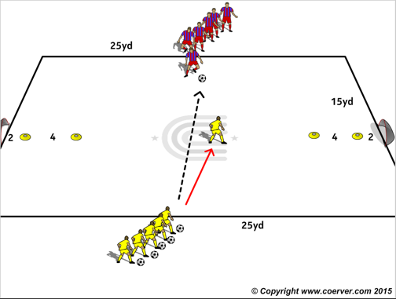
MOVES (M26)
Purpose : To improve decision making and creativity
SET UP
Two small goals 25/30 yards apart with 4 yd cone gates 2 yards in front of each goal. Two teams in pairs facing each other across the field. One team with a ball to each pair.
ACTION.
1v1. Attackers can only score if they dribble through the gate in front of the goal they shoot into. If a player dribbles through a gate at one end then changes direction for the other they must still go through the other gate before shooting. If the Defender wins the ball he can score.
Make Harder
Increase length of field to 40 yards
COACH TIP TO PLAYER
Attackers: Adjust your body shape so your first touch goes towards one of the goals
Defender: don’t give up, block your opponent from going through the gates till they tire, then go in and win the ball.

Slide 29
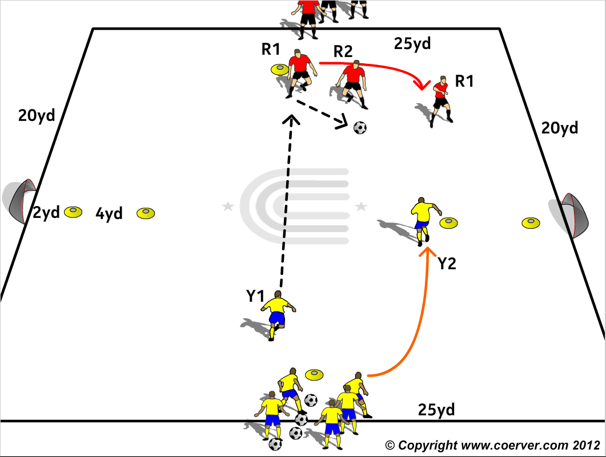
MOVES (M27)
Purpose: To Improve 1 v 1 decision making.
SET UP
Two small goals 25/30 yards apart with 4 yd cone gates 2 yards in front of each goal.
Two teams in pairs facing each other across the field, one team, with a ball to each pair.
ACTION
Y1 passes to R 1 who passes 1st touch to R2 and overlaps behind R2. R2 can use R 1 on the overlap or can choose another action.
Defenders can score if they win the ball.
Teams can only score by either dribbling through one of the gates to shoot or passing through a gate for their team mate to shoot.
If a player dribbles through a gate at one end then changes direction for the other they must still go through the other gate before shooting.
Make Harder
Players can only score with a first touch finish.
COACH TIP TO PLAYER
Attack: Pass & move, find space.
Defenders: work together, communicate constantly and don’t be too far away from each other.

Slide 30
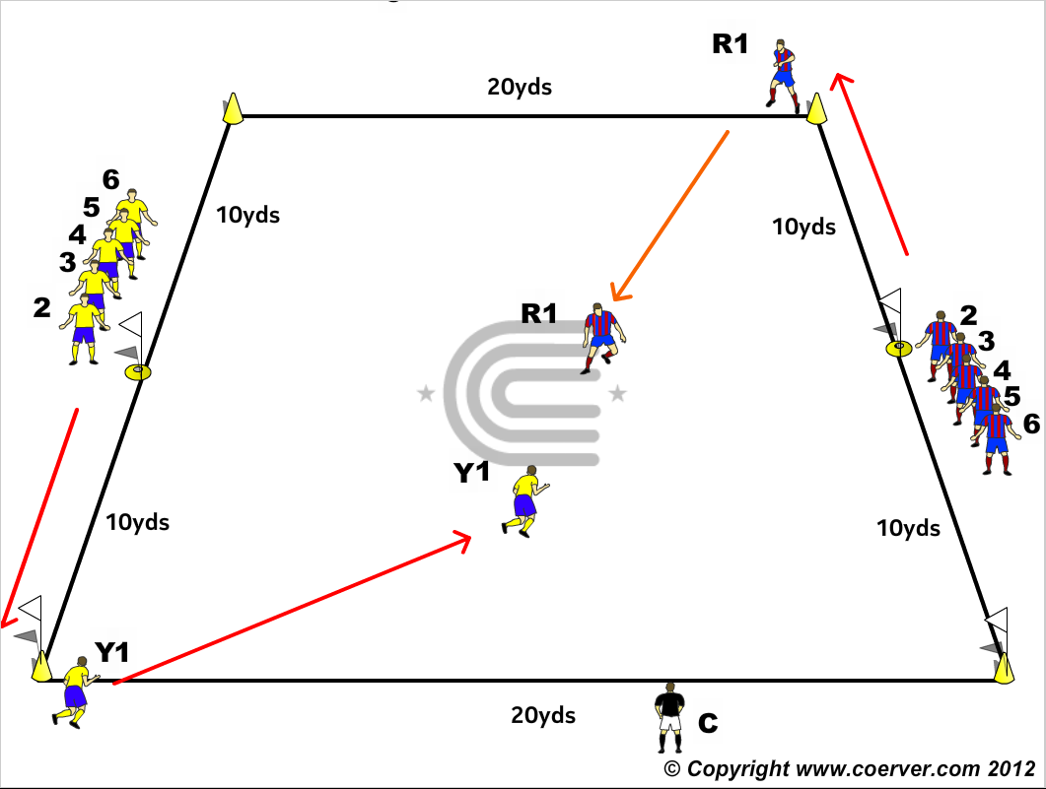
MOVES (M28)
Purpose: To Improve 1 v 1 Attack & Defence.
SET UP
A 20x20yd grid marked with corner cones and two teams lined up at opposite mid points facing opposite directions.
ACTION
V1 :No Ball
The Coach nominates which team will defend and which attacks.
On the Coach’s call the first player from each team sprints around their respective corner
cone and enter the field.
The “Attacker” tries to get over the opposite end line without being tagged by the “Defender.”
If there is a tag the play ends and the Coach immediately calls the next players to start.
The Coach keeps the cumulative score of all games.
Make Harder
V2: Add Ball. The Coach passes to defender who passes to attacker and then tries to win the ball and carry it over the opposite line
COACH TIP TO PLAYER
Attacking: If speed alone can do it then you don’t need the Moves. If you need to us try the Feint Moves
Defending: Don’t rush in.

Slide 31
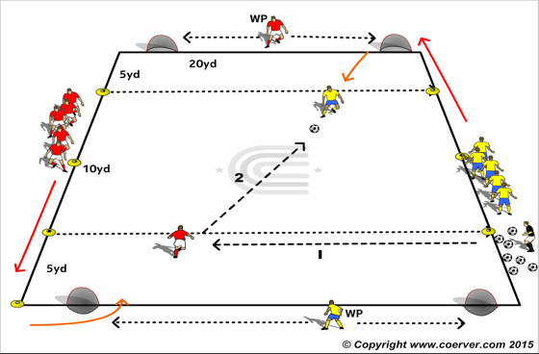
MOVES (M29)
Purpose: Improving 1 v 1 Attack & Defence.
SET UP
A 20x20yd grid marked with corner cones and two teams lined up at opposite mid points facing opposite directions. Two mini goals each end, a Wall Passers at each end.
ACTION
The first red (defender) and yellow (Attacker) sprint around the corner cones, the coach passes to the defender passes, first time to attacker, then defends.
The attacker can score in the zone or pass to Wall passer between the goals to play a wall pass. The attacker has two touches to shoot.
,if defender wins the ball they attack the opposite end and also play with his/her Wall passer.
Make Harder
Attacker has to shoot first time.
COACH TIP TO PLAYER
Attacking: Wall Passer move along the line to give your teammate with the ball angles to pass to
Defending: Defenders shuffle laterally and keep facing the Attacker. Do NOT cross your feet and turn your body from him as you will have a difficult recovery.

Slide 32
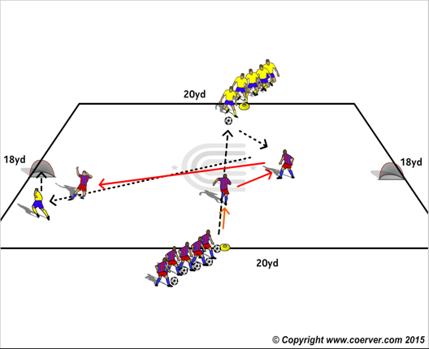
MOVES (M30)
Purpose: To Improve 1 v 1Attack & Defence
SET UP
A 20 x 18yd area. Two teams facing each other across the grid, the defending team with a ball each.
Two small Goals on each side line facing the Defending Team.
ACTION
The First player on the Defending team passes to the first player on the opposite team and sprints to pressure opponent and prevent him/her penetrating the half line to score on the goals facing the defending team.
COACH TIP TO PLAYER
Defender, Try to be touch close when pressing and keep opponent from crossing the mid line. The longer you press the more likely the opponent will tire and make mistakes, forced and unforced.

Slide 33
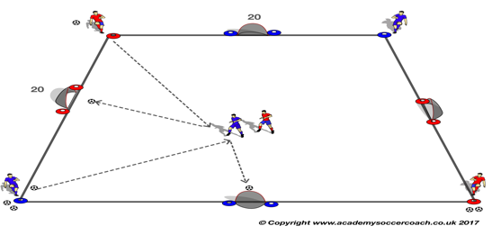
MOVES (M31)
Purpose: To Improve 1 v 1 attacking & Defending.
SET UP
A 15 x 15 yard grid (with 2 x Blue/Orange discs as per diagram).
4 x target goals (North, South, East, West).
Goals that are North/South have Blue discs either side, Goals that are East/West have Orange discs either side.
Attacker and defender on the field
Servers on the outside. 2 Balls each. Change middle player after all 3 balls played
ACTION
If Attacker scores then, a teammate serves again to him, if Attacker misses or defender touch’s the ball attacker and defender change roles.
Make Harder
Servers start with 5 balls each.
COACH TIP TO PLAYER
Attacker use your C.O.D’s to make space to shoot.

Slide 34
All rights reserved.
No part of this booklet may be reproduced in any form or by any means, electronic or mechanical, including photocopying without permission in writing from the author except for brief extracts for purposes of review only.
The word COERVER® and the COERVER® COACHING LOGO are registered trademarks of Sportsmethod Ltd. And Sportsmethod Asia Ltd.

