Slide 1
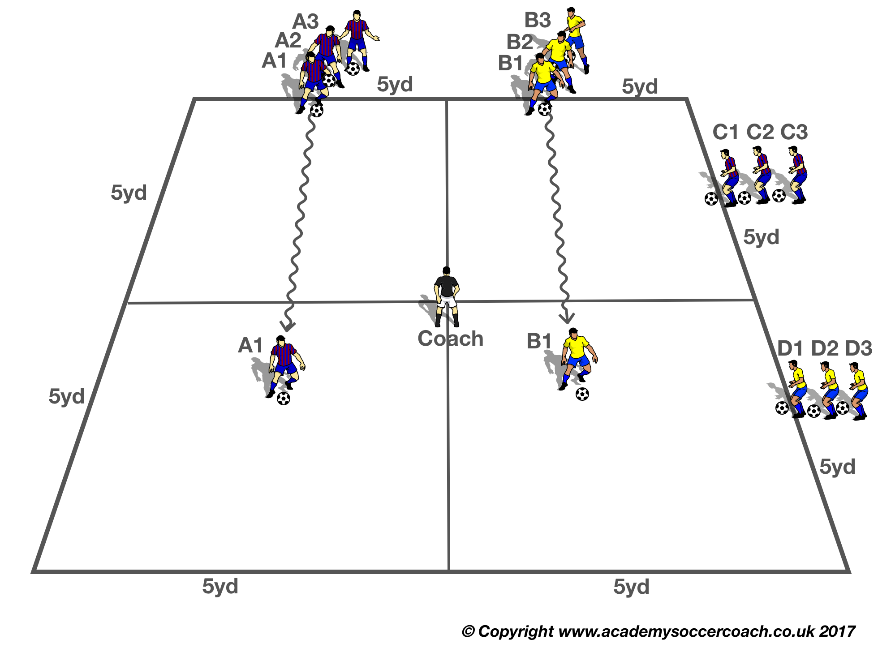


BALL MASTERY (BM1)
Purpose: To improve Ball Mastery
SET UP
4 boxes, 5 yards x 5 Yards each, create a 10 x 10 yard grid.
Two groups of 3 or 4 Players, lineup, North and East, each player with a ball.
Coach holds two different color cones.
ACTION
Ball Mastery Moves to use:
Toe Taps
Single Cuts
Pull Push Inside
Dribble Cut
V1: Players with a ball each, do one selected Ball Mastery Moves, travelling across the grid, trying to stay in line with each other. Coach holds up one of the colored cones, for the player to call color, ensuring they look up.
When the first two players pass the coach, the coach turns to next group and the two player from that group go. Groups go alternatively.
Make Harder
V2: Use harder Ball Mastery Moves and speed up the next player going.
COACH TIP TO PLAYER
Occasionally look up so you stay in line with the player next to you.

Slide 2
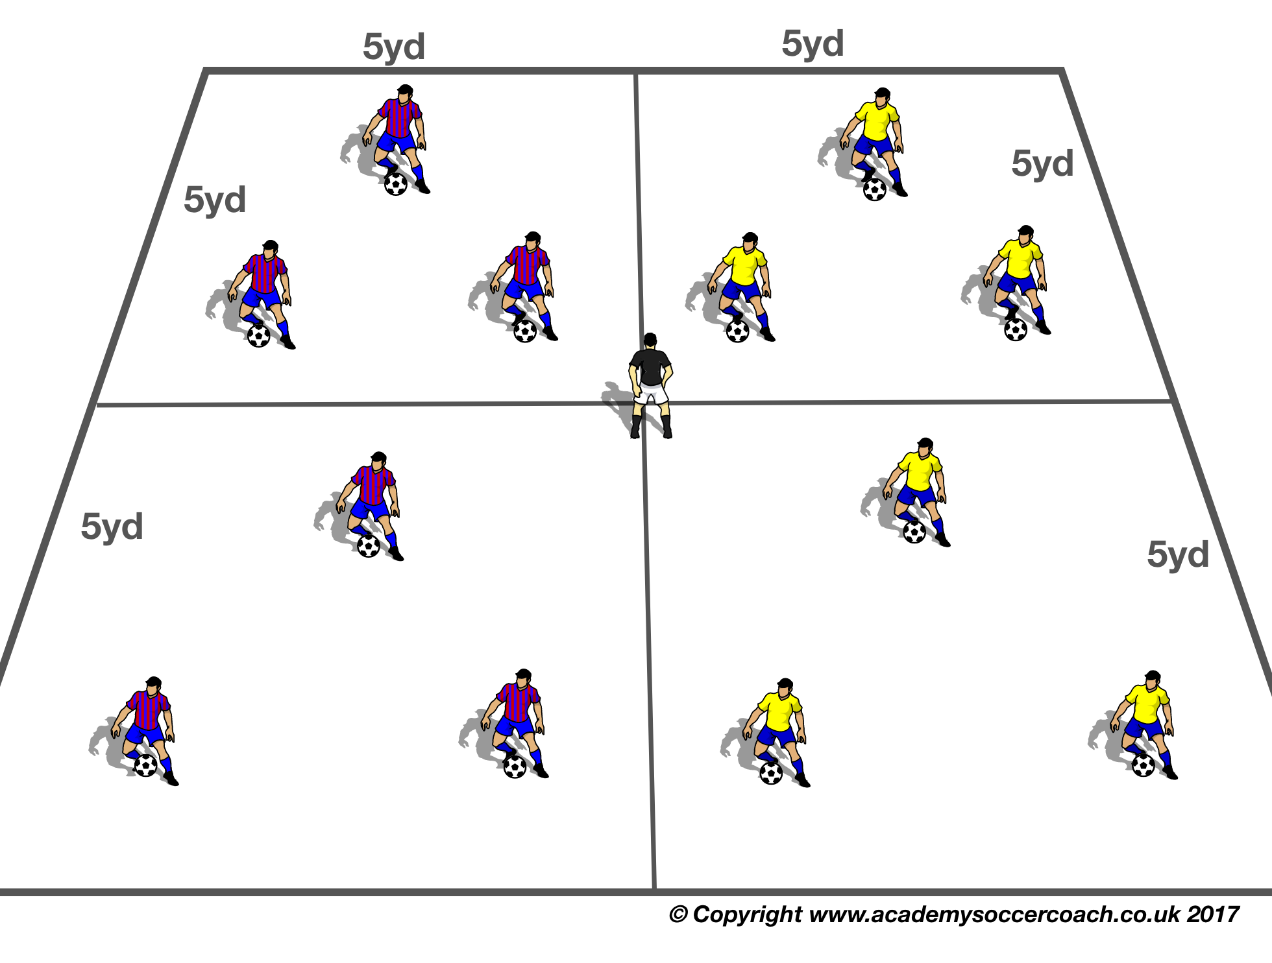
Ball Mastery (bm2)
Purpose: To Improve Quality & Speed of Ball Mastery.
SET UP
4 grids of 5 x 5 yards up to 4 players in each grid. Coach or designated player in the middle.
ACTION
V1: One group per grid, copy a mix of different ball mastery moves, as the coach in the middle does.
Make Harder
V2: Now a player from the group goes in the middle and teammates copy him. Players can make up their own sequences; competition, one point for each different Ball Mastery Move they do (they can invent their own).
COACH TIP TO PLAYER
You need to look up so you can copy middle demonstrator.

Slide 3
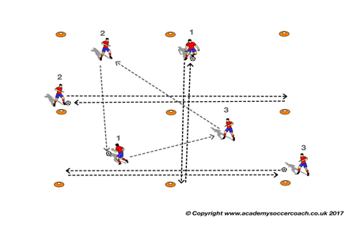
BALL MASTERY (BM3)
PURPOSE: Improving Ball Mastery under competition.
SET UP
4 boxes, 5 yards x 5 Yards each, create a 10 x 10 yard grid.
Two groups of 3.
Group One: One player either end, and one going across the grid, each player with a ball. Group B: 3 players, passing the ball.
ACTION
(Competition)
V1: The 3 players on the outside perform a selected ball mastery move going back and forth across the grid, while the other group passes the ball.
Passing players must not come into contact with players going across the grid,
Players work for 30-60 seconds, switch roles and repeat.
Competition
Teams against each other, 1 x point for each successful pass, 2 x point for each successful lap per player. Play for 60 sec, individual players add their scores up.
The team with the most points wins, switch roles and repeat.
Make Harder
V2: To make more difficult make the grid smaller or have more players in the grid so players have less space or make bigger for beginner players.
COACH TIP TO PLAYER
Eyes up, look for space, the more space the more time to decide.

Slide 4
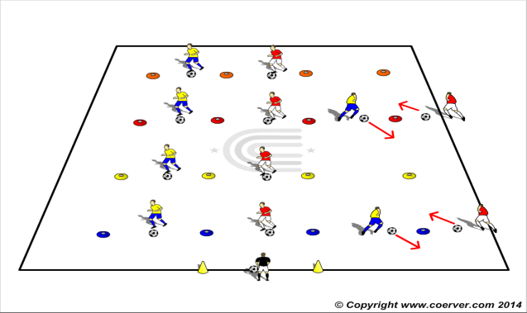
BALL MASTERY (BM4)
PURPOSE. To perfect skills by repetition.
SET UP Players in pairs with a ball each standing 1 yard away from a cone (which is in the middle of the players).
ACTION
GAME MOVES TO USE: FEINTS
SIDE STEP
SCISSORS
DRAG PUSH
V1 Players do the Move on the coaches instructions take the ball 45 degrees then end up facing each other waiting for next instruction to go.
MAKE HARDER
V2: Player with the ball passes and follow as limited pressure defender. Receiver makes a Move and goes past him, the sequence continues.
COACH TIP TO PLAYERS
Start slowly and then add speed as the movement is perfected.

Slide 5
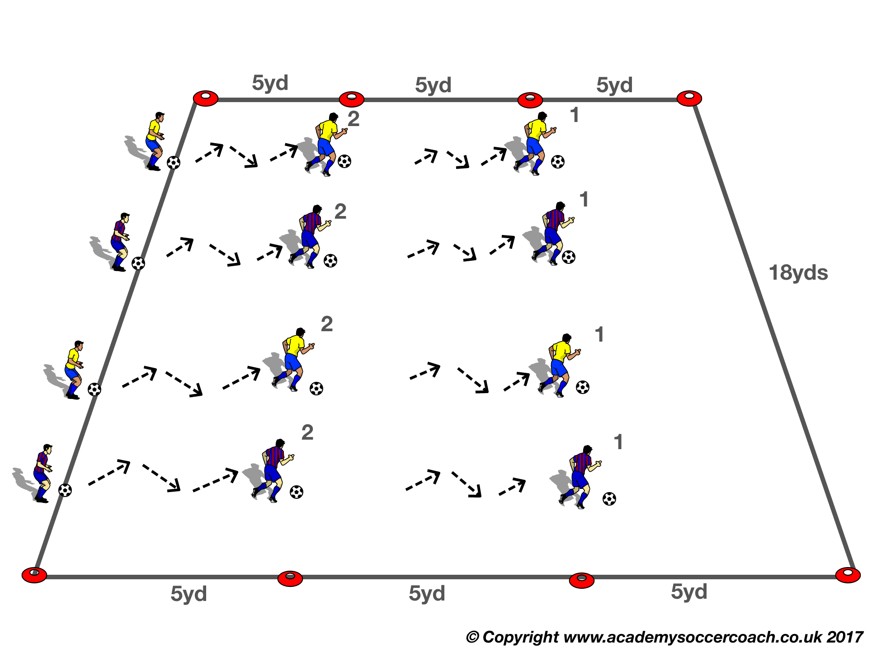
Ball Mastery (BM5)
Purpose: To perfect Ball Mastery Moves
SET UP
Players numbered 1, 2 or 3 are lined up with a ball on one side of a 15x20 yd grid.
Coach in front of the players.
ACTION
Ball Mastery Moves to use: Toe Taps, Single Cuts, Pull Push Inside, Dribble Cut
V1: On the Coach’s signal #1s cross the grid doing the action the coach nominates.
When #1s are 1/3 across the grid the coach calls for #2s to start.
When #2s are 1/3 across the Coach calls for #3s to start.
Make Harder
V2: Same Action , but a new Ball Mastery Move at each cone
V3: Action the same but now the player gets a point for each different Ball mastery they use to end line.
COACH TIP TO PLAYER
Try not to watch the ball all the time. Try to keep your eyes up as much as possible. It will get easier with practice.

Slide 6
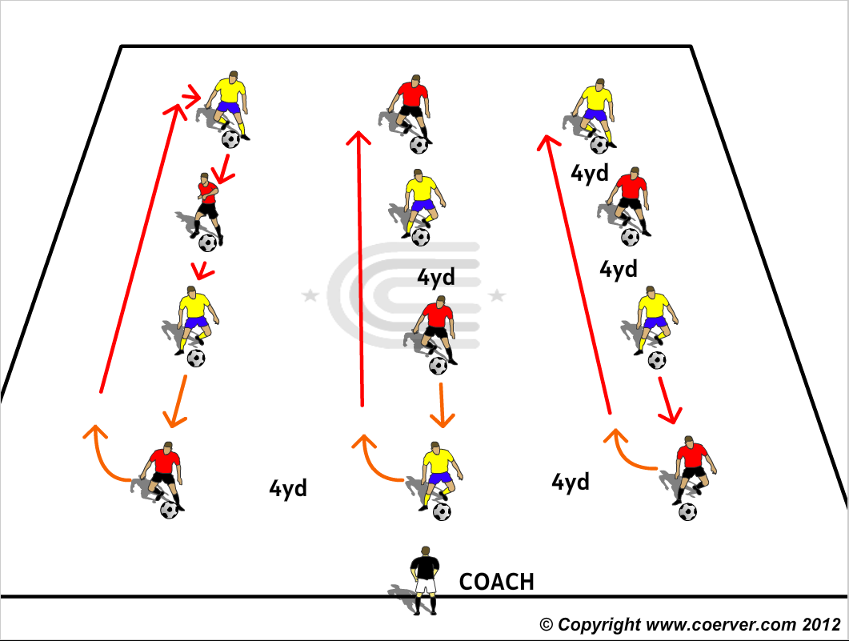
Ball Mastery (bm6)
Purpose: To Improve the quality & Speed of Ball Mastery.
SET UP
Players in in groups of 4 each with a ball.
ACTION
Step 1 Repetition:
The coach sets a different ball mastery move at each station. On his signal players sprint and change positions
Step 2:Competition:
Relay Race between the groups. Each player has to do 8 Ball Mastery Moves then go to next station7 do same.
Each player goes twice.
First Team to finish wins.
MAKE HARDER BY USING MORE DIFFICULT BALL MASTERY MOVES.
COACH TIP TO PLAYER
Eyes up occasionally.

Slide 7
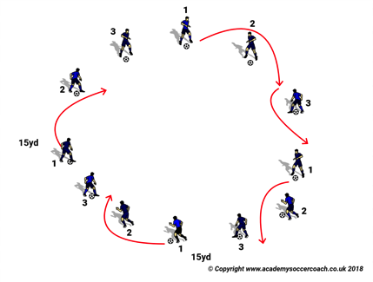
Ball mastery (BM7)
Purpose: To improve the Quality & Speed of Ball Mastery
SET UP
In a 15 x 15yd area, 12 players with a ball each make a circle.
Players numbered 1,2,3.123 etc.
ACTION
Ball Mastery Moves Can Use: Game Moves can use
Toe Taps
Sole Taps Drag Push
Slides Scissors
Single Cuts Side Step
Pull Push Inside
V1: On the coach’s signal, players start a Ball Master Move on the spot
Coach calls a number, the numbered players zigzags around the circle doing the designated Ball Mastery Move.
Develop into a race
Make Harder
V2 : Same action but players do a different Ball Mastery Moves on each zig zag
Develop into a race
COACH TIP TO PLAYER Eyes up so you can make your Move at the right time & place

Slide 8
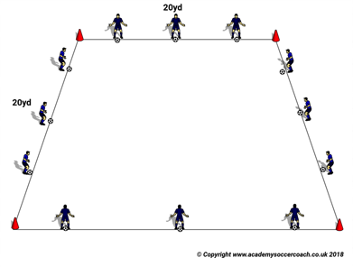
Ball Mastery (bm8)
Purpose: To Improve the Quality & Speed of Ball Mastery.
SET UP In a 20x20yd square, 12 players at the all sides 3 players each with a ball.
ACTION
V1: On the coach’s signal, North and South side's players go to other sides Then West & East.
Make Harder
V2: All go together causing less space.
V3: Competition Both North & South players go together, doing one of the Ball Mastery Moves that the Coach calls out, when the coach shouts “sit” the players have to sit on the ball, the last player the coach selects that sits on the ball goes back to the start line. First player that crosses finish line wins.
COACH TIP TO PLAYER Eyes up for not to hit other players. Move both feet quickly and accuracy.

Slide 9
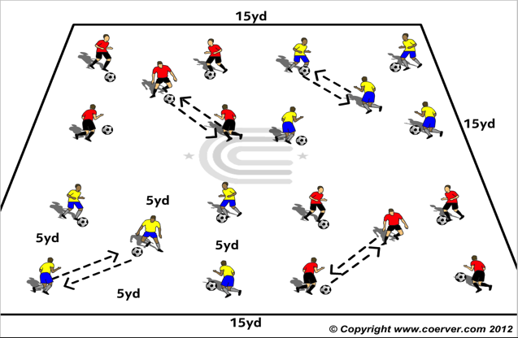
Ball Mastery (BM9)
Purpose: To Improve the Quality & Speed of Ball Mastery.
SET UP
Groups of 4 players with a ball each in a 5 yard square with a working player in the middle.
ACTION
V1: Outside players repeating a ball mastery move then passing to middle player who passes back, then turns clockwise to receive from the next player.
Outside players do a Ball Mastery Move, middle player, two or one touch passing.
Change middle player each 30/45 seconds.
Make Harder
V2: Outside players do a ball mastery Move ,pass to middle player who does a Ball Mastery Move and switches places with perimeter player.
V3: Groups compete against each other. First team to 20 passes from middle player wins.
COACH TIP TO PLAYER
Sneak a look up occasionally.

Slide 10
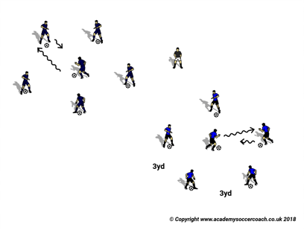
Ball Mastery (bm10)
Purpose: To Improve the Quality & Speed of Ball Mastery.
SET UP
Groups of 5 Players, 4 each with the ball form a circle, around one player in the middle with a ball.
ACTION
Ball Mastery Moves to use:
Sole Taps
Toe Taps
Single Cuts
Pull Push Inside
Dribble Cut
V1:On the coach’s signal, players start Sole on the spot. The Players go around clockwise, end player and middle player exchanging places.
MAKE HARDER
V2: Competition: Same action, but now a race between the Groups. First Team to complete the Circle wins.
COACH TIP TO PLAYER
Try and go as quick as you can without losing control of the ball.

Slide 11
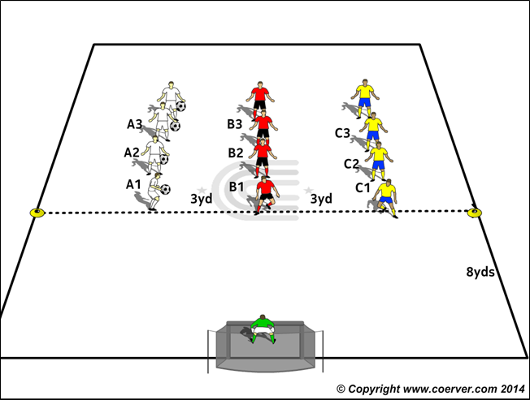
Ball Mastery (bm11)
PURPOSE: To improve heading technique & accuracy (For Phase 3 & 4 Age Groups Only)
SET UP
Players in 3’s facing the Goal
ACTION
V1: A1 throws to C 1,C 1 Heads to B1, B1 heads to GK
Each time the Coach catches an accurate header, the player gets a point
Make Harder:
V2: A to C. C Heads to B heads to A,A heads to GK
V3: A to C,C to B,B to A,A back across goal for either B or C to head at Goal
COACH TIP TO PLAYER
Focus on the ball
Focus on the timing of your jump and your footwork to meet the ball at the right time

Slide 12
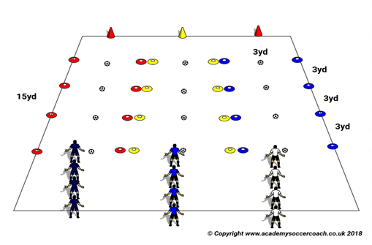
Ball Mastery (BM12)
©Copyright www.coerver.com 2018
Purpose: To maintain Ball Mastery quality under fatigue.
SET UP
In a 15x15yd area with 3 lanes marked by small cones 3 yards apart. 3 Large cones in front of each group. Players in teams of 4 to 6.A Ball placed between each cone.
ACTION
Ball Mastery Moves to use:
Sole Taps
Toe Taps
Slides
Pull Push Inside
V1: a Different Ball Mastery Move at each Station
On the coach’s signal, on each coach’s signal, players go to the next ball and do the designated Ball Mastery Move
At the end they sprint around the large cone and back to the start
MAKE HARDER
V2 : Now a relay race between the teams. Each player does 5 Ball Mastery Moves at each Station, then tags next teammate. First team to finish wins.
COACH TIP TO PLAYER
This is tiring so maintain focus & quality.

Slide 13
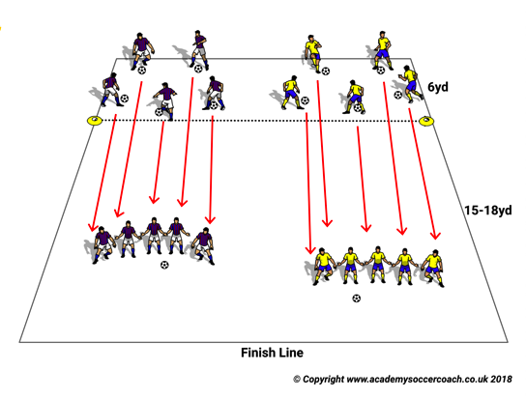
Ball Mastery (bm13)
Purpose: To Improve Touch.
SET UP
Groups of 4/5 players with a ball each.
End Line 15-18 yards away.
ACTION
V1:ACTION.
Juggling competition, if ball dropped, start again.
One bounce, after 10, first team over end line wins.
MAKE HARDER
V2 Same but no bounce
V3: After designated number juggles (Can allow one bounce or no bounce). Team tries to take ball over end line together. If Ball bounces starts again.
COACH TIP TO PLAYER
Try to get your eyes up occasionally and be aware of what’s going on around you.

Slide 14
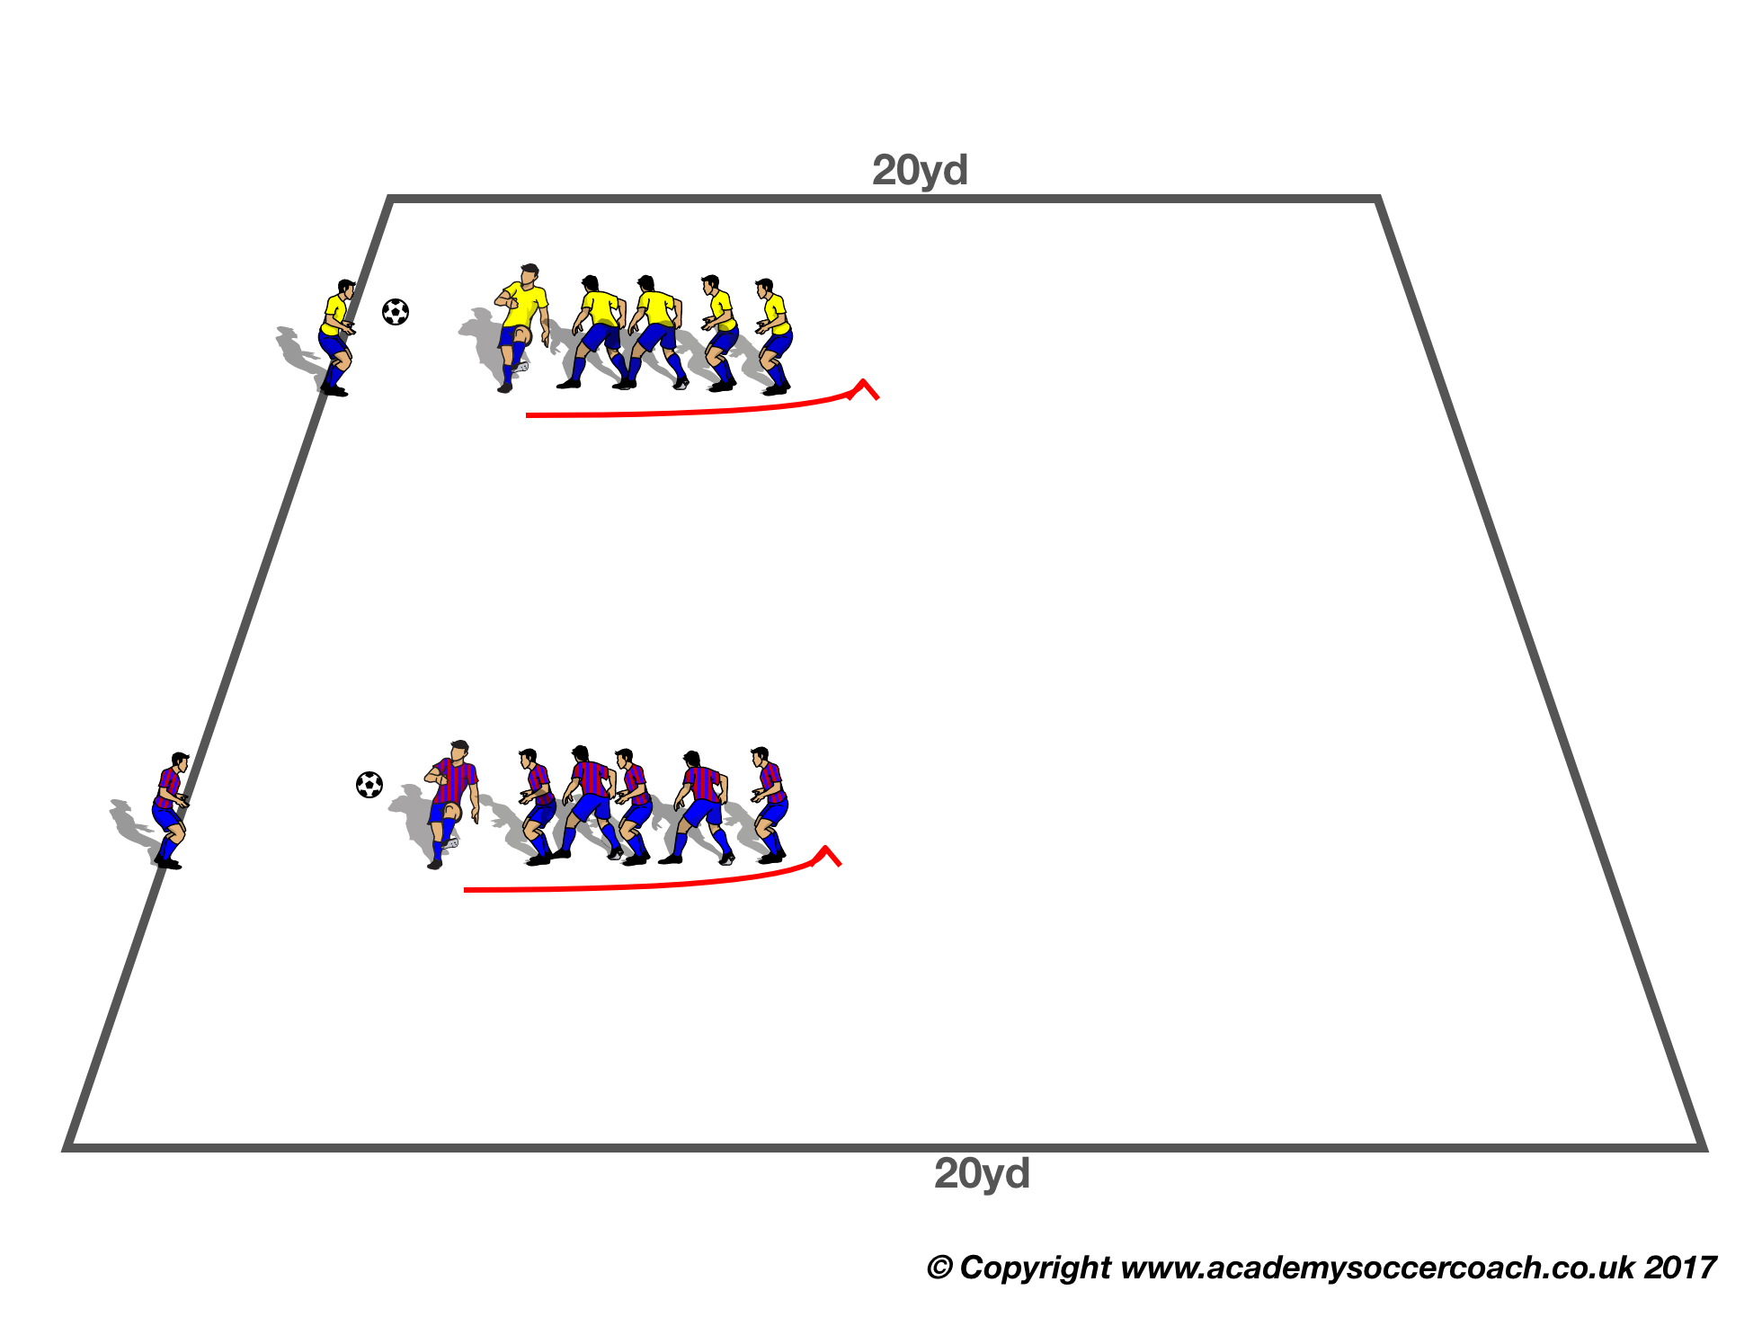
Ball Mastery (bm14)
PURPOSE
To develop Ball Feeling through the Ball Mastery curriculum (For Phase 3 & 4 Age Groups Only)
SET UP
Groups of 4 or 5 players , one ball per group.
End line 20/25 yards away.
ACTION
Heading backwards, if ball dropped, start again.
COACH’S TIP TO PLAYER
Head upwards so easier for your teammate.

Slide 15
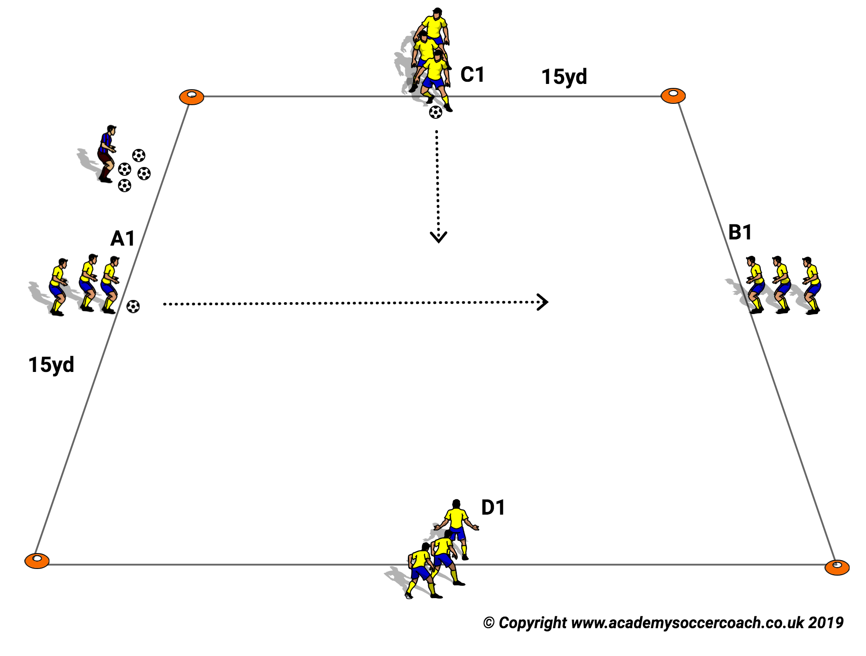
BALL MASTERY (BM15)
PURPOSE: To develop Ball Mastery through quick repetition.
SET UP
In a 15 x 15 yard area Groups of 3/4 players with a ball each. The first player of A & C group with a ball
ACTION
V1 : Players run across the area alternately ,doing “Messi Taps’ .
V2: Same action but use Ball Mastery Moves :
Toe Taps/Single cuts/Dribble Cut
Make Harder
Game Moves to use: Drag Push & Scissors
V3: Now the Coach designates a Game Move in each half
V4: Same Action but Coach designates one Game Move ( Player repeats 4,5,6 of that Feint Move as they go across).
Coach Tip to Player
Eyes up occasionally.

Slide 16
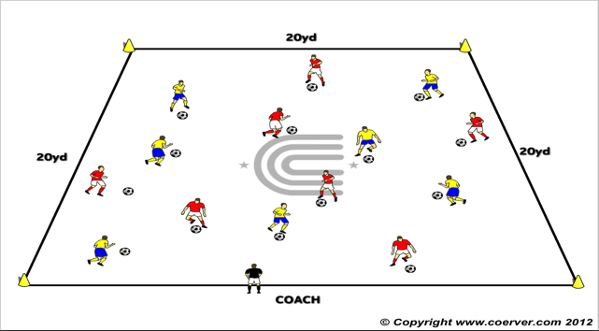
Ball Mastery (BM16)
PURPOSE: To improve the Game Moves by repetition.
SET UP
A 20 x 20 grid marked with 4 cones at the corners.
Two teams of 5 or 7 or 9 players with a ball each dribbling in the grid.
ACTION
FEINTS
SIDE STEP
SCISSORS
DRAG PUSH
CHANGE OF DIRECTION
INSIDE CUT
OUTSIDE CUT
STOP/START
STEP ON
HIGH WAVE
V1: The players dribble around the grid and the Coach calls out a Move Label. The player makes that Move, and accelerates away
Make Harder
V2 :The players dribble around the grid and the Coach calls out a Move Label. The player makes that Move, When the coach calls an odd number, players leave their ball and group together according to number called.
COACH TIP TO PLAYER
Accelerate after the Game Move.

Slide 17
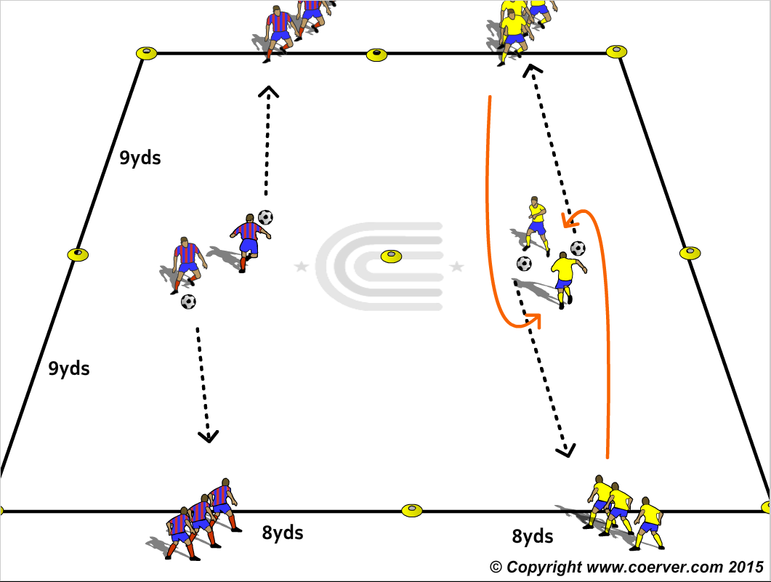
Ball Mastery (BM17)
PURPOSE. To improve Ball Mastery Moves and Game Moves.
SET UP. Teams of 3 or 4 players with a ball to each team lined up opposite each other in 8 x 18 yd lanes.
ACTION.
Ball Mastery Moves to use:
Sole Taps/Toe Taps/Single Cuts
V1: Each player uses a Ball Mastery Move to go around their opposite teammate at mid point of lane and pass to their next team mate and rejoin the team.
V2 Opposite players go towards each other and before they meet they do a Game Move to go past each other ,then they pass to the next player and join the end of that line
Game Moves to use:
Drag Push
The Side Step
The Scissors
The Chop
COACH TIP TO PLAYER.
When receiving try for a good first touch to take the ball on the run.

Slide 18
All rights reserved.
No part of this booklet may be reproduced in any form or by any means, electronic or mechanical, including photocopying without permission in writing from the author except for brief extracts for purposes of review only.
The word COERVER® and the COERVER® COACHING LOGO are registered trademarks of Sportsmethod Ltd. And Sportsmethod Asia Ltd.

