Slide 1

Small Sided Games (SSG)

Slide 2
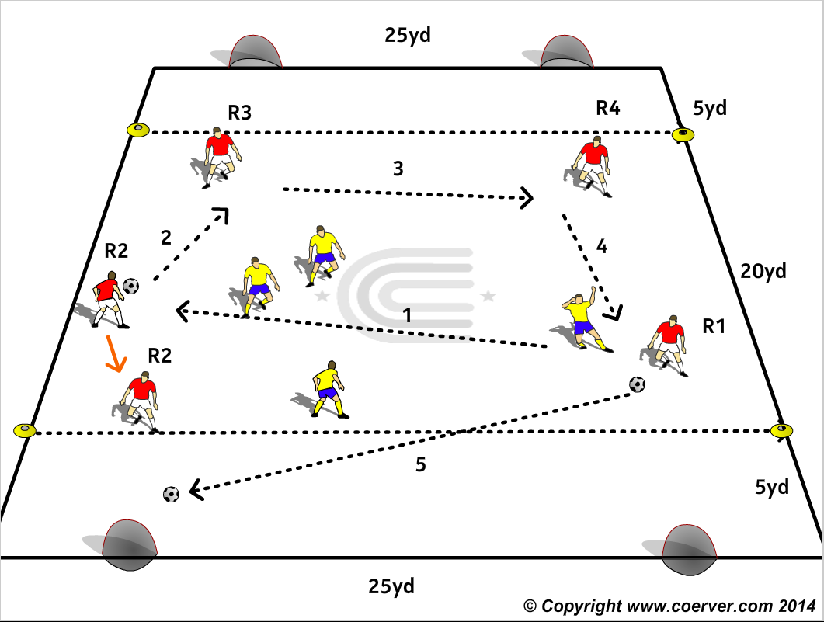
SSG1
Purpose: To Improve the “Killer Pass” & the “Killer Run”
SET UP
A 30×25yd field. Players play 3 v 3, 4 v 4 in the 25 x 20yd middle zone.
ACTION
After a minimum of 3 consecutive passes, the team in possessions can score in either goal by passing into the shooting zone to one of their players who is making a run (note: defenders may not go into either end Zone)
MAKE HARDER
1. Add an extra neutral player who plays with the team who has the ball.
2. Shooter must score 1 Touch.
3. Increase the minimum number of passes according to the players’ abilities.
COACH TIP TO PLAYER
Try to not get offside and don’t enter the shooting zone until the pass is made.

Slide 3
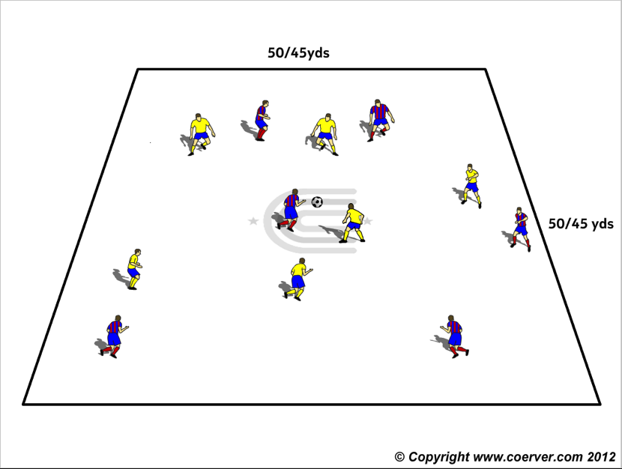
SSG2
Purpose: To encourage players to win, then keep possession as long as possible.
Set Up Field of 50 x 50 yds. or adjusted according to age and ability of players. Two teams of 6/7 players.
Action
Teams play keep away to a total of 25 passes for any team.
Passes do not have to be consecutive but must be intentional, not rebounds or deflections, and must be received under control by a team mate to count.
Teams forcing the ball out of play get possession at the restart.
Coach counts passes out loud so everyone knows the score.
MAKE HARDER
1.Teams play two touch soccer to 25 passes.
2. Teams play to 15 wall passes.
COACH TIP TO PLAYER
Make passing, moving and calling a habit. Good communication is vital.

Slide 4
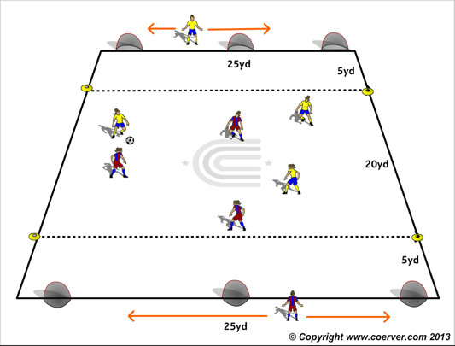
SSG3
Purpose: “Think Forward, Look Forward, Play Forward”.
SET UP
A 30 x 25yd field with three small goals and a 5 yard shooting line in front of them at each end.
ACTION
Teams play 3v3 ( 4v4 ) in the middle 20x25 yard Can shoot from anywhere.
A player from each team plays behind their team’s goal line, if they stand behind any goal the opponents cannot score in it.
V 1: End player GK
Make Harder
V2: 3 v 3 , 4 v 4 End Player both GK & Fastbreak player (Switch with passer).
COACH TIP TOPLAYER
Players with the ball look beyond your opponents to where the Sweeper Keeper is and his movements.

Slide 5
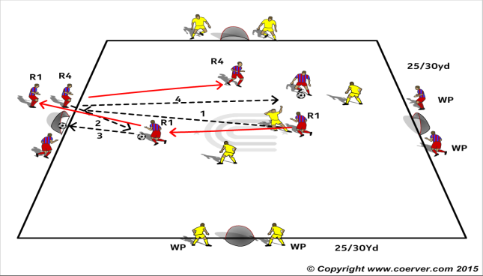
SSG4
Purpose: to encourage one touch finishing.
SET UP
A 30 x 30yd area with 4 small goals on each side.
Red Team plays E & W and has two players positioned either side of their two small goals.
Yellow play N & S and also have two players positioned by the side of their two goals.
ACTION
The perimeter players by the goals only have one touch each time they play the ball and try to set up their team mates to score.Reciever can take up one touch or finish first time.
MAKE HARDER
V2 Same Game but now only one wall passer at each goal.
V3 End players start with a ball each; Shooter and end Player switch
COACH TIP TO PLAYER
The first player to the ball has the advantage of scoring, so focus all the time.

Slide 6
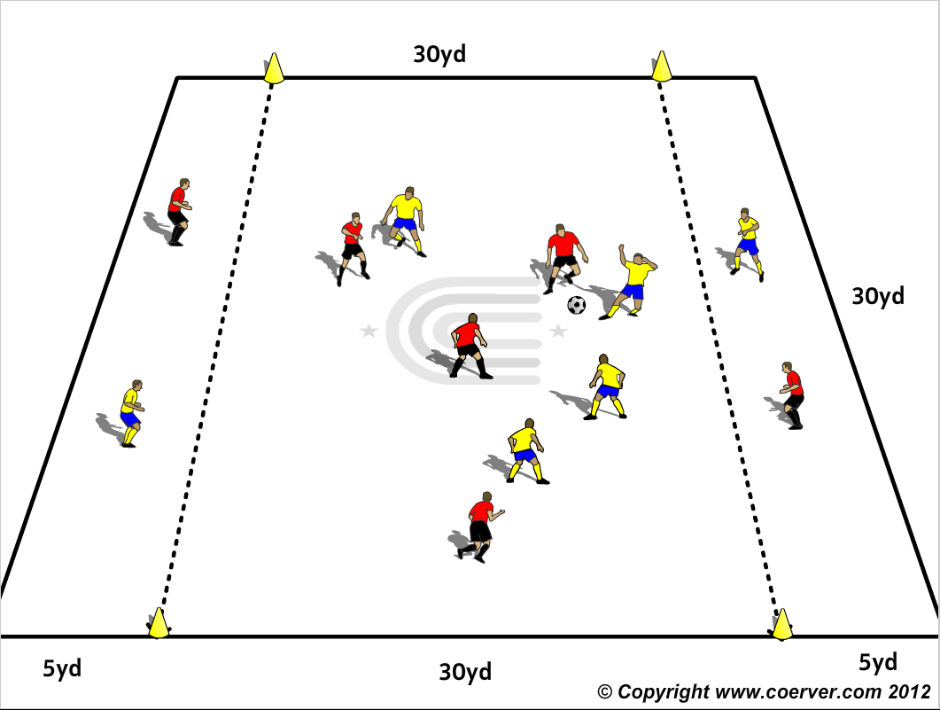
SSG5
Purpose: To improve Fastbreak Attack.
SET UP
A 40 x 30 area with two 5yd passing zones at each end of the 40yd length.
Teams of 6 or 7 players.
ACTION
Teams have one player in each of the passing zones and the rest play 3 v 3,4v4 in the middle 30 x 30yd zone.
The Middle players combine and try to pass to end zone player and switch with that player and the released player tries to take the ball or combine with team mates to release teammate in opposite passing zone.
Balls going out of play go to the pressing team.
MAKE HARDER
The two end player now become defender, when opponent has ball they defend the first line to cut out passes to the other player in the zone who goes to back line to receive from the team in possession
COACH TIP TO PLAYER
Look for the forward pass, but if it is not on, be patient and keep possession and probe for an opportunity for a Killer pass.

Slide 7
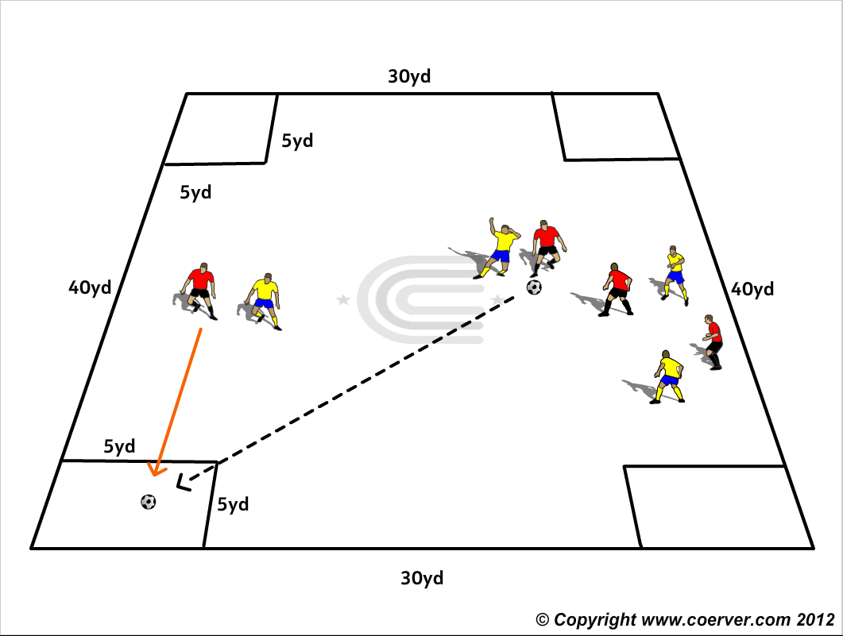
SSG6
Purpose: To improve decision making and the Killer Pass.
SET UP
A 40 x 30 area with 4 8 yard boxes marked by cones in each corner.
ACTION
Teams play 4v4 or 5 v 5 and try to pass into one of the corner boxes for a team mate to run onto. Opponents cannot enter the box the ball is passed to.
Make Harder
Player in box must play a first touch pass to any teammate.
COACH TIP TO PLAYER
Don’t force things. Be patient, try to keep possession and probe for a good opening for a Killer Pass.

Slide 8
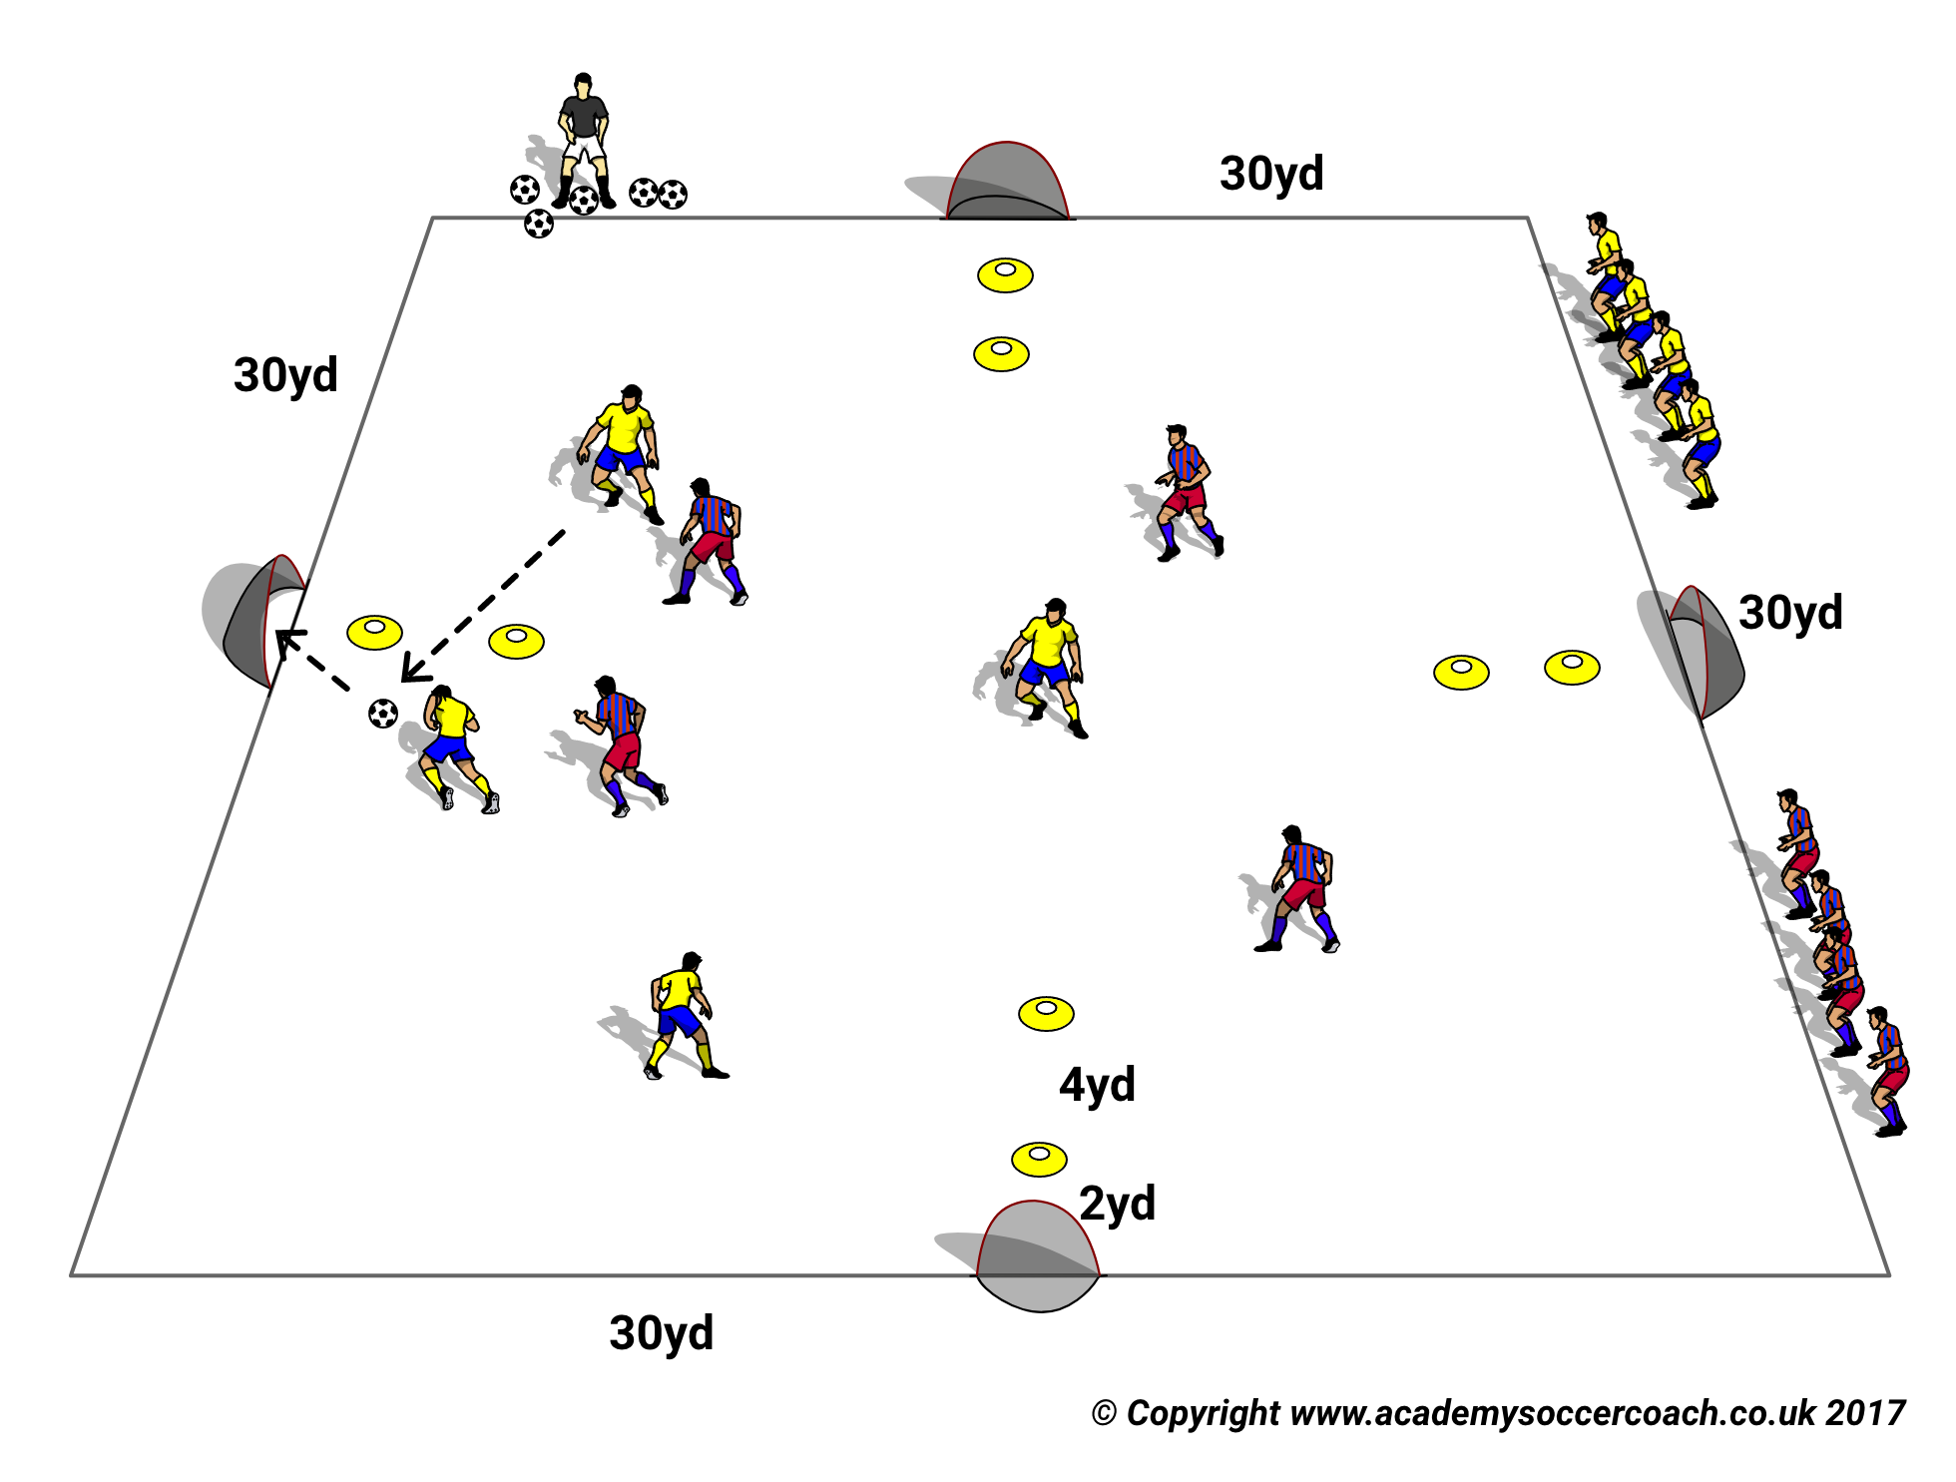

SSG7
Purpose: To Improve both attacking & Defending Turnovers.
SET UP
A 30x30yd field with 4 small goals on each side with a 4 yd cone gates 2yds in front of them.
The Coach with a supply of balls.
ACTION
Teams play 3v3 - 6v6 according to the players’ abilities.
Teams can only score by passing through the gate in front of any goal for a team mate to finish 1 touch.
If the ball goes out of play the coach supplies a new ball to the pressing team.
MAKE HARDER
3 point goals are awarded for goals scored from a pass through a gate for 1. A 1 touch volley or 2. a.header from pass through a gate.
6 points awarded for 1. A diving header (at the coach’s judgment ) or 2. A a second header from a team mate to another team mate to score.
COACH TIP TO PLAYER
Encourage players not on the ball to look for scoring positions at gates.

Slide 9
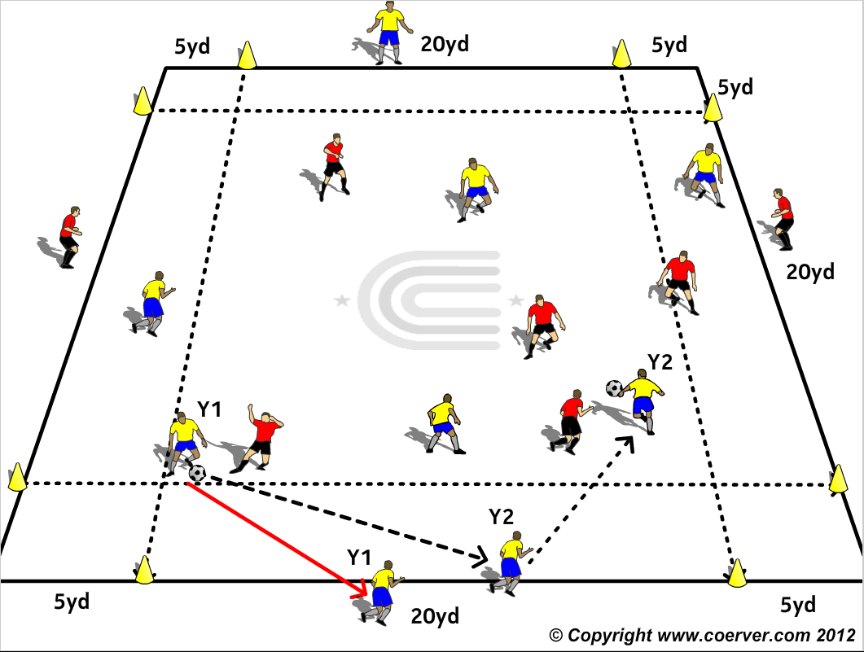
SSG8
Purpose: To encourage & Improve Fastbreak Attacks.
Set Up A 30 x 30 yd. area with 5yd zones marked on each side with cones. Two teams of 4,5 or 6 players on the field according to their abilities to handle the area. One team Y Yellow plays N/S and the R Red team plays E/W. Each team has a Break Out player on each of their end lines.
Action The teams play 5v5, 6v6 in the grid and try to feed and release their break out player from either end and the passer takes their place.
If the Break Out player is blocked he can play back to the passer on the line and take his place again but this can only be done once and then the attacking team must go to the opposite end and release their other Break Out player.
The Break Out players can only receive in the 20 yd. area in the middle of their end line and must be mobile on the end line to make good angles for their team mates and release themselves off the line with a positive first touch.
Make Harder: Passers can only pass within the 5 yd. passing zone and each end. This demands good movement along the end line by the Break Out players to help their team mates with an angled pass and immediate release on to the field.
COACH TIP TO PLAYER Break Out players should know where they are going and have a positive first touch to get the attack towards the opposite end started.

Slide 10
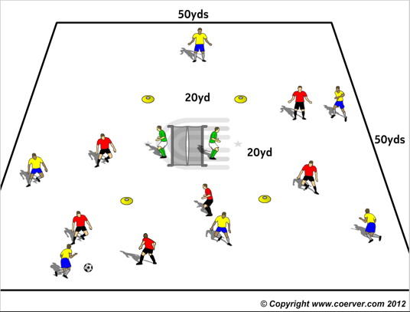
SSG9
Purpose: To Improve first time finishing.
SET UP
A 40x40 or larger field with two goals back to back in the middle with a GK in each goal. 4 cones mark a 18x20yd box around the goals.
ACTION
Teams of 5/6 players try to score on either goal but they cannot shoot inside the box around the goal, except with a one touch finish or a header.
First team to set score wins. One GK defends both Goals.
Make Harder
Now GK in each Goal.
COACH TIP TO PLAYER
Follow up shots.

Slide 11
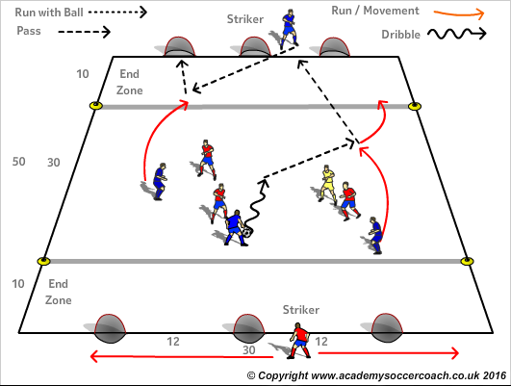
SSG10
Purpose: “Think Forward, Look Forward, Play Forward”
SET-UP
3v3 + 1 Neutral player (who plays with team in possession), in the middle zone.
No defenders in end zones.
1 striker from each team plays behind the end zone.
Striker has only "1 touch" to pass back to teammate.
ACTION
Blue players are trying to find their striker behind the end zone and combine with a 1 touch wall pass, and a 1 touch finish.
COACH TIP TO PLAYERS
Communicate and move into space as soon as you pass.

Slide 12
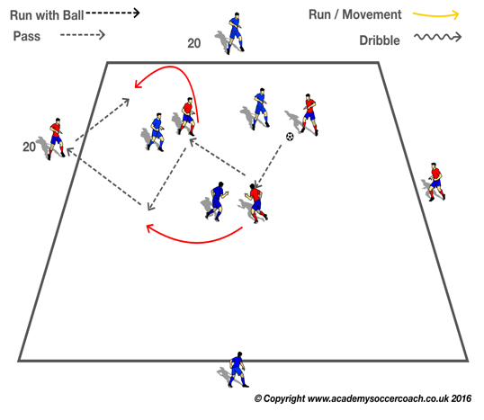

SSG11
PURPOSE: To show the Coerver Team Styles. Fast break Attack & Effective Possession.
SET-UP
30 x 30 yard Area. 3 v 3 in the area plus End players.
ACTION
Reds east and west, blues North & South. Reds play” Fast Break Attack”, passer switches with end player, the Blues play “Effective Possession, the end players are Goalkeepers/Strikers, with up to two touches to start attacks, or help keep possession.
COACHES TIP TO PLAYERS
Focus on your first touch “The Golden Touch” the better it is the more time & space you will have to decide “what's next”.

Slide 13
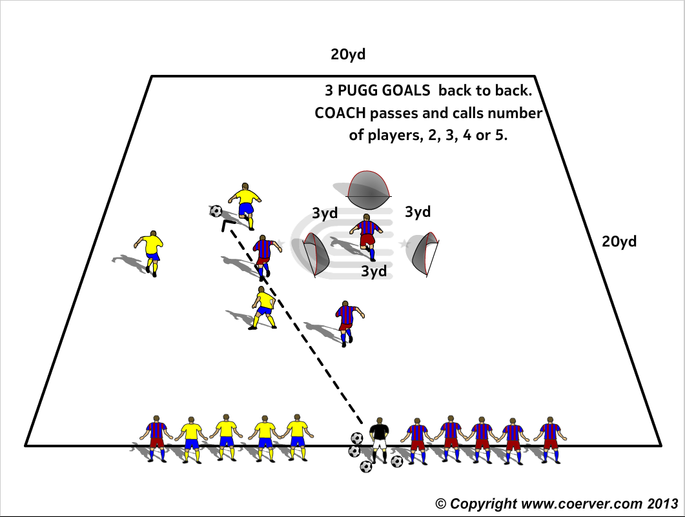
SSG12
Purpose: To encourage & improve quick combinations.
SET UP
A 20x20yd area with 3 goals (or tall cones) 3yds apart in the center in a triangle facing outwards.
Two teams lined up on one side of field on either side of the coach with a supply of balls.
ACTION
The Coach passes a ball onto the field and calls number of players to play, 2, 3, 4 or 5 and players from each team sprint out to get possession and try to score on one of the goals (if tall cones from outside to in)
Make Harder
Teams can score with 6 consecutive passes or a regular goal.
Teams get three goals for 1. A one touch goal finish. 2. A one touch volley finish. 3. A header finish.
COACH TIP TO PLAYER
Keep calling and moving and looking for finishing positions when not on the ball.

Slide 14
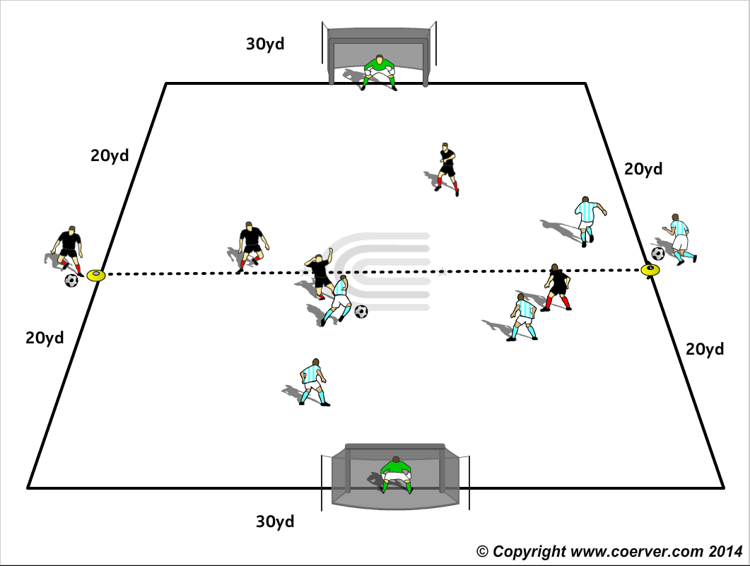
SSG13
Purpose: To encourage fast direct play.
SET UP
In 40 x 30 yard area 4 v 4 with GK’s. An additional player of each team with a ball on the
halfway line.
ACTION
Sides play 4 v 4; any player on the ball can dribble it out, which then signals player on
halfway line to enter with his ball. Dribbler who runs ball out, takes halfway line position.
Make Harder
Replace big goals with mini goals in corners.
GK has to defend both goals.
COACH TIP TO PLAYER
Try and take opponents away as you either field to give your teammate on halfway line a fast break on goal.

Slide 15
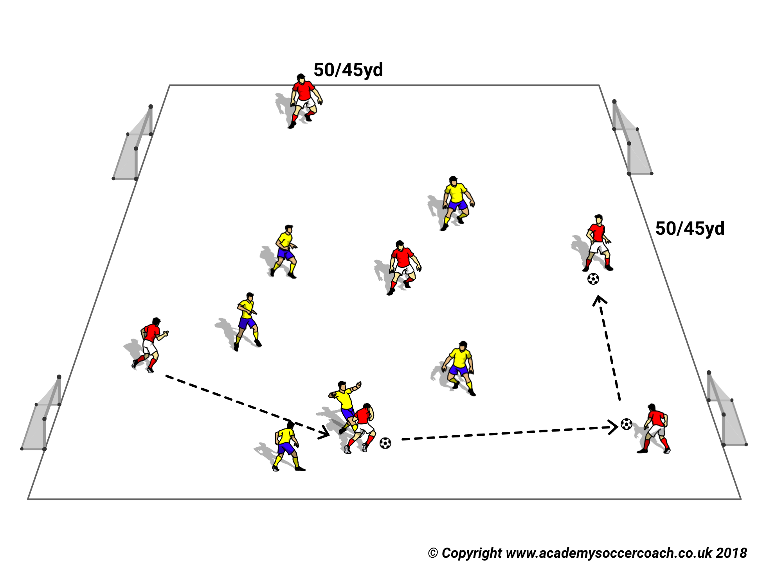

SSG14
Purpose: To improve possession football.
Set Up
Field of 50 x 50 yds or adjusted according to age and ability of players. Two teams of 6/7 players.
Action
Teams play keep away to a total of 30 passes for any team.
Passes do not have to be consecutive but must be intentional, not rebounds or deflections, and must be received under control by a team mate to count.
Coach counts passes out loud so everyone knows the score.
NB. Teams forcing the ball out of play get possession at the restart.
MAKE HARDER
1. Teams play to 20 1-2 wall passes.
2. Teams play2 touch soccer to 20 nonconsecutive passes.
3. Teams must make minimum number of passes before scoring on any goal.
4. Teams must make minimum number of passes before scoring on only 2 goals at one end.
COACH TIP TO PLAYER
Communication within a team is vital. Get used to calling to teammates and receiving instructions from them in the flow of the game.

Slide 16
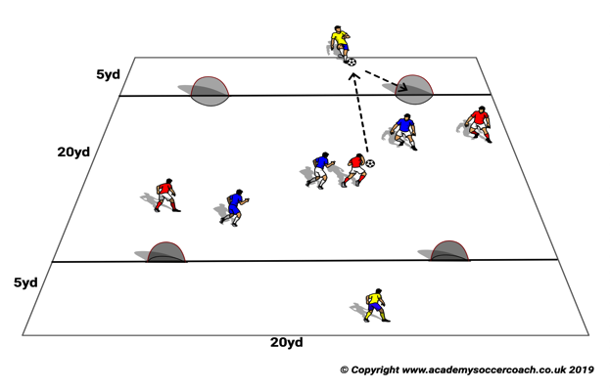
SSG15
Purpose: To Improve Attacking & Defending.
SET UP
3 v 3 in middle Zone. A yellow striker in each end Zone, Goals facing out.
ACTION
V1: After 3 consecutive passes the team in possession tries to pass for either yellow striker to finish first time.
MAKE HARDER
V2: Now add Red & Blue striker in each end Zone. They can not tackle each other but can block the shot of the other.
Strikers must finish first time.
COACH TIP TO PLAYERS
Middle players look constantly up to see where strikers are moving to.

Slide 17
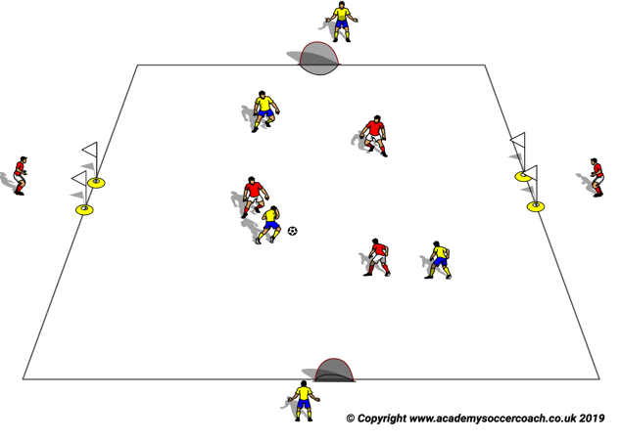
SSG16
Purpose: To Improve Attacking & Defending.
SET UP
4 v 4 in 30 yards x 30 yards.
ACTION
Red Players going east to west,; they must play a one two pass through the flags to score
Yellows North to South, shooter has up to two touches to score; end yellows only have one touch.
MAKE HARDER
Turn mini goals north & south outwards. Striker must finish first time.
COACH TIP TO PLAYERS
Players on perimeters dont stand in one spot, move around constantly.

Slide 18
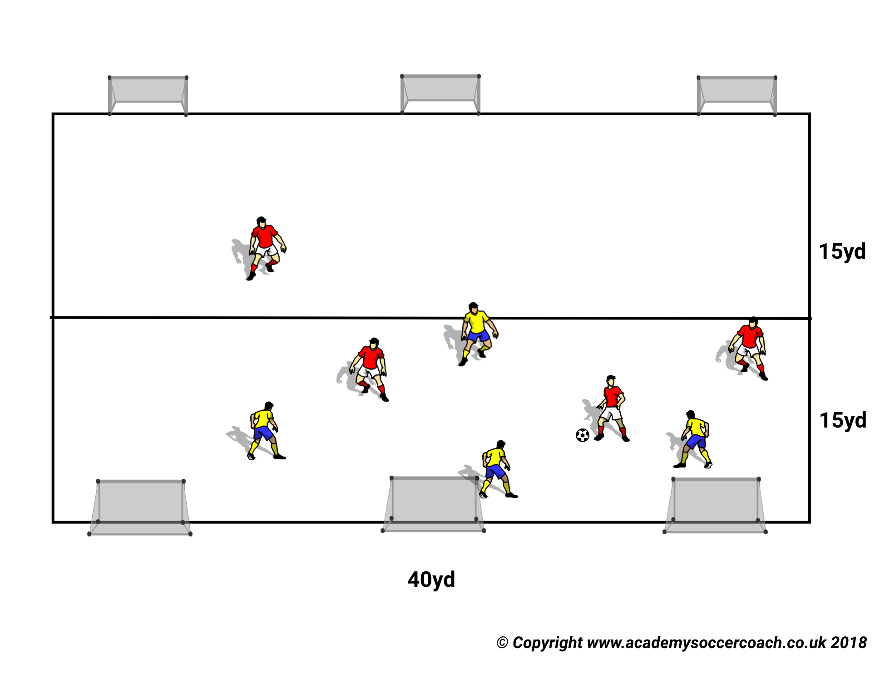
SSG17
Purpose: to improve attacking & defending.
SET UP
A 40×30yd field.
ACTION
Players play 4 v 4 and can shoot from anywhere. No GK.
MAKE HARDER
Players can only shoot in the opposition half.
COACH TIP TO PLAYERS.
Just encourage & focus on safety points e.g. tackling.

Slide 19
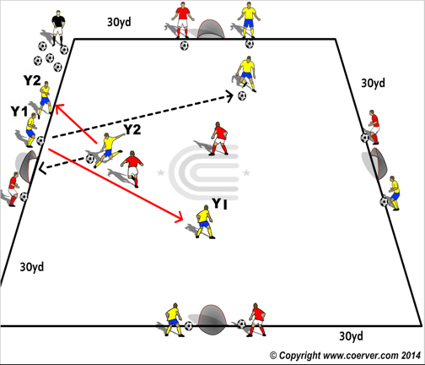
SSG18
PURPOSE: To improve finishing.
SET UP
A 30x30yd field with 4 small goals at the mid point of each perimeter line. A player from each team positioned on either side of the goals with a ball each.
ACTION
Teams play 2v2 or 3 v 3 in the middle and players can score on any goal. Shooter changes with his teammate by the goal that the shot is made at. His teammate passes to a teammate on the field and runs on as an outfield player. The end players can take two touches.
Make Harder
Now end players have to pass first timer
COACH TIP TO PLAYER
End players focus on the game and try and decide which pass you want to make as your teammate is about to shoot on your goal.

Slide 20
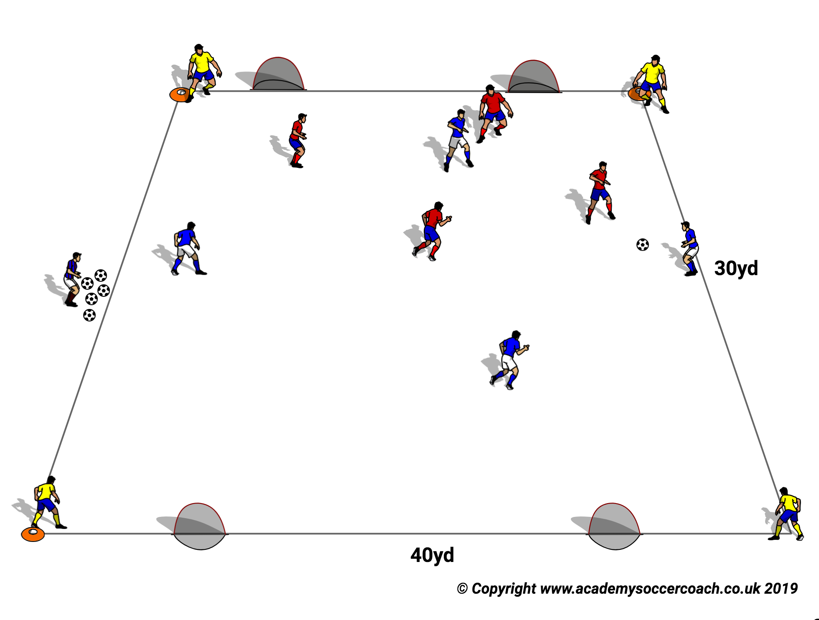
SSG19
PURPOSE: To improve team attacking & Defending.
SET UP
4 v 4 v 4 in 40 x 40 yard area. Blues start v Reds, one yellow in each corner
ACTION
The team in possession play with corner players.
When one team scores the losers go into the corners and the Yellow's come on and play the winners.
The winners have to attack the opposite Goals.
MAKE HARDER
Goal can only be scored with first time finish.
COACH TIP TO PLAYER
Be alert and play quickly.
.

Slide 21
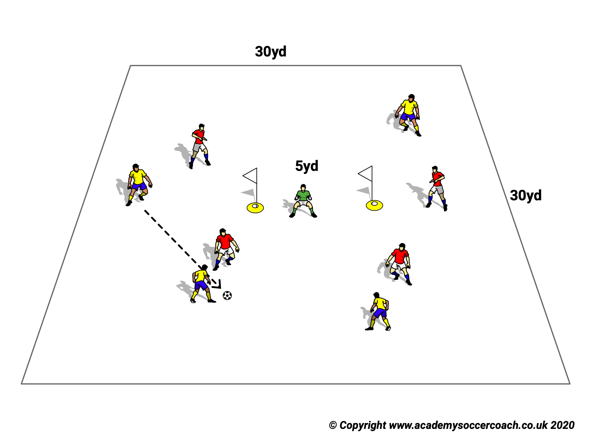
SSG20
Purpose: To Improve finishing.
SET UP
A 30x30 or larger field with a goal marked by tall cones or flags. In the middle with a GK.
ACTION
Teams of 5/6 players try to score on either goal but they cannot shoot inside the box around the goal, except with a one touch finish or a header.
First team to set score wins. One GK defends both Goals.
COACH TIP TO PLAYER
GK should be the Coach, no challenges on the GK.

Slide 22
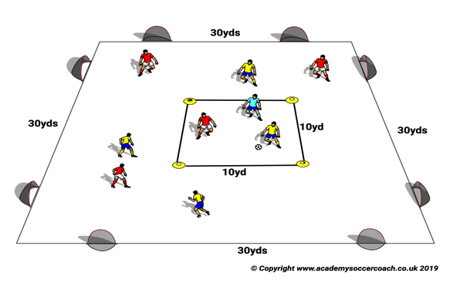
SSG21
Purpose: To Link Quick Combinations to the Killer Pass (Crucial to our Attacking Possession Team Style)
SET UP
1 v 1 + neutral player in middle box. Change middle square players regularly.
ACTION
V1 After 2 consecutive passes (with neutral player) middle player makes a pass to one of their strikers in outer box who has up to 3 touches to score.
Make Harder
V2: Outer Box strikers must finish first time.
COACH TIP TO PLAYER
Player without the ball constantly look for space and communicate.

Slide 23
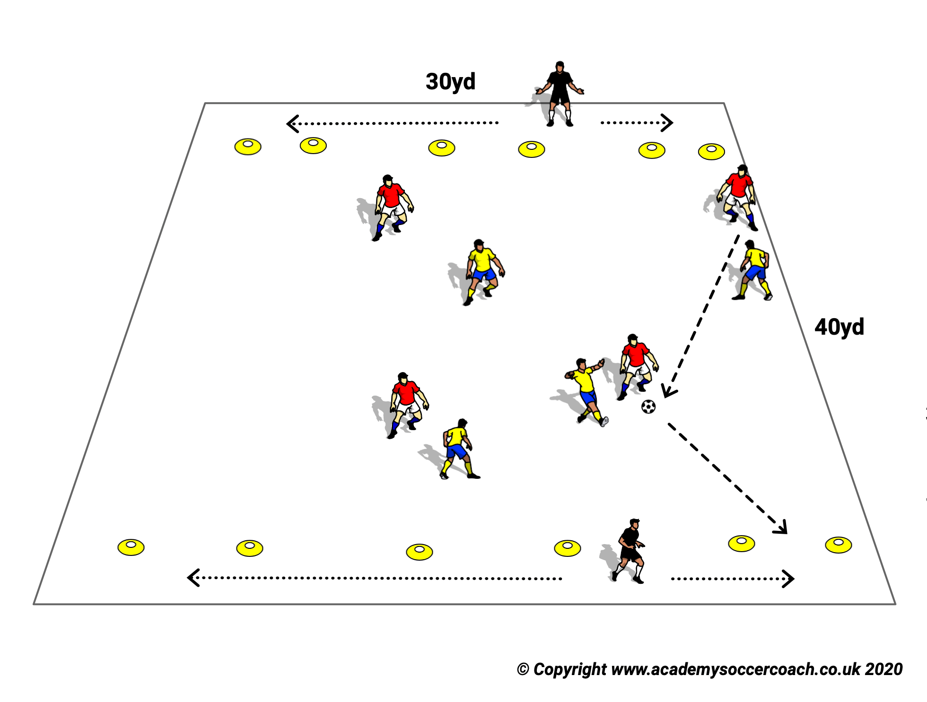
SSG22
Purpose: To Link Quick Combinations to the Killer Pass.
SET UP
4 v 4 + neutral players at each end line.
ACTION
V1 Neutral players play with team in possession. They have two touches.
Make Harder
V2: Neutral players play with only one touch pass.
COACH TIP TO PLAYER
Neutral players move along the line and focus on the game.

Slide 24
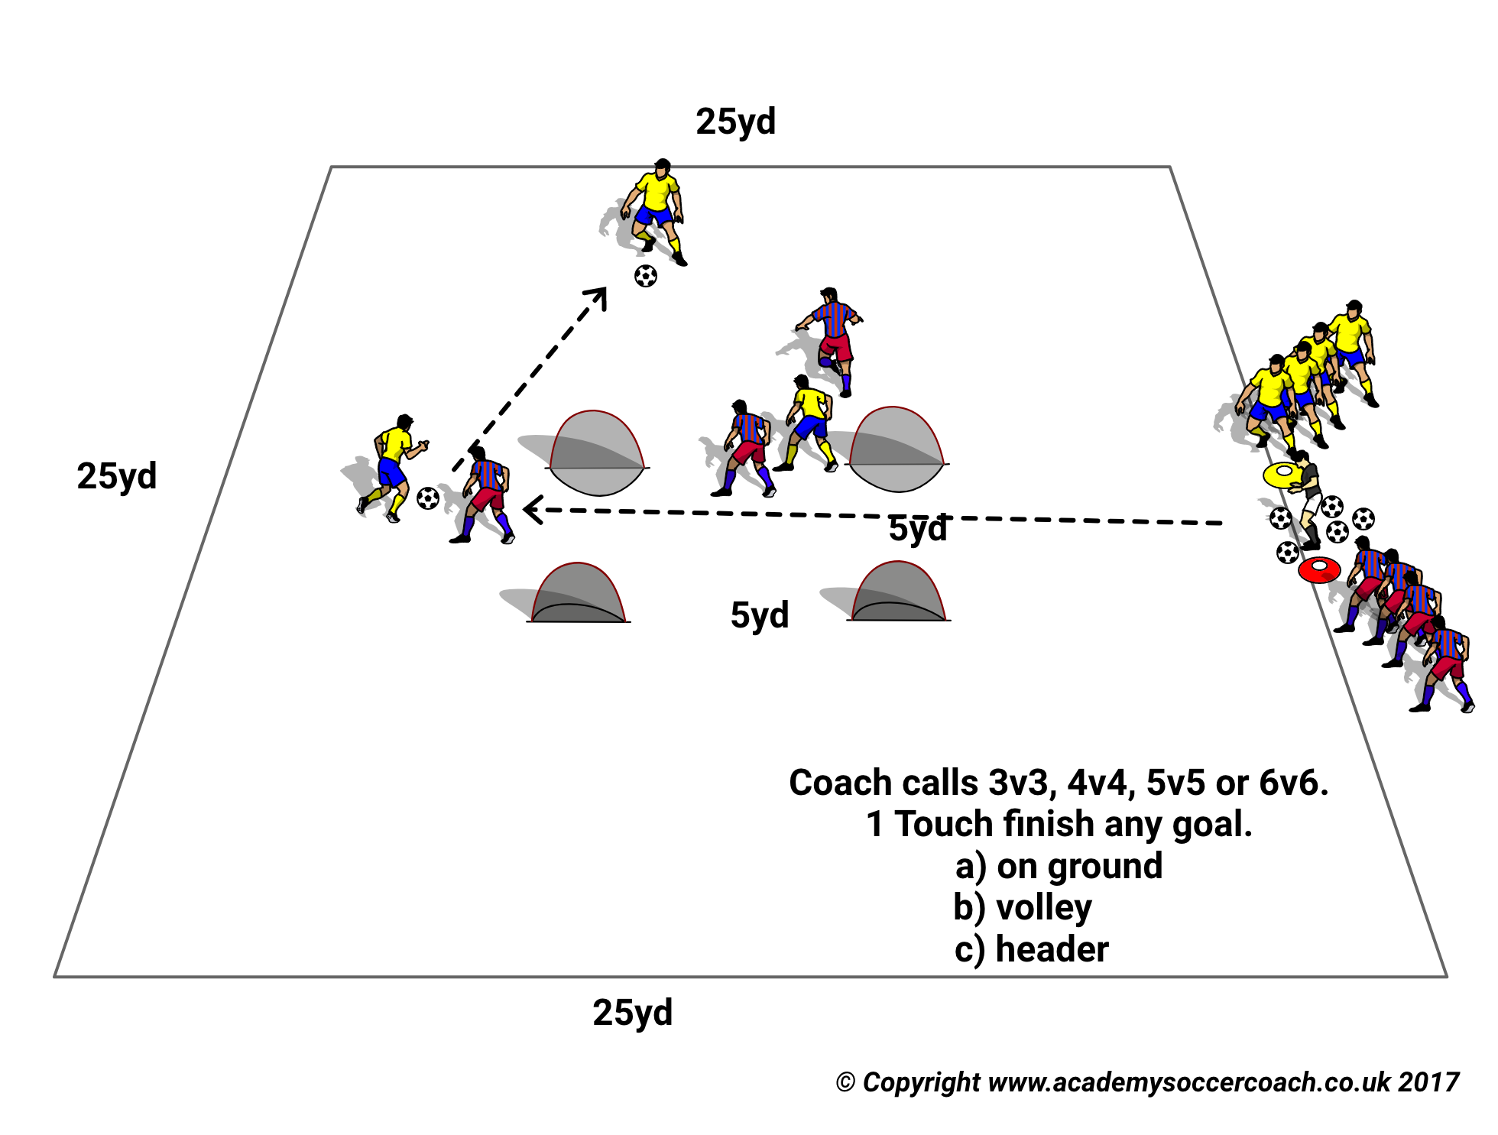
SSG23
PURPOSE: To develop 1 Touch finishing in traffic.
SET UP
A 25x25yd area with 4 small goals 5yd apart facing the outfield.
Coach with balls at mid line on one side of field with teams on either side of him.
ACTION
Coach calls 3, 4, 5 or 6 players from each team and they sprint on to the field to compete. Free number of touches.
Make Harder
Goal only if first time finish.
COACH TIP TO PLAYER
Coach your teaMmates when you’re not on the ball.

Slide 25
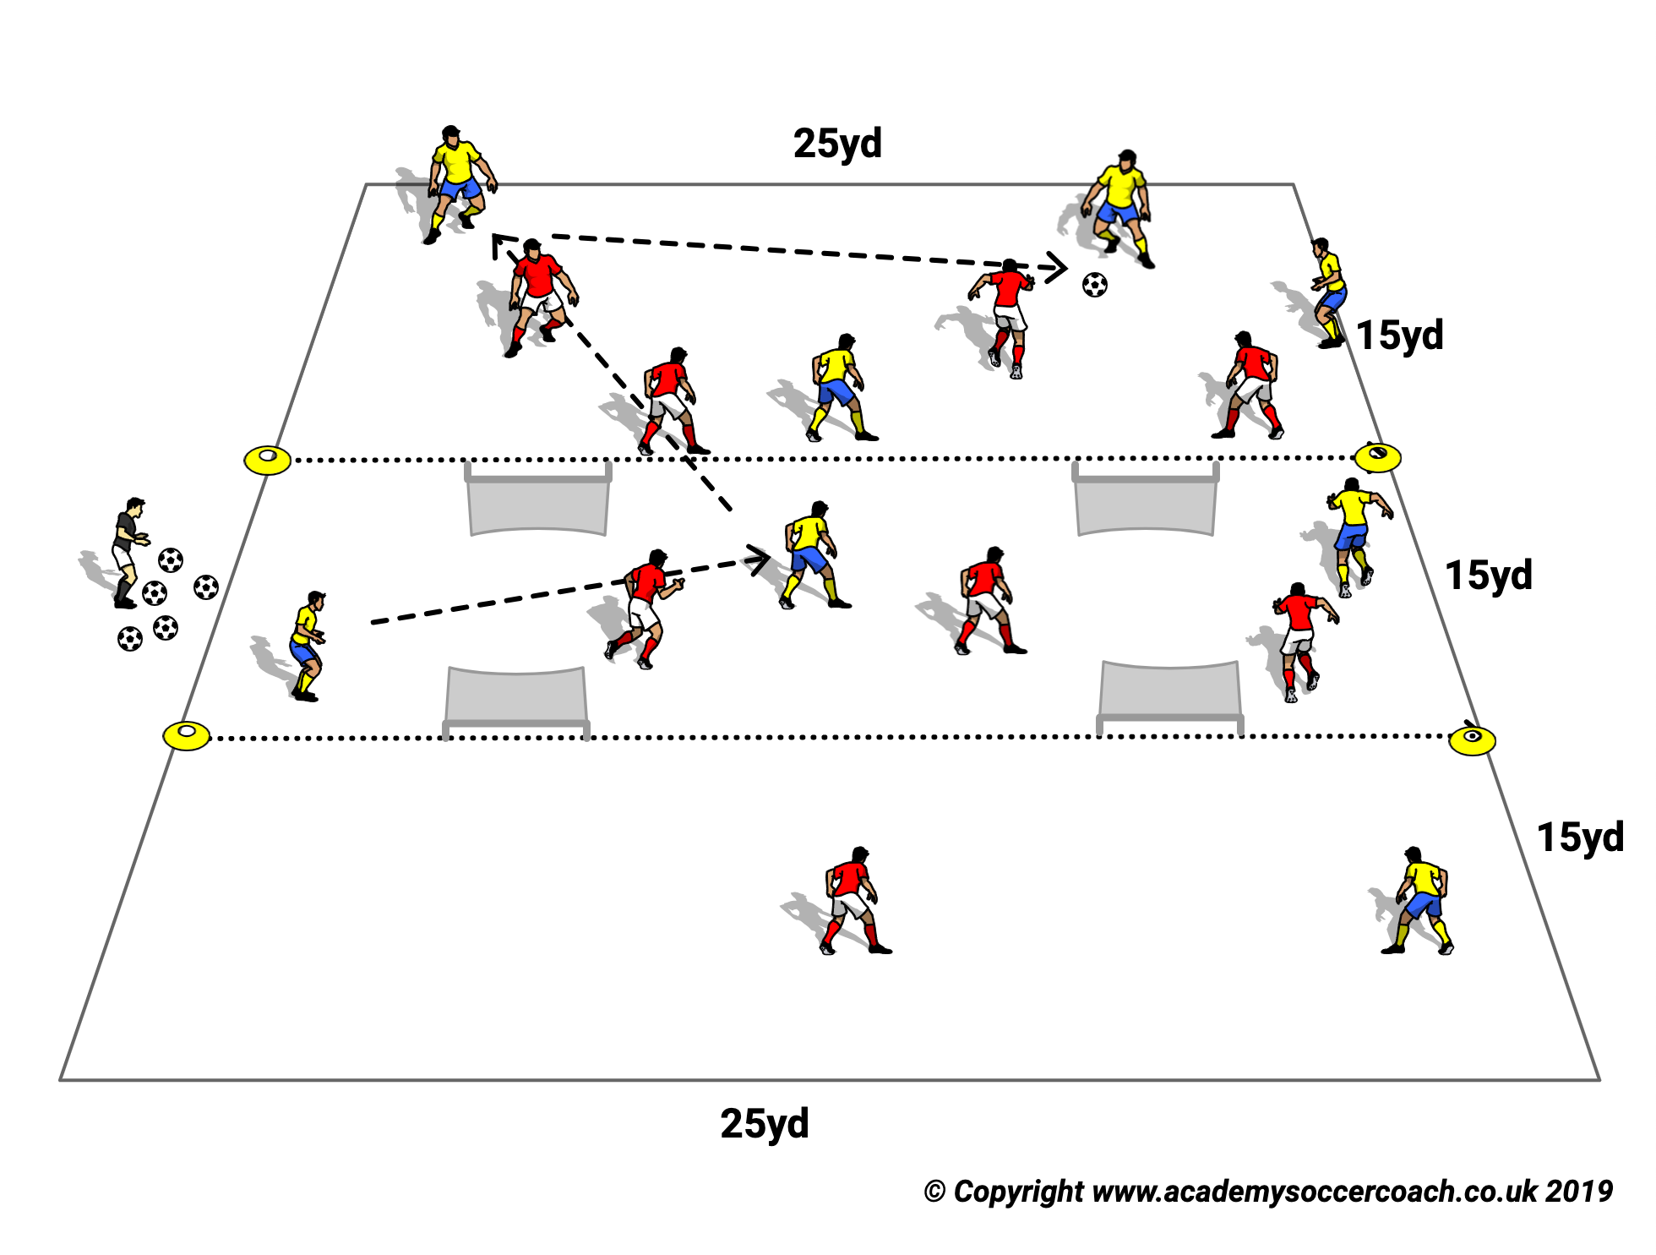
SSG24
PURPOSE. To Possess, Protect and Create and Convert one touch finishing.
SET UP
A field 45x25yd in 3x15yd zones marked by cones.
2 small goals on each end zone line12/14 yds apart facing outwards.
ACTION
Teams play 6/7/8 v 6/7/8 and try to score by
making 8/10 consecutive passes according to coach’s stipulation.
Shooting 1 touch into any of the small goals.
Play 4/5 minute games and keep scores to find the winner.
MAKE HARDER
Reduce number of players on one team by 1 or 2 players so that attackers have advantage.
Play for 4/5 minute games and keep scores.
Change team roles with the player advantage changing.
COACH TIP TO PLAYER
Once you lose the ball Try and win it back as soon as you can.

Slide 26
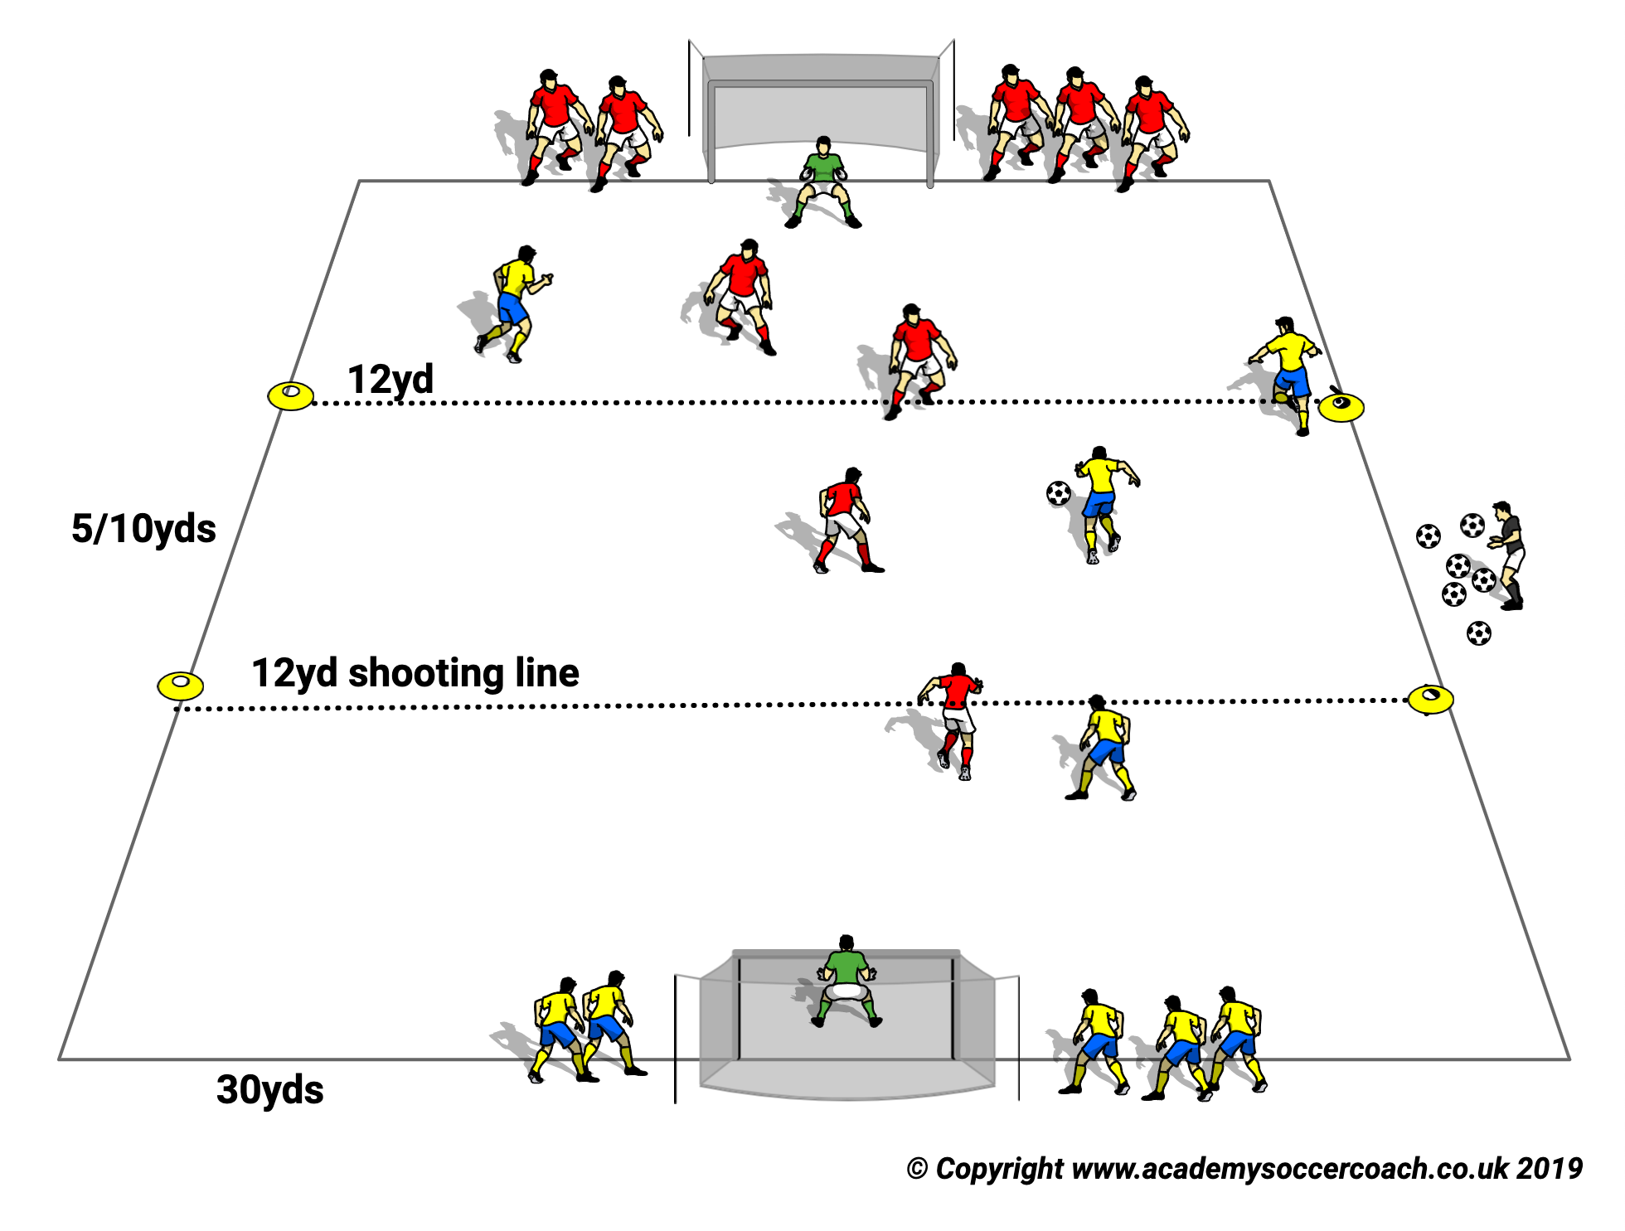
SSG25
PURPOSE: To improve 1 & 2 Touch Finishing.
SET UP
A 35/40 x 30 yd field with full size goals and GK at each end.
2 teams lined up either side of goals.
10 & 14yd Shooting lines marked by cones in each half.
ACTION
V1: Coach calls out number of players to enter the field e.g. 4. He passes to a player who passes 1 touch to an opponent and presses with teammates.
Teams score as follows.
Outside 12yd line. 1 touch finish = 3pts. 2 touch finish = 2pts.
Inside 12 yd must be 1 touch finish = 1pt.
Play game for 4 mins. Players can change on the fly when they get tired.
All players must press and counter press when out of possession.
Pressing team gets possession at restart whether they knock ball out or force an inaccurate pass.
Make Harder
V2: Each team has a WP in Attacking half and can only score from
Outside 12yds.
COACH TIP TO PLAYER
Try and keep your finishing low and accurate.

Slide 27
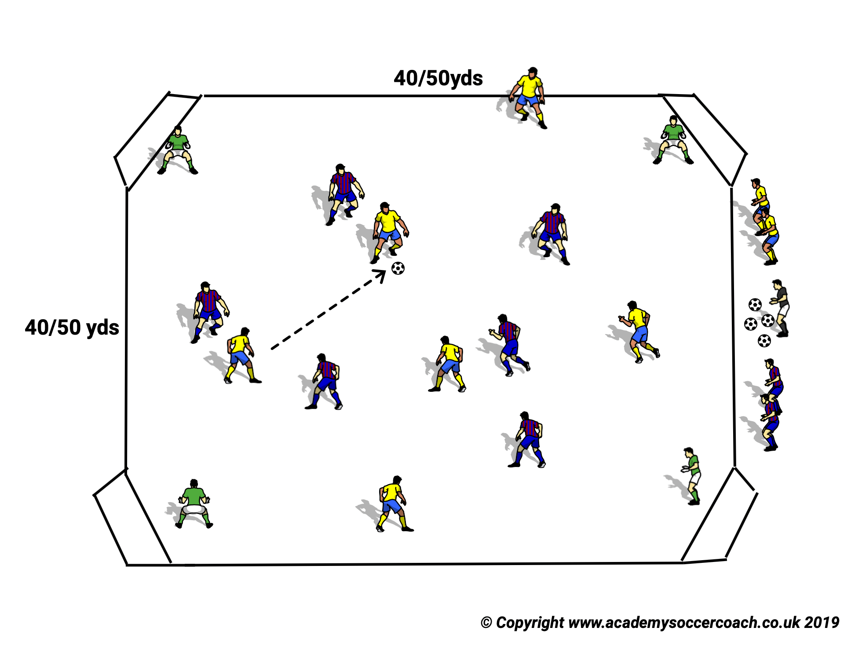
SSG26
PURPOSE. To improve pressing and 1 touch finishing.
SET UP
A 40/50x40/50 yd field according to the players ages and abilities.
4 full size goals with GKs cut off the corners of the field.
ACTION
Teams play 6 v 6 or 7 v 7
Teams can score by
accumulating 8(or more) consecutive passes which can include any of the keepers using their feet but their passes don’t count in the total. or
Scoring 1 touch in any of the 4 full size goals.
If GK saves he gives defending team possession.
If team scores it gets possession from the GK or coach.
MAKE HARDER
Take 1 or 2 players off a team and play for 4 minutes. Defending team can change on the fly when they get tired.
Change team roles and play again for 4 minutes.
Keep score. Winning team scores most goals.
COACH TIP TO PLAYER
When you win the ball look to keep possession and attack

Slide 28
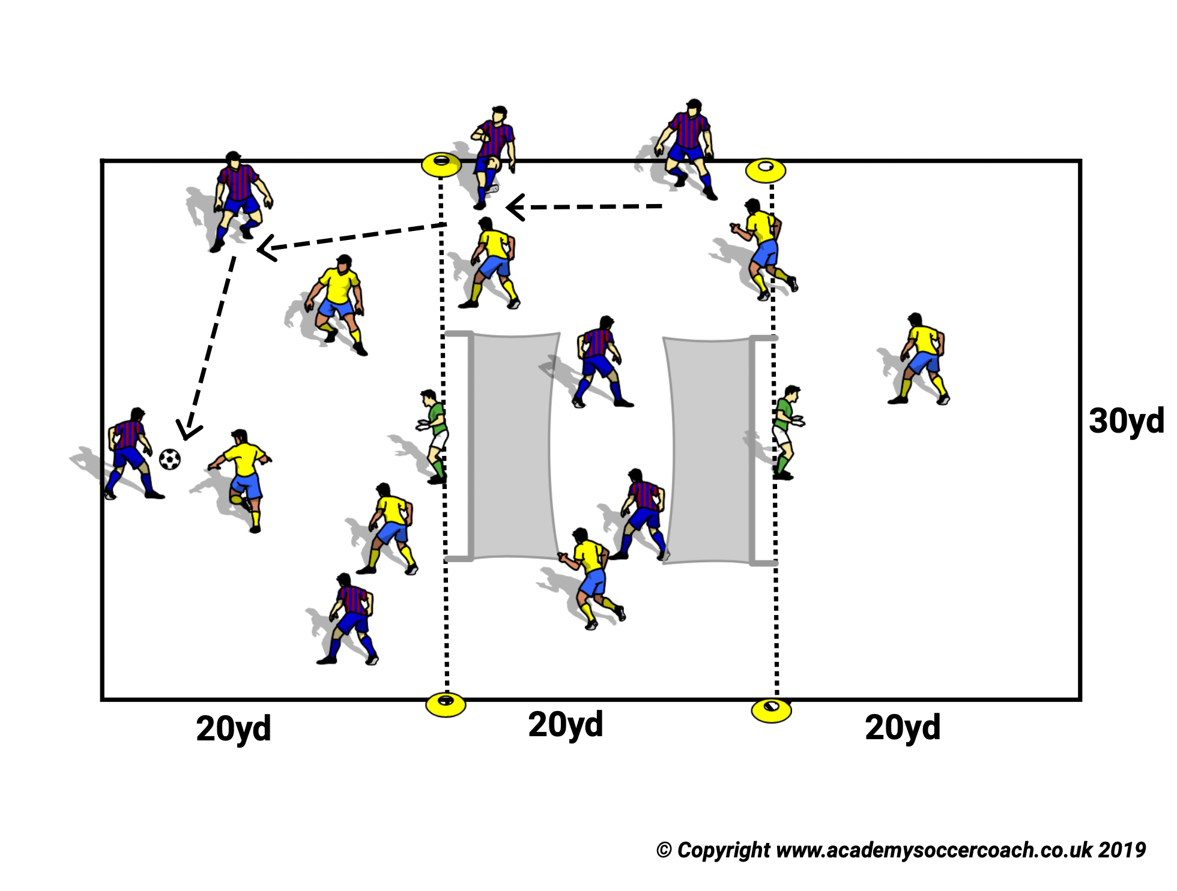
SSG27
PURPOSE: To improve possessing and probing skills and ability to create and convert goal chances.
SET UP
A 60x30y field split into 3x20 yd grids.
2 Full size goals with GKs are placed on 20yd lines facing outwards towards the end zones.
Teams play 6 v 6 or 7 v 7.
ACTION
Teams try to keep possession and accumulate 8/10/12 consecutive passes or score 1 touch in either of the two end zone goals.
MAKE HARDER. Coach has one team play 1 or 2 men down and keeps score for 4/5 minute game.
Reverse team roles and team that scores the most goals either by accumulating consecutive passes or 1 touch goals wins.
COACH TIP TO PLAYER
No challenges on the GK.

Slide 29
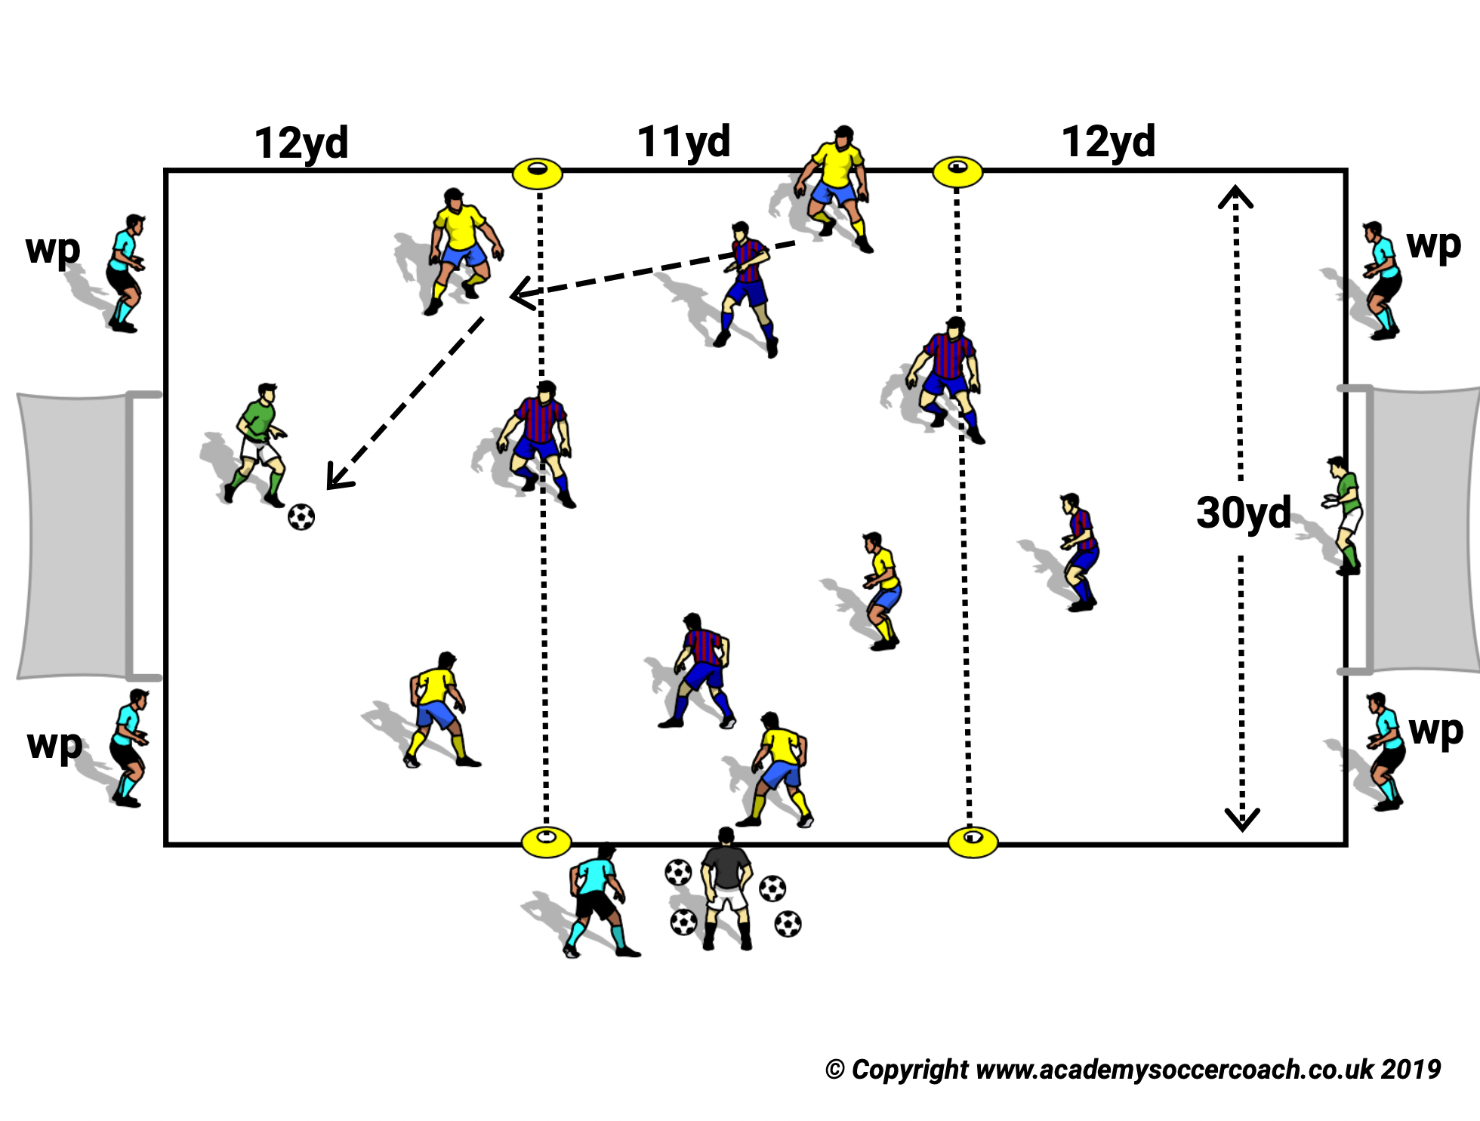
SSG28
PURPOSE: To increase GK role in and improve possession play and 1 touch finishing.
SETUP
A 35 x 30 Field with a full size goal an GK at each end.
12 yd shooting lines are marked by cones in each half.
ACTION
Teams of 4 or 5 players combine to score in opponents goal. If a team scores it keeps possession of the ball and now attacks the opposite goal.
Teams can also score by accumulating 8/10/12 consecutive passes according to coach’s instructions.
The accumulated passes must include a pass or passes from their GK or the score is not valid. The point is that when the GK joins in the possession play the attacking team becomes a man up.
Teams that press the ball out get possession at the restart even if they were last to touch the ball.
MAKE HARDER
Increase one team’s advantage by reducing the other team by 1 or 2 players.
COACH TIP TO PLAYER
GK communicate constantly with your teammates.

Slide 30
All rights reserved.
No part of this booklet may be reproduced in any form or by any means, electronic or mechanical, including photocopying without permission in writing from the author except for brief extracts for purposes of review only.
The word COERVER® and the COERVER® COACHING LOGO are registered trademarks of Sportsmethod Ltd. And Sportsmethod Asia Ltd.

