Slide 1
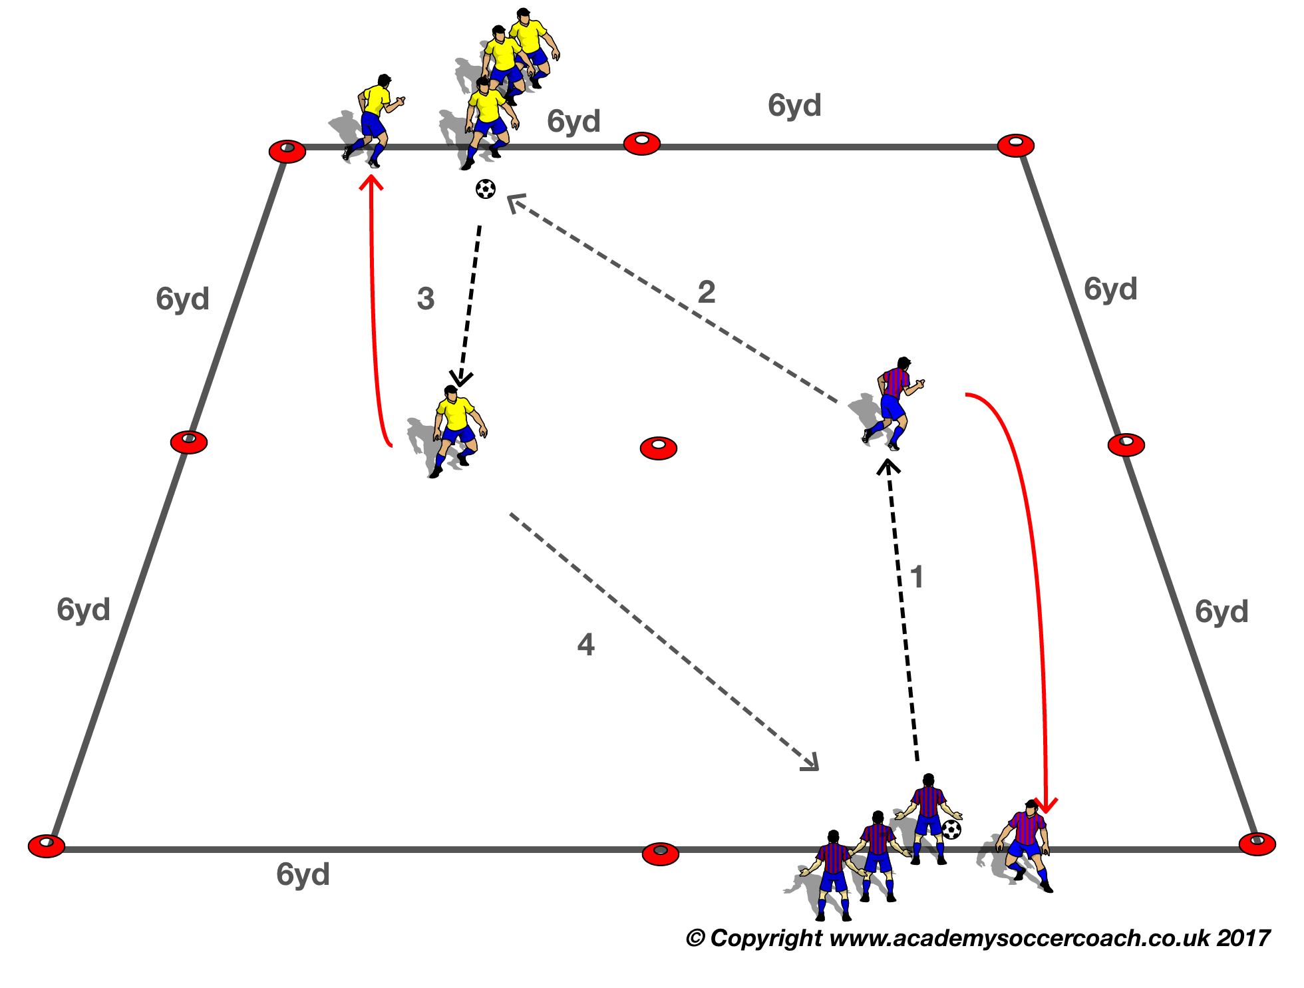


SPEED (S1)
Purpose: To improve running with and without the ball.
SET UP
Two adjacent 24yd grids with 4 yds. lines marked with cones at the end of the grids. Two teams with a ball to each player for the initial drill.
ACTION.
V1:Player who passes, runs backwards, receiver takes the ball forward with their first touch and sequence continues.
Make harder
V2: First player of each group runs forward with the ball ,after they cross the halfway cones they pass to opposite player, who takes ball forward, the passer chases the player with the ball.
COACH’S TIP TO PLAYER
Ask the player running backwards to glance back so they don’t run into their teammate.
Receiving player go towards the ball as it is passed.

Slide 2
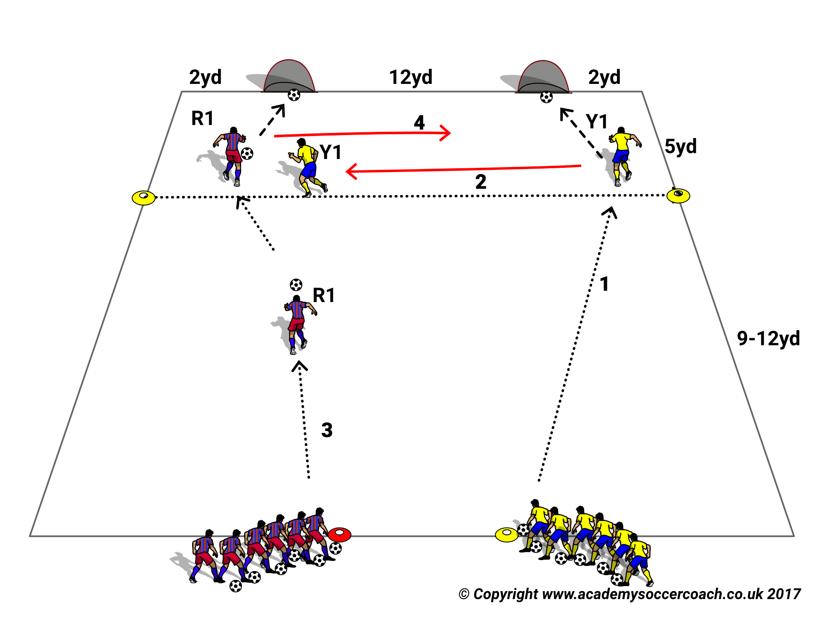
Speed (S2)
Purpose: To improve Running with the ball.
SET UP
Two teams with a ball to each player lined up 10 yds. apart and approx. 14 yds. from two small goals10-12 yds. apart on the end line with a 5 yd shooting line marked by cones in front of them.
ACTION
V1: Red A1 attacks the goal nearest his team as Yellow Y1 presses him.
As soon as A1 shoots Yellow Y 2 attacks either of the two goals and A1 immediately must defend against Y2.
Players must get inside the 5yd shooting line to score.
Make teams change sides so that players get used to challenges from either side.
Make Harder
V2. To make harder move the starting cones gradually further away from the goal line so the at some point the Attackers will be forced to “take on” the defender in order to penetrate the shooting zone to score.
COACH TIP TO PLAYER
If you can get to the shooting zone with speed alone, use it.
When confronted by the recovering defender use all your Moves especially your Feints to beat them and shoot.

Slide 3
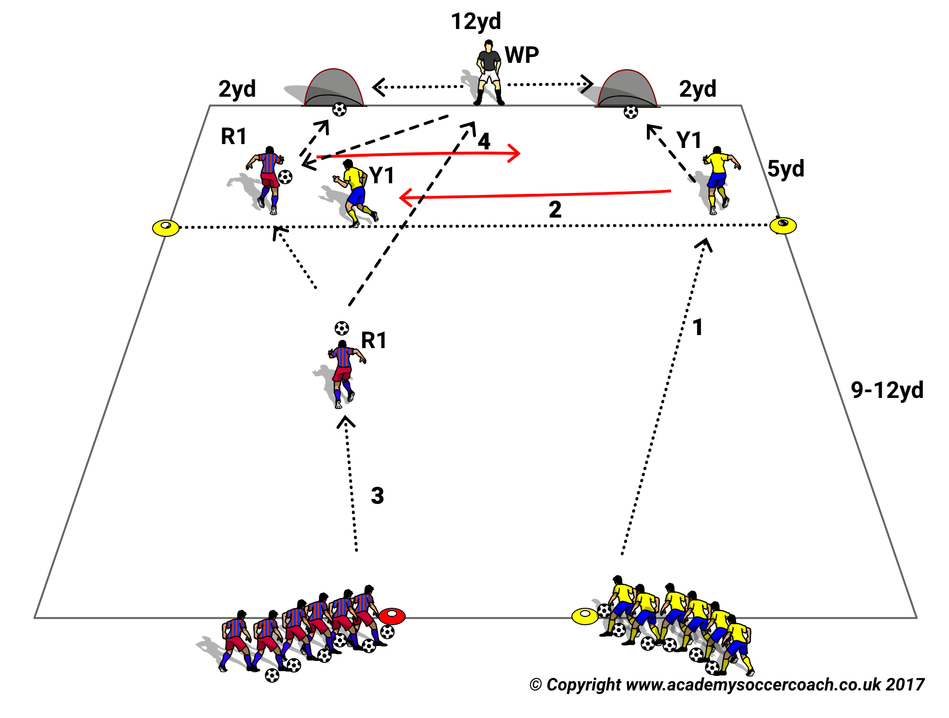
SPEED (S3)
Purpose: To Improve decision making Speed.
SET UP
Two teams with a ball to each player lined up 10 yds. apart and approx. 14 yds. from two small goals10-12 yds. apart on the end line with a 5 yd shooting line marked by cones in front of them. A WP operates between the goals for both teams. Attackers get 3 pts for a 1 touch goal from the WP or 1 pt for more then 1 Touch to score.
ACTION
V1: Red A1 attacks the goal nearest his team as Yellow Y1 presses him.
As soon as A1 shoots Yellow Y 2 attacks either of the two goals and A1 immediately must defend against Y2..Attacker can pass to WP.
Players must get inside the 5yd shooting line to score and has up to two touches to finish
Make Harder: Must be a first-time finish
COACH TIP TO PLAYER: After shooting whether you score or not turn ‘inside’ to defend and not outside where you have to cover more ground. If you can get inside the shooting line on speed alone do so.

Slide 4
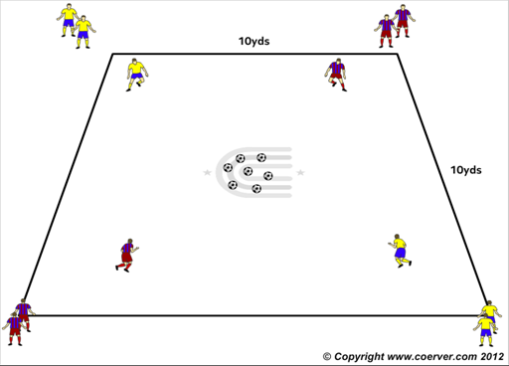
Speed (s4)
Purpose: To Improve Decision making speed
SET UP
A 10x10yd square with up to 5 players at each corner. 7 Balls are placed in the middle.
ACTION
V1 First player of each group starts sprint into middle picks up the ball and takes back to their corner, they then go back into the middle and take another ball until all the balls in the middle are gone. Once that happens then player can “steal” a ball.
From opponents corner. First player with 3 balls in their corner wins the game. Then next players go. No protecting the ball in the corner, no tackling and that ball must be placed still in the corner, not thrown so it rolls.
V2 Team relay, after placing ball down, your teammate goes
MAKE HARDER
V3: Same Individual & Team Race but now with feet only.
COACH TIP TO PLAYER
Good decision making requires that you keep your eyes up to see where your best options just like in a match.

Slide 5
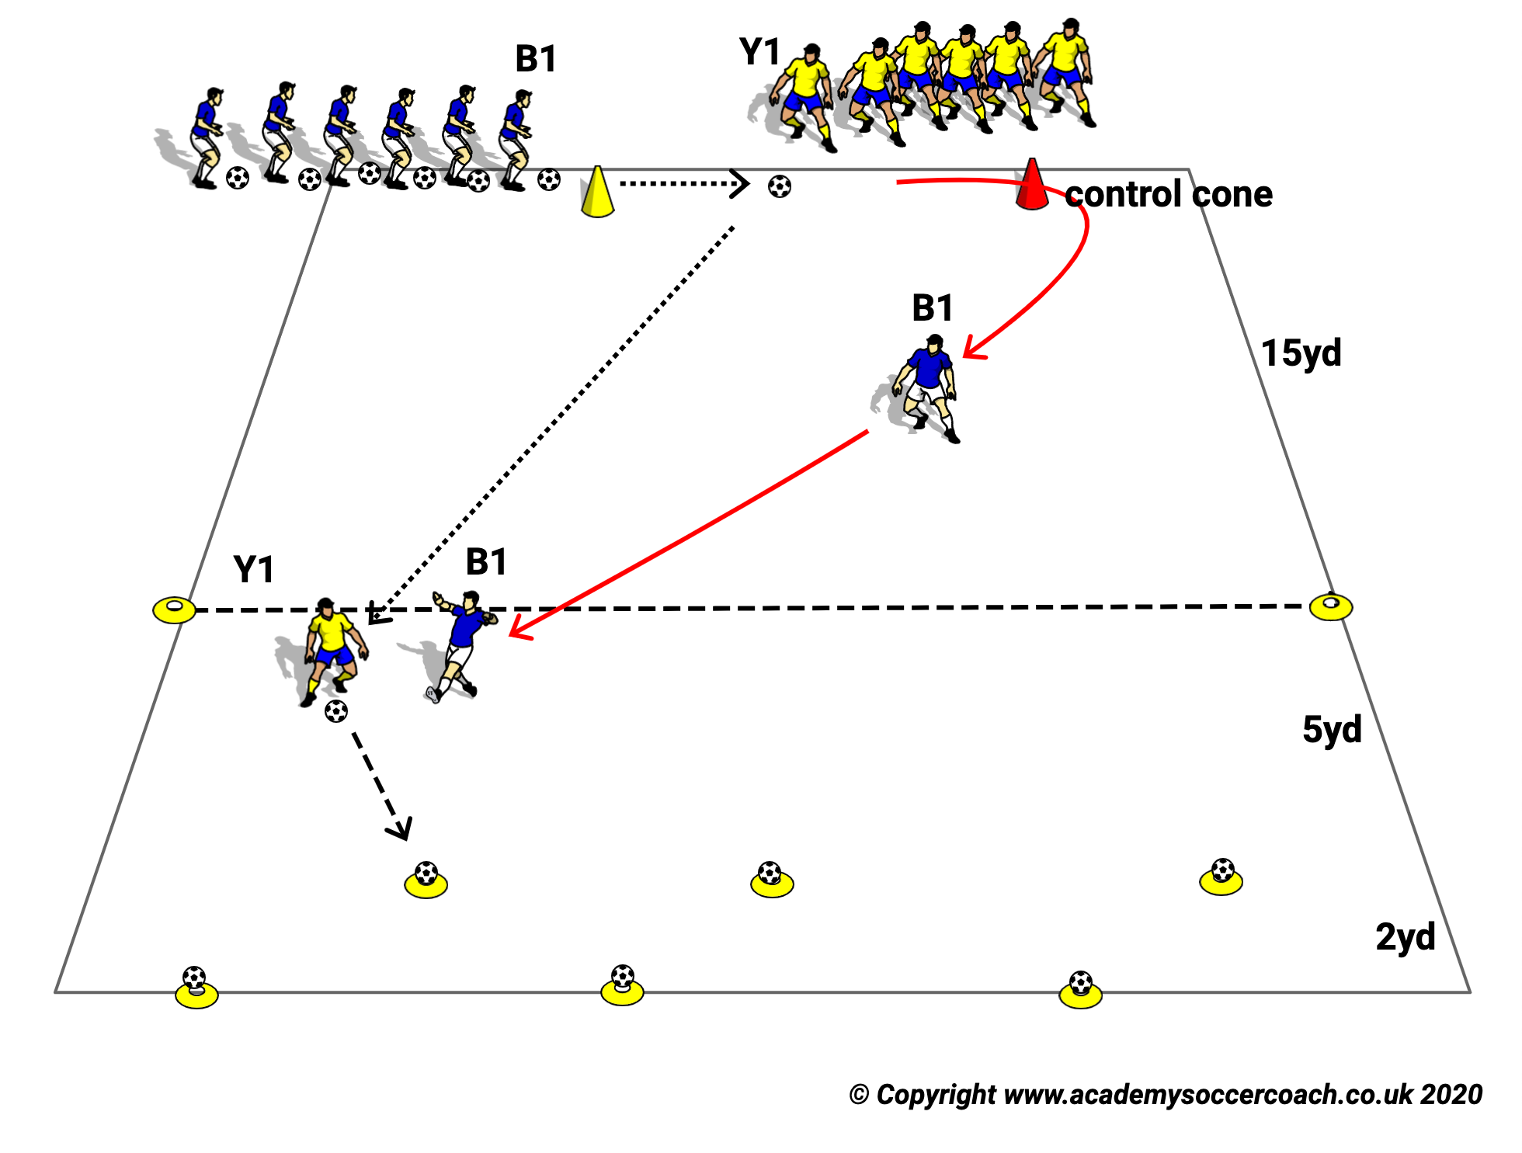
Speed (s5)
Purpose: To Improve running speed without and with the ball.
SET UP
A 25 x 25 yds. grid with 5 yd shooting line and three to six balls set on cones 3 yds. apart on the end line.
Red team line up25yd from goal as attackers 2 yds behind the line of the yellow and red control cone..
The Yellow defenders line up by the yellow cone with a ball each.
ACTION
V1: Y1 dribbles the ball between the cones and steps on the ball with the sole and leaves it for R1. Y1 then sprints around the CONTROL CONE to give chase to R1.
R1 takes possession of the stopped ball and speed dribbles to try to get inside the 5 yds. shooting zone at the opposite end to shoot and knock a ball off a cone before Y1 can close him/her down.
Adjust the position of the CONTROL cone to their skill levels of the players.
Further from starter conemakes it easier for the Attacker. Closer to the yellow starter cone makes it harder for Attacker.
MAKE HARDER
V2 Add 3 small goals on the end line in place of the balls on cones. Now Coach instructs Attackers to shoot outside the 5yd line on the three small goals.
Start from both sides of the field and encourage Attackers to shoot with their weak foot.
V3 . Same but now a one two pass with coach & a first time shoot
COACH TIP TO PLAYER
Attacker. Get the ball out of your feet with a bold first touch then take as few touches as possible to cover the ground to penetrate the shooting zone to shoot; or to keep distance from defender and have time to shoot accurately.

Slide 6
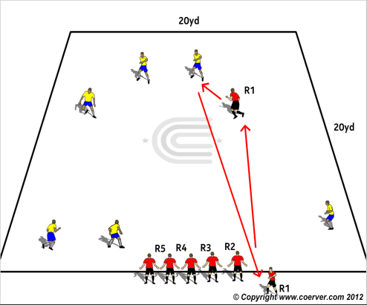
Speed (S6)
PURPOSE: To improve individual pressing speed.
SET UP
A 20x20yd grid. 2 teams of 6 or 7 players. One team on the grid as “Attackers”. The second team lined up on a sideline as “Defenders.”
ACTION
On the Coach’s signal one “Defender” sprints onto the field to tag an “Attacker” then sprints off to release his next team mate. The tagged player goes out and sits down.
If an ‘Attacker ’steps off the field that is considered a tag.
Each Defender takes his turn and the Coach times how long it takes the defending team players to tag an opponent and get back in their starting position.
Change team roles and see which team takes least time to complete the job. Each Defender must carry a ball in his arms as he chases the attackers.
Make Harder:
V2 Players now in pairs. Pass to team mate to tag.
COACH’S TIP TO PLAYER
Focus on one opponent and try to corner them. Don’t constantly change your target and lose your energy and focus.

Slide 7
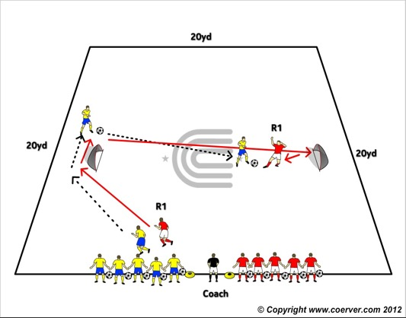
Speed (S7)
Purpose: To Improve running with & without the ball.
SET UP
A 20 x 20 yard grid with two small goals 15-18 yds. apart in the middle of the field. Two teams with a ball to each player stand on the sidelines with the Coach between them.
ACTION
V1:On the Coach’s signal Y1 sprints around the top goal while R1 dribbles around it. Y1 has to touch crossbar the can tackle.
MAKE HARDER
V2: On the Coach’s signal Y1 sprints around the top goal while R1 dribbles around it. Y1 has to run either around a cone 2one yard behind the goal then can tackle.
COACH TIP TO PLAYERS
Each player will have a turn to be attacker and defender; the same role that you will play in the team game.
.

Slide 8
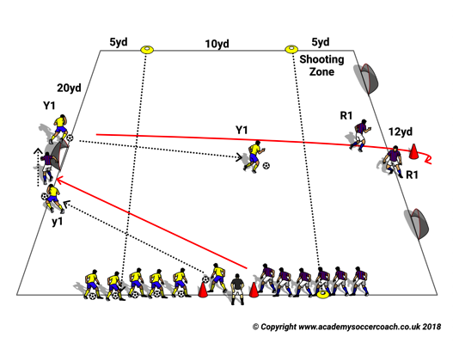
Speed (S8)
Purpose: To Improve speed with & without the ball.
SET UP. A 20x18/20yd grid with 2 goals 12 yds. apart at one end, for the Attacker to score in.
ACTION.
V1: On the Coach’s signal Y1 with ball and R1 without a ball sprint around one goal then around the cone between the two end goals.
Y1dribbles after R1 and tries to score on either of the two goals ,R1 is defending , by getting within 5yd of the goal before shooting.
If R1 wins the ball he/she can score at the opposite end but must get inside the 5 yd shooting line there to do so.
Make Harder
Adjust the distances between attacker & defender and/or distance between the end goals
Coach Tip To Player
Attacker with the ball don’t make too many touches otherwise you will give time to defender to block the goals.

Slide 9
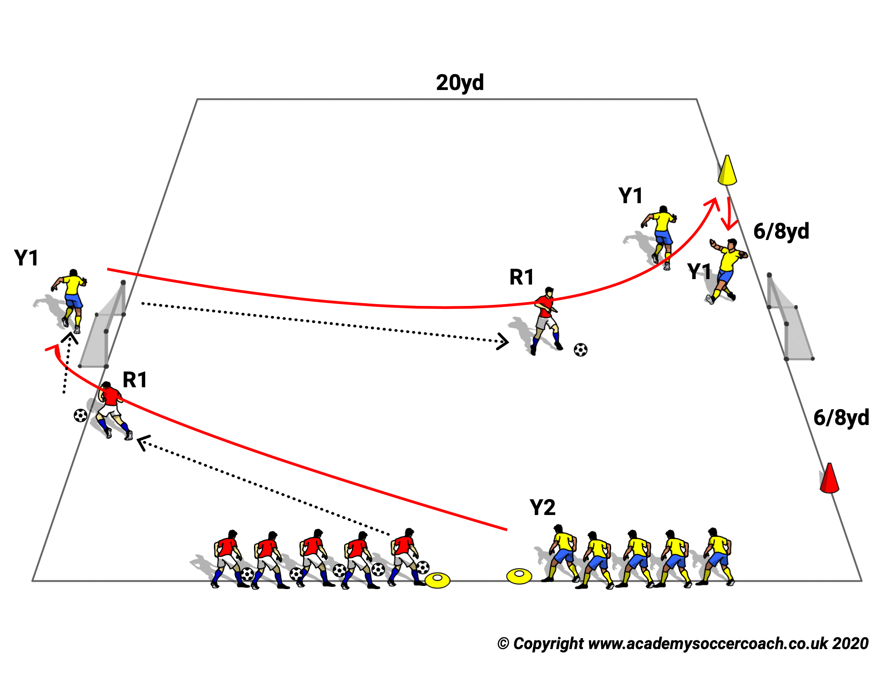
Speed (S8 V2)
Purpose: To Improve running with & without the Ball.
SET UP
A 20 x 20 yard grid with two small goals 15-18 yds. apart in the middle of the field.
Two teams with a ball to each player stand on the sidelines with the Coach between them.
ACTION
On the Coach’s signal Y1 sprints around the top goal while R1 dribbles around it. Y1 has
To go around either side cone before can tackle
COACH TIP TO PLAYERS
Each player will have a turn to be attacker and defender; the same role that you will play in the team game.

Slide 10
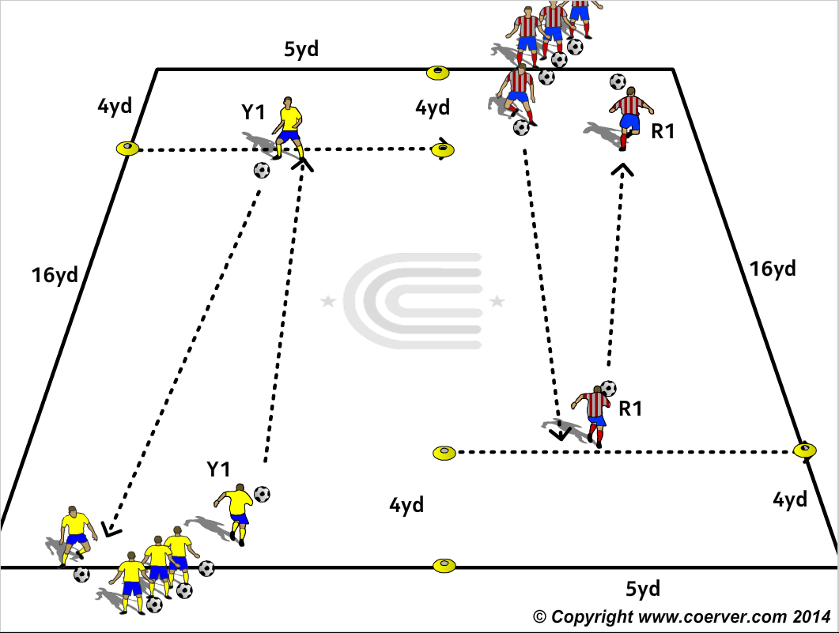
Speed (S9)
Purpose: To Improve & encourage “Changes of Pace” and improve Changes of Direction.
SET UP
2 teams, each player with a ball, at opposite ends of adjacent 20x5 yd grids with a line marked with cones 4 yds from the end line of each grid.
ACTION
Game Moves to use:
CHANGE OF DIRECTION
INSIDE CUT
OUTSIDE CUT
STOP/START
STEP ON
HIGH WAVE
PULL PUSH
V1. R1 speed dribbles to the line 4 yards from the end line then Steps on the ball ,turns with a Change of Direction Move, and speed dribbles back to his start line.
As R1 turns at the line the 1st Yellow player speed dribbles to try to beat R1 before making a similar C.O.D the Yellow 4 yd line a speed dribbles back to his start line.
Players try to catch and pass the opponent off the 4 yd start before reversing the roles when the reach their own 4 yd line before the opponent.
Make Harder
V2: Player adds a Stop/Start in the middle.
COACH TIP TO PLAYER
Take few touches in the middle of the dribble but take short controlled touches before the stop and turn.

Slide 11
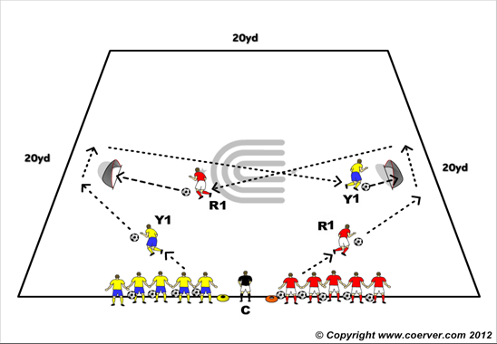
SPEED (S10)
Purpose: To Improve running with the ball & Finishing on the run.
SET UP
Two mini goals 18yds apart inside a 20 x 20 yds. grid with a ball on the mid line in front of each goal. Two teams lined up on either side of the coach on a sideline.
ACTION
V1 :Each Player with a ball. The first player on each team dribbles from the side-line around their own goal and shoots on the opponents goal then sprint to release their next teammate. Every ball must be in the goal for team to win.
MAKE HARDER
V2:Shoot (if you score or miss) retrieve the ball & then Pass to next Player.
V3: Pass to Wall Passer then finish first Time.
COACH TIP TO PLAYER
Eyes up before you set off and before you pass or shoot.

Slide 12
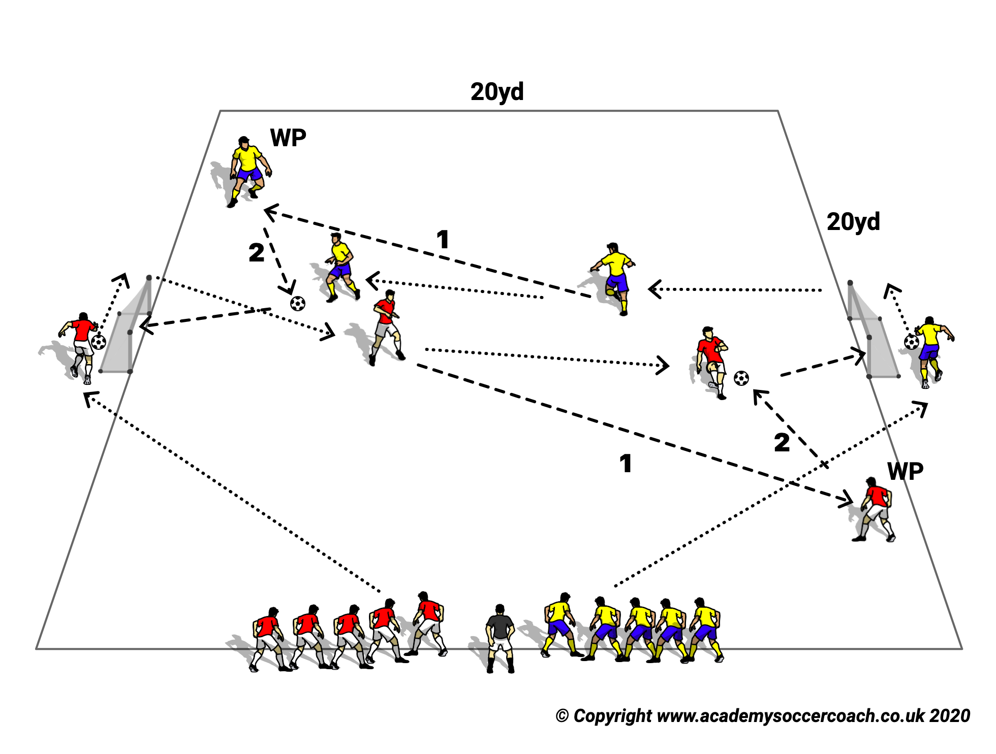
SPEED (S11)
Purpose: To Improve Running with the ball & Finishing.
SET UP
As Drill Speed 13 (V3)
ACTION
As Drill 10 (V3) but now Dribbler passes across front of 1st goal to self going round goal before playing 1-2 w WP.
COACH TIP TO PLAYER
Receiving player adjust body shape to play an accurate ½.

Slide 13
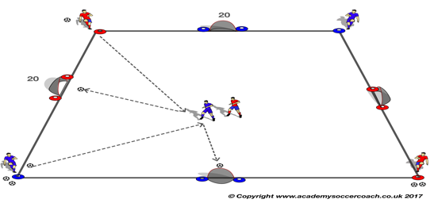
Speed (s12)
Purpose: To encourage quick movement to the ball and improve reaction speed.
SET UP
a 15 x 15 yard grid (with 2 x Blue/Orange discs as per diagram).
4 x target goals (North, South, East, West).
Goals that are North/South have Blue discs either side, Goals that are East/West have Orange discs either side.
Attacker and defender on the field.
Servers on the outside. 2 Balls each. Change middle player after all 3 balls played.
ACTION
If Attacker scores then, a teammate serves again to him, if Attacker misses or defender touches the ball attacker and defender change roles.
Make Harder
Servers with 5 balls each.
COACH TIP TO PLAYER
Attacker use your C.O.D’s to make space to shoot.

Slide 14
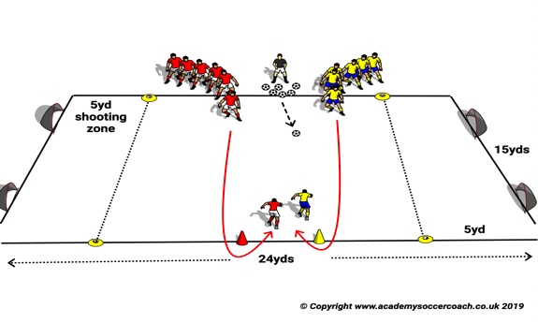
Speed (S13)
Purpose: To Improve running with the ball and reaction speed.
SET UP
A 20/24 x 20/24yd grid with two small goal at each end and 5 yd shooting zones marked by cones in front of each goal.
The Coach at the mid point on one side of field with a supply of balls with both teams on either side of him and two cones on the opposite side of the field opposite each team.
ACTION
The coach blows whistle and a player from each team sprints across the field and around their cone and come back towards Coach to get possession.
Once player shots (Goal or not) then coach passes the ball to the other player.
Make Harder
V2: The player first to the ball passes to his/her next teammate, as soon as that player touches the ball an opposite player comes on the field, making the game 2 v 2
V3. The coach blows whistle and a player from each team sprints across the field and around their cone and come back towards Coach to get possession and try to score on either goal from inside the shooting zone. If Goal scored ,goal scorer stays on the field and runs around end cone to play against the next player.
COACH TIP TO PLAYER
In Coerver Coaching we develop players who are attackers and defenders rather than positional players (10 or a 6) therefore think you are two players in one.

Slide 15
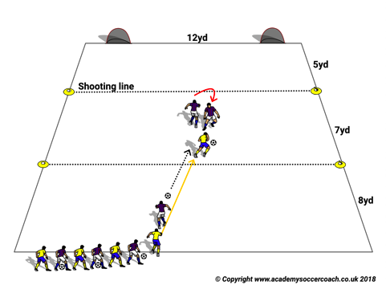
Speed (s14)
Purpose: To improve running with the ball Speed
SET UP
A 20 x 20yd grid with 2 small goals 12 yds apart at one end.
Two teams line up at the opposite end. The Defending team players have a ball each with an Attacking opponent without a ball lined up immediately behind them.
ACTION
The Defender speed dribbles to the 12 yd line approx. then steps on the ball to leave it for the following Attacker and immediately turns to defend against the Attacker.
The Attacker takes the ball and must get inside the 5yd shooting line to score on either of the small goals.
MAKE HARDER
V2 Add a GK behind the Defender to defend either goal. The GK can not advance out of the 5 Yard shooting zone, the attacker must shoot before the shooting line
COACH TIP TO PLAYER
Try to take a bold 1st touch and use your speed to beat the Defender and shoot. If speed alone doesn’t work use your Fakes and Feints to freeze or move the defender to one side to penetrate the shooting zone and score in the other goal.

Slide 16
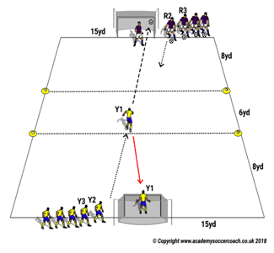
Speed (s15)
Purpose: To Improve reaction and shooting speed.
SET UP
A 20/24 x 15yd field according to your players abilities.
2 Teams by the side of normal size goals at either end of field. A 6yd Shooting Zone in midfield.
ACTION
Yellow Player Y1 dribbles into the shooting zone and shoots on the opposite goal then runs back to own goal to be GK against the opposite attacker R2 who starts as soon as Y shoots.
V2: MAKE HARDER. Each team has a Wall Passer(WP) at the side of the opposite goal. Each player passes to the WP who passes back 1 touch for the Attacker to shoot 1st touch.
COACH TIP TO PLAYER
Look for accuracy before power.

Slide 17
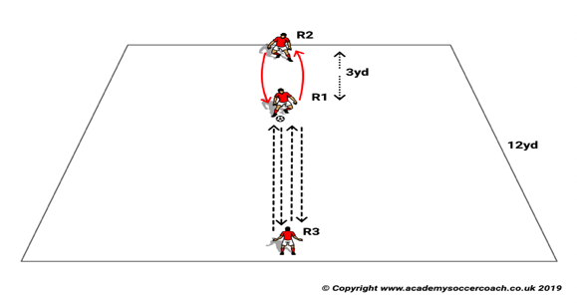

Speed (S16)
Purpose: To improve reaction speed
SET UP.
3 players,R3 starts with the ball.
ACTION.
V1: R3 & R1 make first time passes, R2 can intercept & pass back as he decides
MAKE HARDER.
V2: Middle players change
COACH TIP TO PLAYER: Try and keep the ball on the ground by leaning slightly over it when you pass

Slide 18
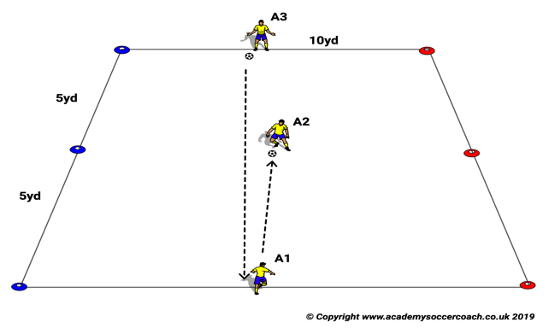
Speed (S17)
Purpose: To Improve decision making speed
SET UP.
A3 Holds a red & blue cone in his hands. Blue & red cones set as diagram.
ACTION.
V1: A3 passes to A1,who passes first time to A2.
As Soon as A1 touches the ball A 3 has following options:
Hold red cone to the left ( A 2 when he/she receives must take the ball with one touch to the red cones on the side, makes a C.O.D and pass to A3
If A3 holds the cones above his head, A2 must turn with the ball & pass to A3
Players can take up to two touches
Make Harder
V2: All one touch passing
COACH TIP TO PLAYER: Position your self side on so your “Scan “ can be wider

Slide 19
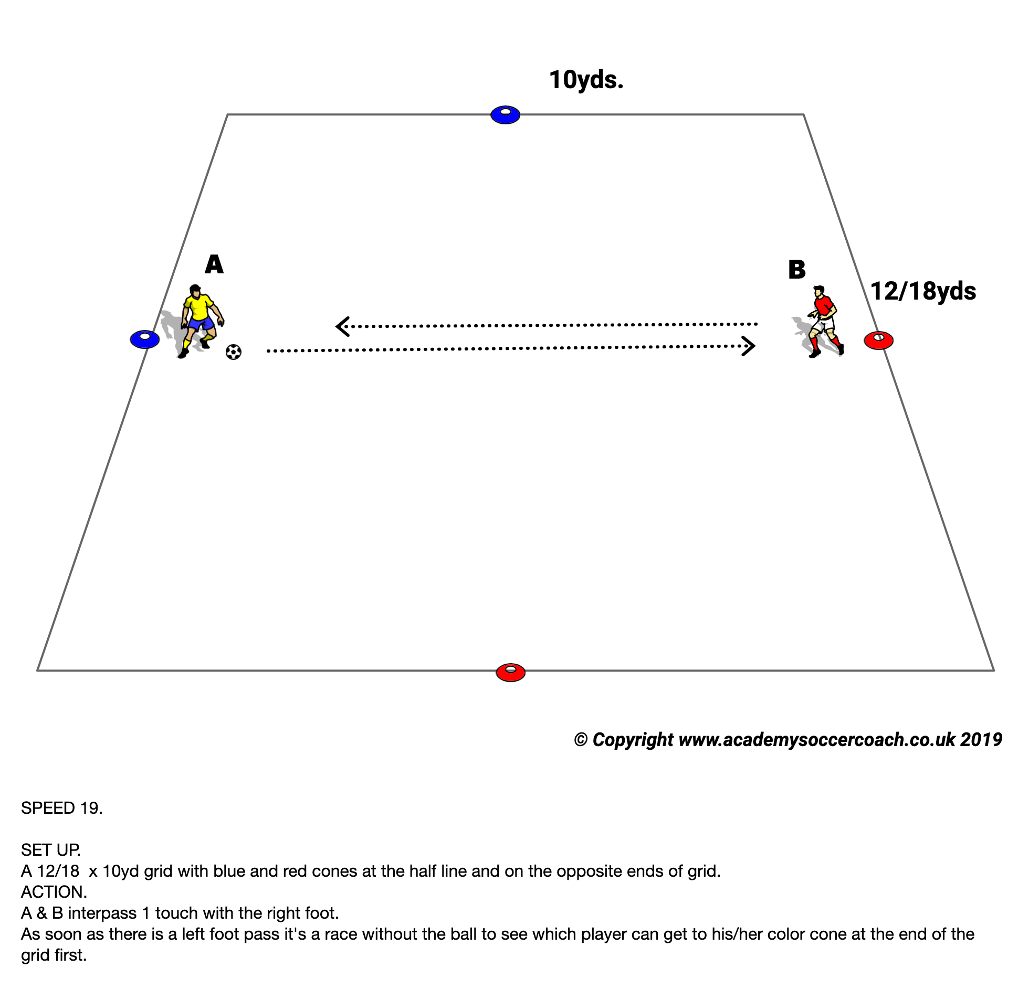
Speed (18)
Purpose: To Improve reaction speed.
SET UP
Two players 8/10 yards away, one player starts with the ball.
Red and blue cones to each side.
ACTION
Players pass first time with right foot, as soon as one passes with left foot then it a race to the cone.
V2: MAKE HARDER
Winner now is who goes around both cones.
COACH TIP TO Player
Make sure the passing is firm & accurate.

Slide 20
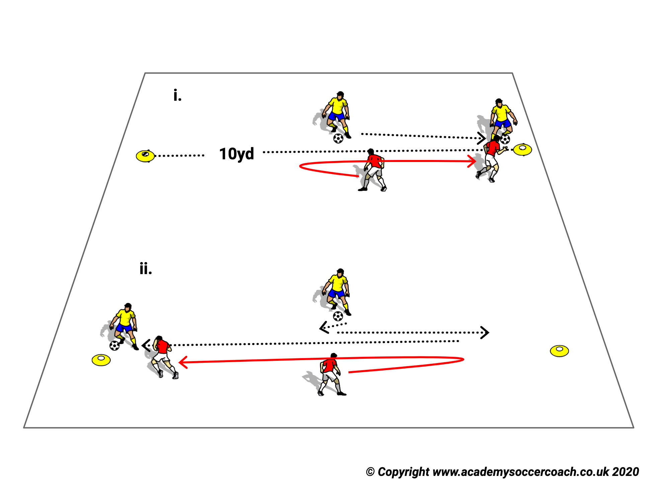
Speed (S19)
Purpose: To improve 1 v 1 Speed.
SET UP
Two players, facing each other between cones 10 yards apart.
ACTION
V1 No Ball: Players take turns, one is attacker, one defender. Attacker uses body fakes to try and find space to run and touch either cone. If defender touches the cone with his/her foot, then the attacker can not go to that cone.
Make Harder
V2 Same Action but attacker has a ball. No tackling
COACH TIP TO PLAYER
With the ball you can try your Game Moves:
The Step On and the Side Step.

Slide 21
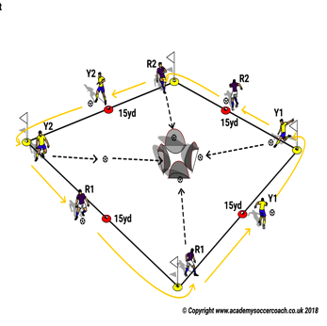
Speed (S20)
Purpose: To Improve Running with the ball
SET UP
A player with a ball on each corner of a 15 yard square.
4 small Goals facing each corner.
ACTION
On the Coach’s signal each player dribbles at speed around the square and at each middle red cone change feet
On completing the circuit they dribble around their starter cone try to be first to score in their small goal
MAKE HARDER.
They have to shoot with their weaker foot
COACH TIP TO PLAYER
Eyes up and try to be aware of other shooters progress.

Slide 22
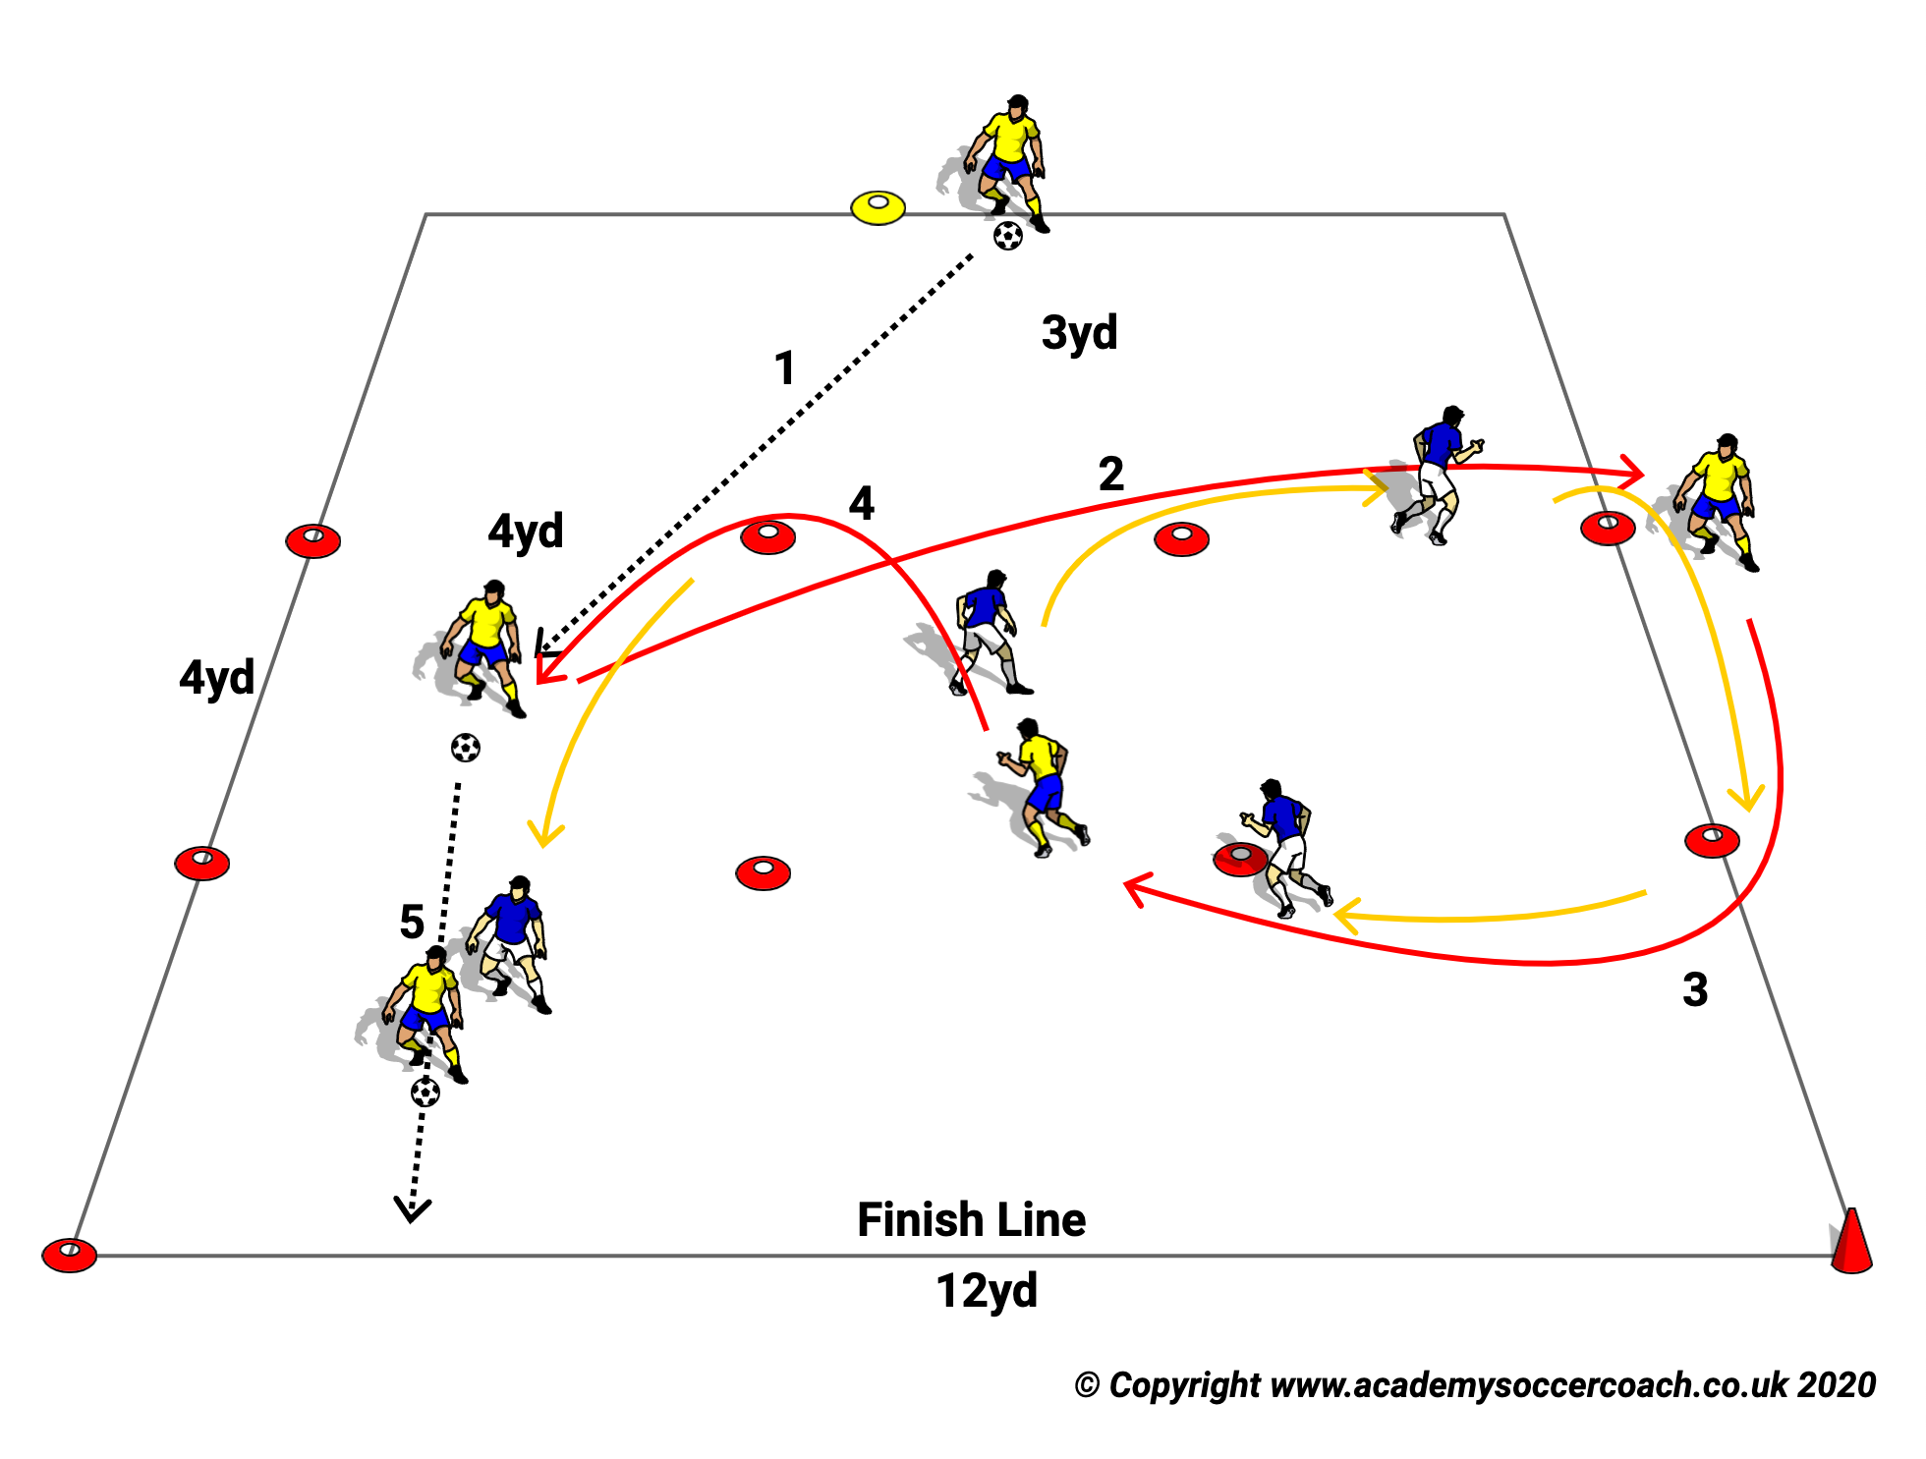
Speed (S21)
Purpose: To Improve speed with & without the ball.
SET UP
3 Lanes of 4 x 12 yards Yellows start as attackers, reds defenders.
ACTION
Yellow takes ball into middle lane, red shadows his/her movements. Yellow tries to make space by leaving the ball ,going to either side ,then quickly coming back and trying to run past yellow. Defender can not tackle.
Make Harder:
Defender can now tag attacker before attacker crosses end line.
Coach Tip To Player
Attacker use your feints to fake to take the ball.
Defender, shadow, don’t rush in

Slide 23
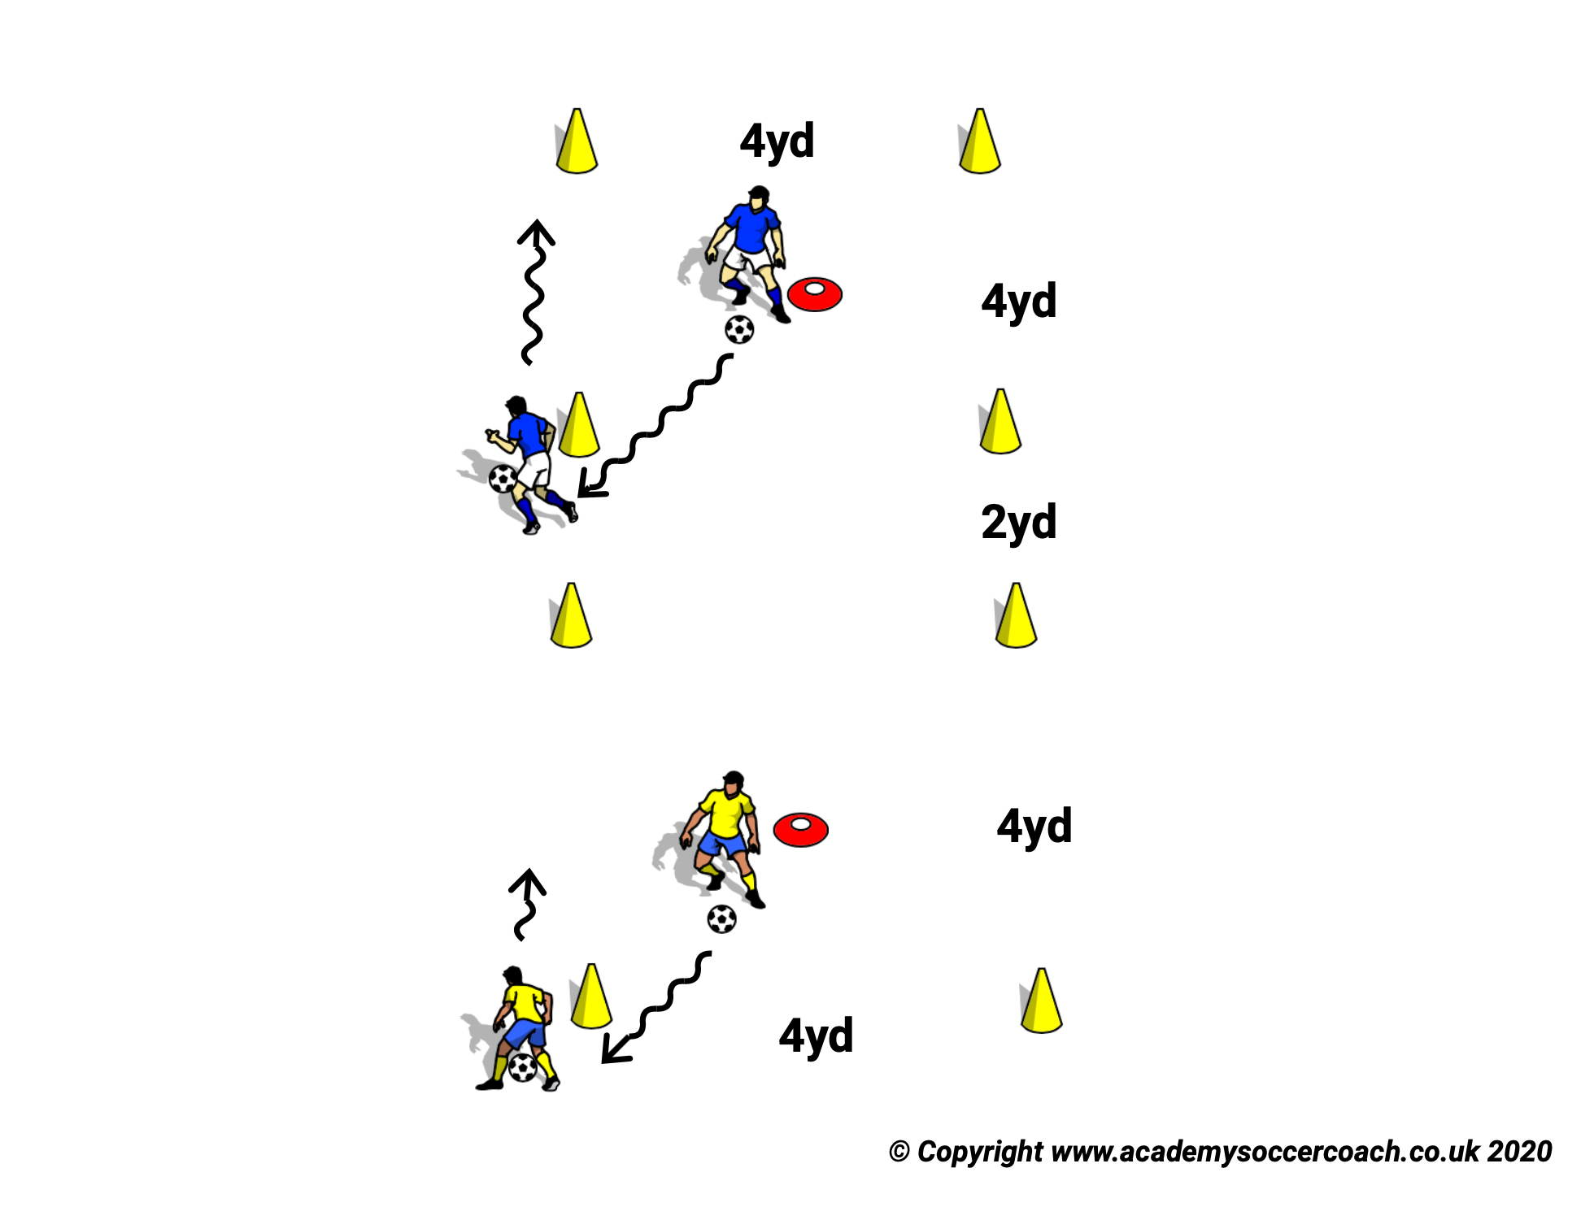
Speed (S22)
Purpose: To improve reaction speed.
SET UP
2 x 4x 4 yards squares marked by tall cones. A different color Tall Cone in Middle of each square. One player in each Square.
ACTION
V1 No Ball one player copies the other. 45 second rounds.
Make Harder
V2: With Ball: Race between the two players. 45 seconds ,count how many cones dribbled around, can not do same cone consecutively.
COACH TIP TO PLAYER
Cut the ball quickly as you go around and eyes up.

Slide 24
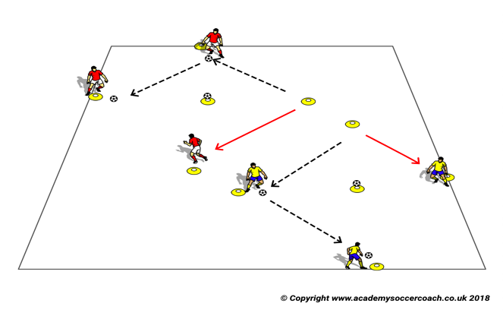

Speed (S23)
Purpose: To Improve Speed of passing.
SET UP
Groups of 3 players in a 8 - 10 yds. square.
ACTION
V1. One of the players counts the number of passes and after a specified number, 7-10, designated by the Coach, the player receiving at the end has one touch to set up and a second to score by knocking the ball off the center cone.
Make Harder
V2: Now the players without the ball try to block the shot on the call of the designated number.
Coach Tip to Player
The quicker the play is the more you need to focus.

Slide 25
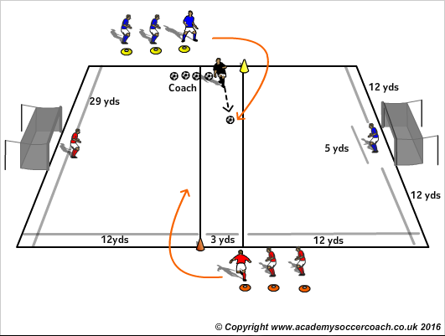

Speed (S24)
PURPOSE: To Improve Game Understanding.
SET UP
Penalty Area (Length 27 yards x Width 29 yards ) / Have 3 yards of space in the middle.
GK in each goal.
ACTION
Game begins with the signal from coach, Red and Blue players run around the big cone who coach distributes the ball.
When out of bounds players run around the cone once more to restart.
Offside applies.
V1: 1 v 1
V2: 2 v 2
V3: 3 v 3
COACH TIP TO PLAYER
Communicate at the right time and place.

Slide 26
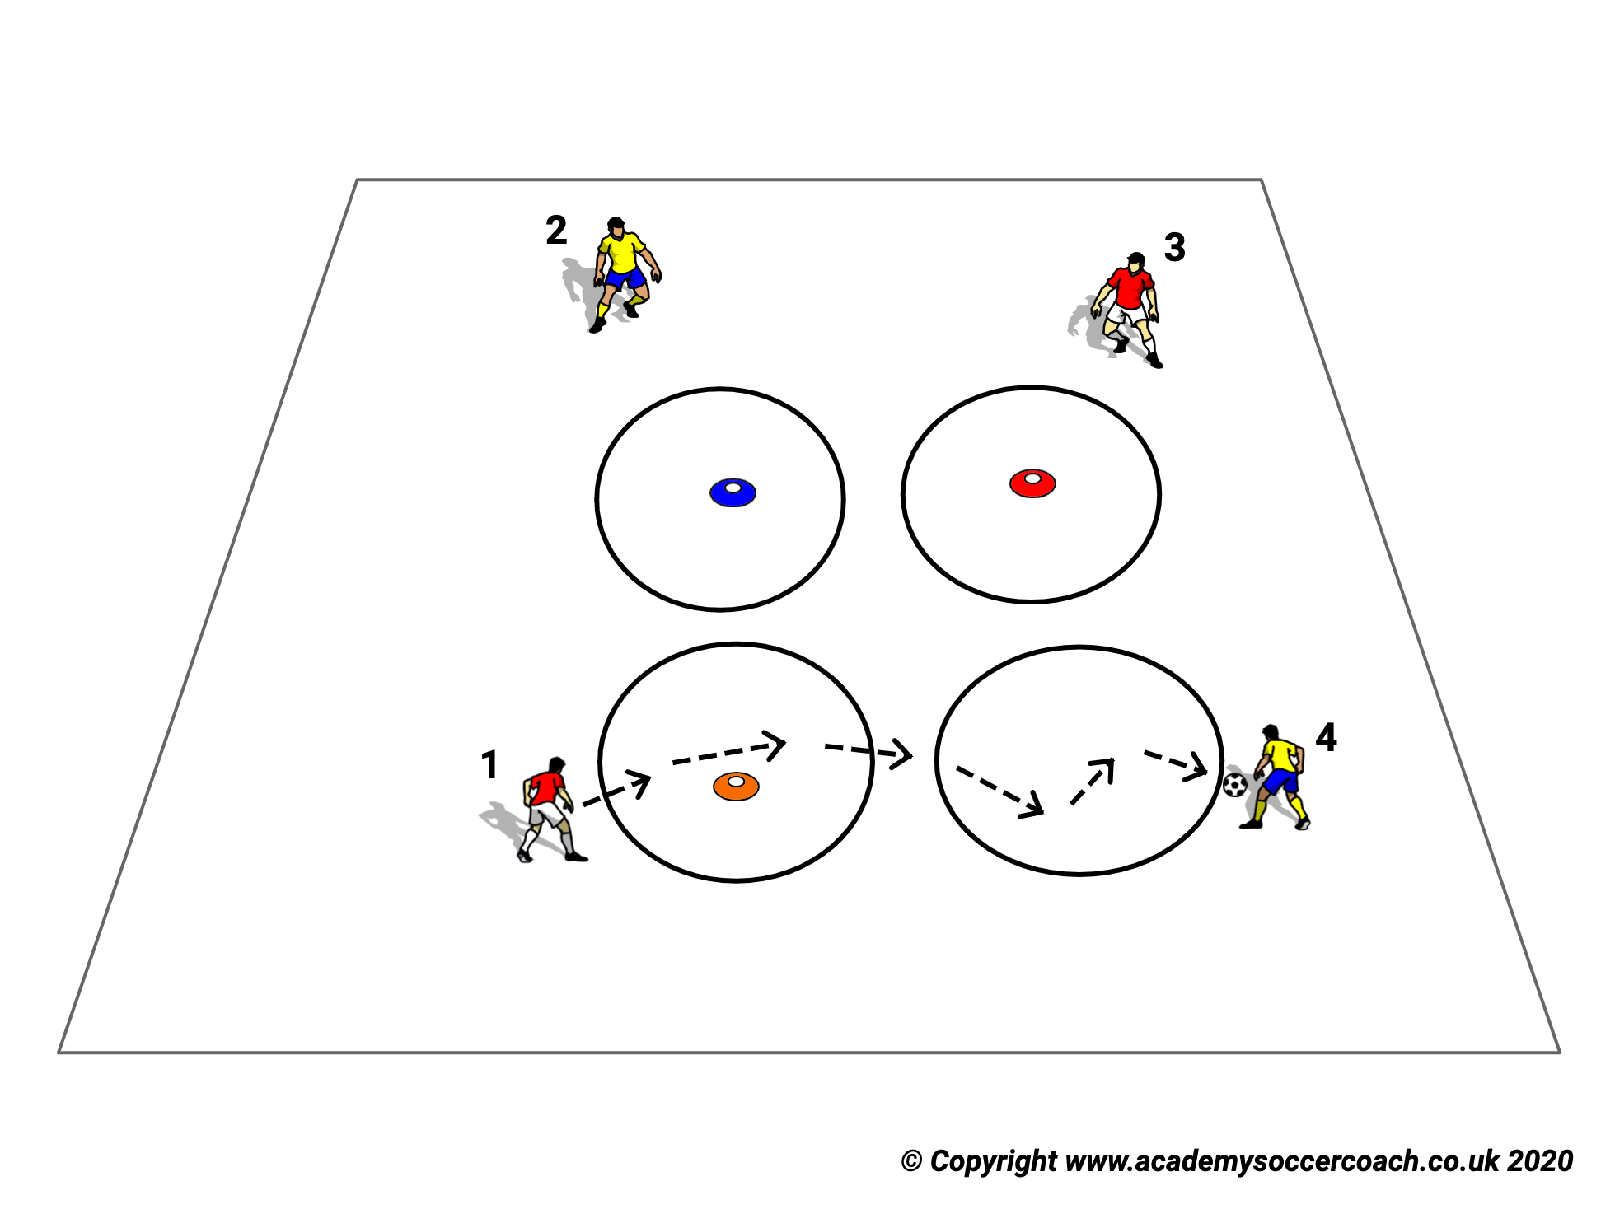
Speed (S25)
Purpose: To Improve Reaction Speed.
SET UP
4 players,4 Different color rings, 1 ball.
ACTION
One player starts with the ball and bounces it in another players ring. That player catches and does the same. Player can move his color ring after throwing the ball.
MAKE HARDER
Speed up
COACH TIP TO PLAYER
Focus

Slide 27
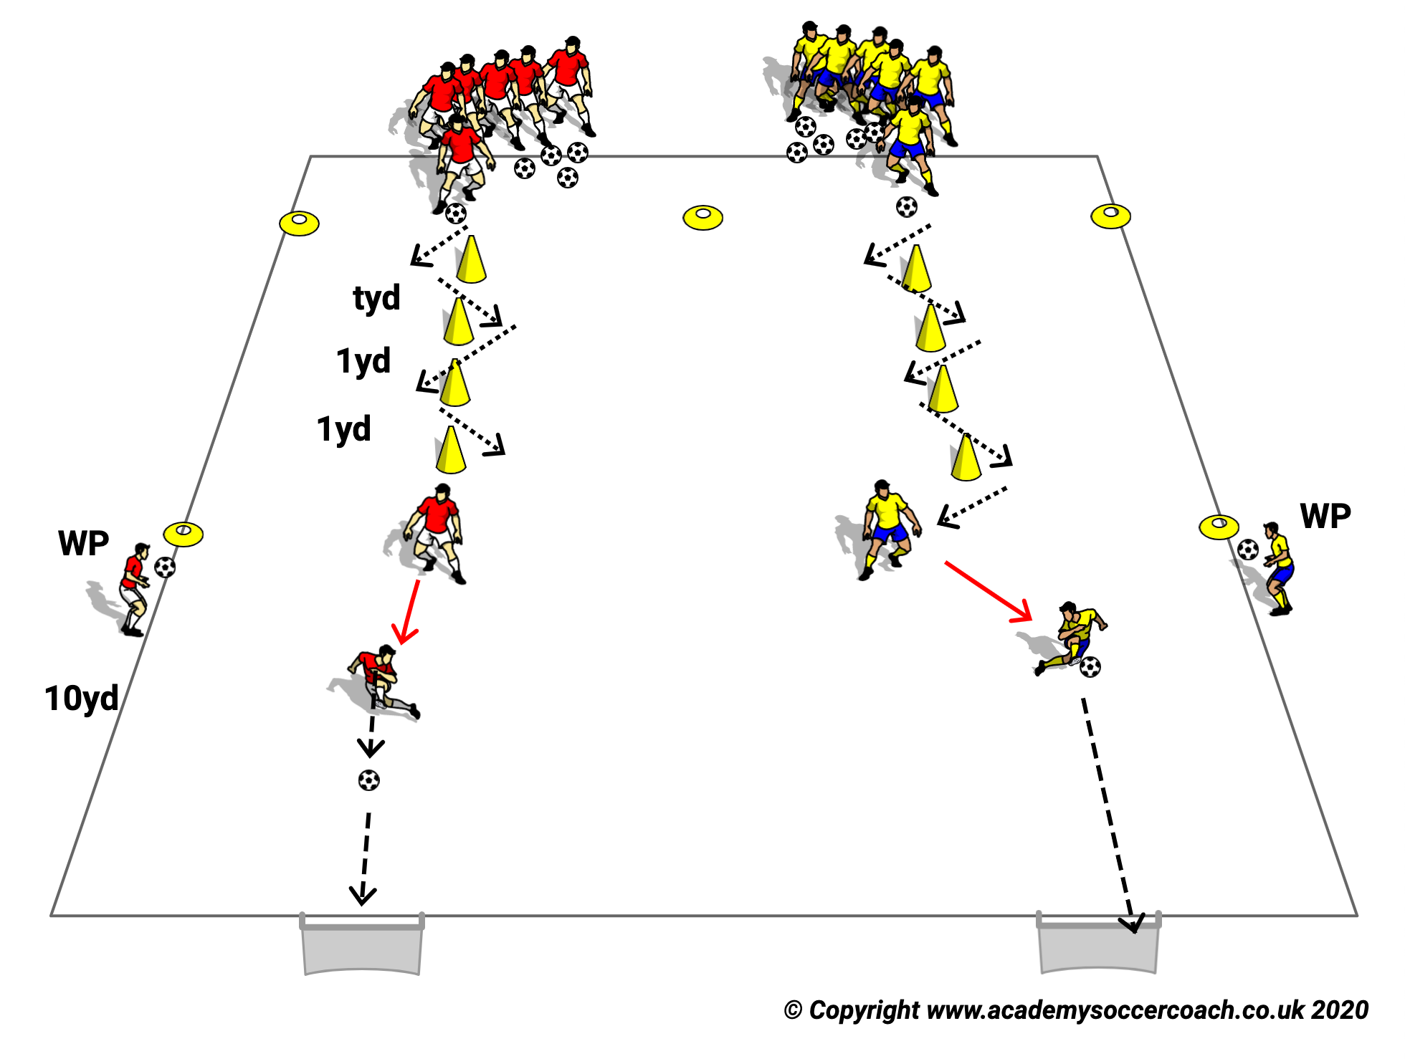
Speed (S26)
.
Purpose: To Improve Speed and Heading.
SET UP
Two teams of up to 6 players. One WP on each time holding a ball, acting as server .Server ideally has one ball per player. Two mini goals 8 yards away from each WP.
ACTION
Players zig zag through cones. Next player goes when the final cone. Server throws to player after he/she has gone around final cone, player heads down into goal.(If only one ball, the heading player retrieves the ball and gives back to WP).
COACH TIP TO PLAYER
Time your jump for the header.

Slide 28
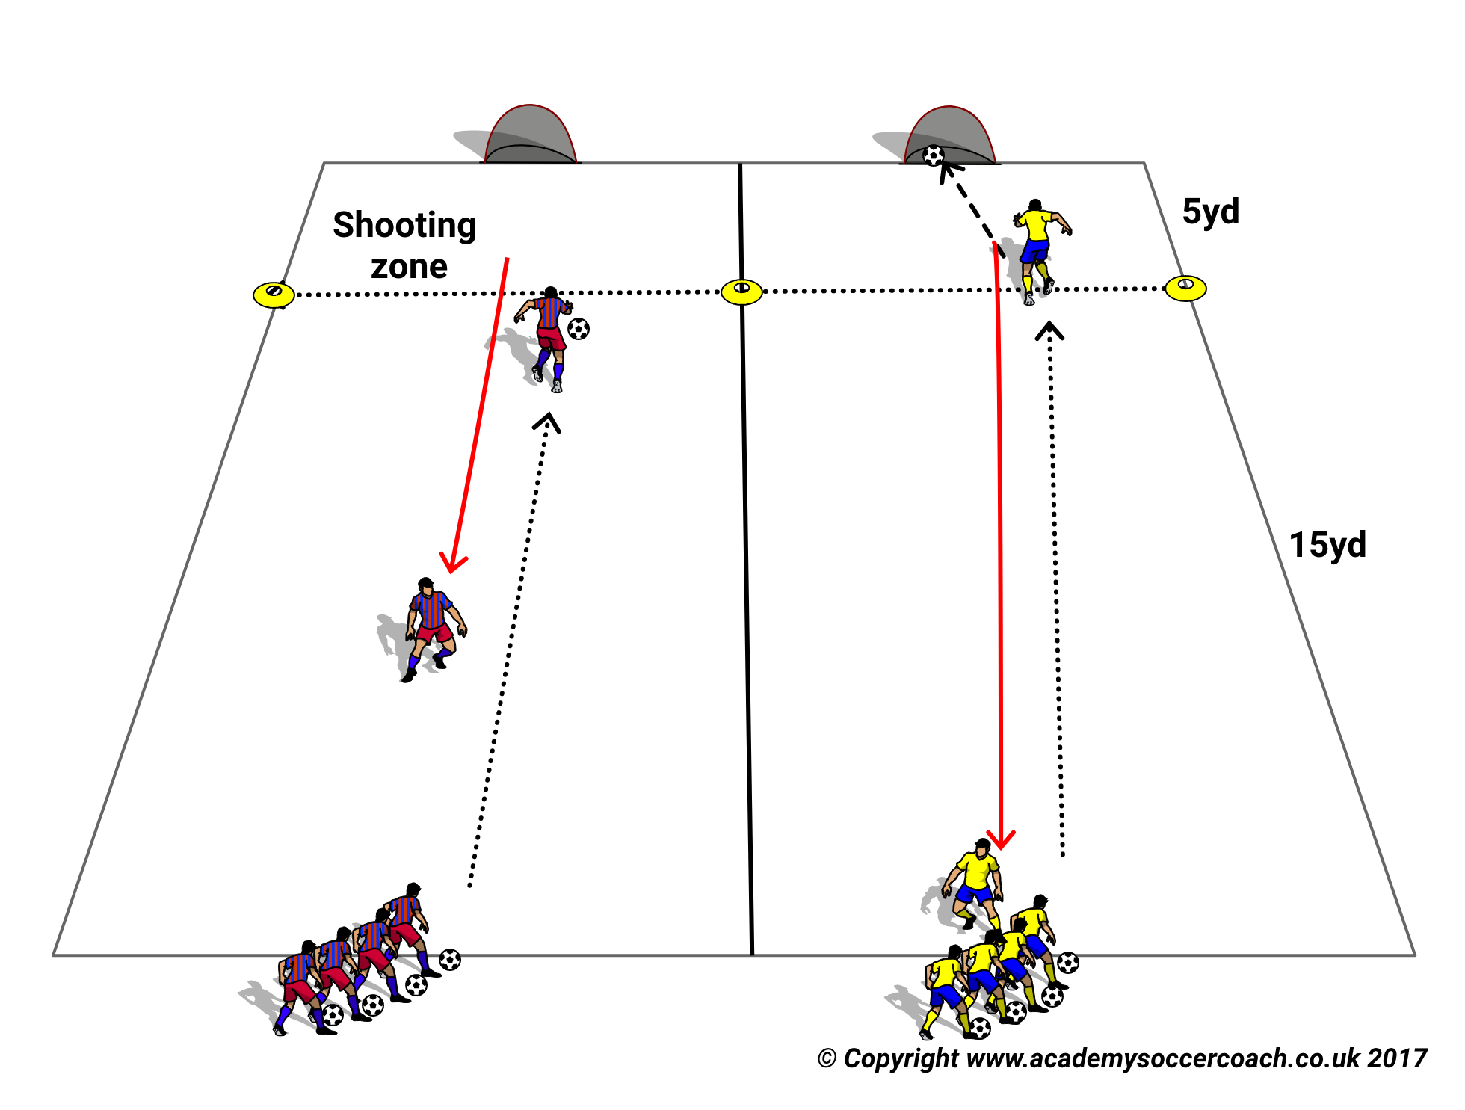
Speed (S27)
PURPOSE: To improve running with the ball.
SET UP
2 adjacent 10x20yd grids with small goals at one end.
2 teams with a ball to each player lined up at opposite ends to the goals.
ACTION. The first player of each team dribbles and shoots in the shooting zone then sprints back to release the next player.
The winning team is the first to finish with all their balls in their goal.
Make Harder
Shoot outside the area
COACH TIP TO PLAYER
Get the ball out from under with your first touch and take as few touches as you are able to the shooting zone.

Slide 29
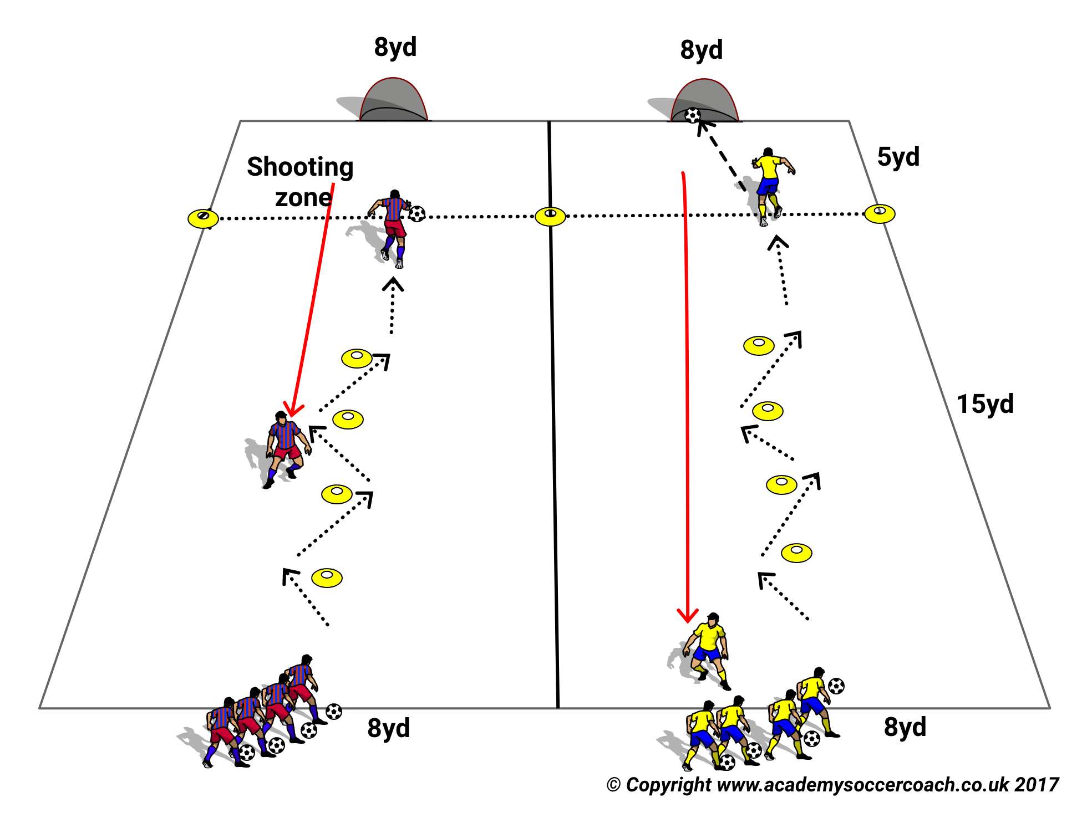
Speed (S28)
PURPOSE: To improve speed with the ball.
SET UP
As in previous drill but now the teams have 4 cones 2 YD apart they must negotiate before entering the shooting zone.
They then sprint back to release next teammate.
Winning team finishes back at the start with all balls in their goal.
Make Harder
Make a Game Move at each cone.
COACH TIP TO PLAYER
Slow down if the cones are troublesome until you master them then build up your speed.

Slide 30
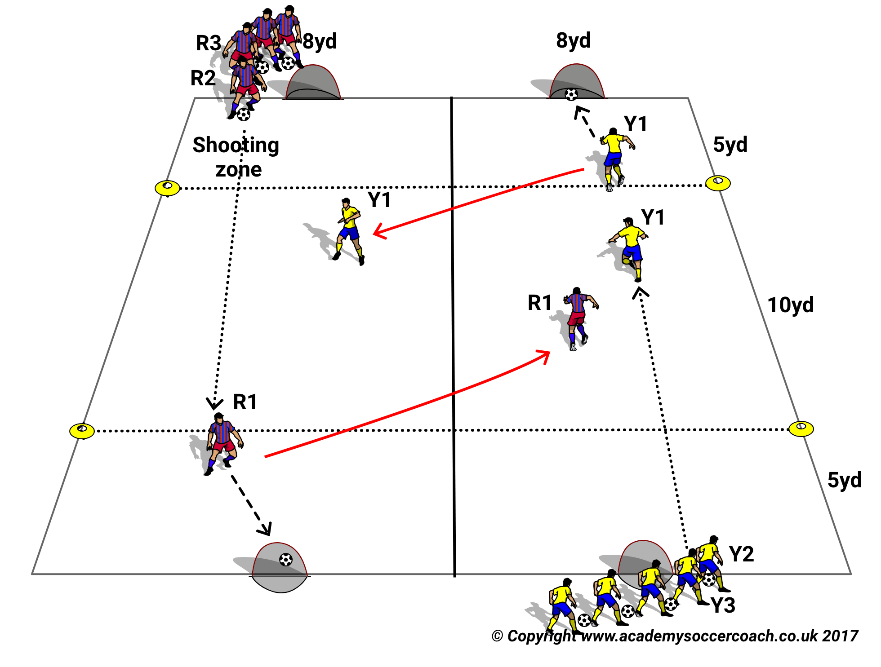
Speed (S29)
PURPOSE
To improve speed with ball and finishing under pressure.
SET UP
2 adjacent 20x10 grids with small goals at both ends of the grids.
Team with a ball to each player lined up by their goal at opposite ends of grids.
ACTION
The first Player dribbles to the shooting zone and shoots then peels off immediately to try to catch the fist player from the opposite team scoring.
The teams continue this Fast Break scoring until all have gone. The winning team is one with most goals.
COACH TIP TO PLAYER
Try to get the ball out from your feet with your first touch and try for few touches before you get to the shooting zone.

